Slide 1
Quantum LDPC codes Problem session 2
Nicolas Delfosse
Norah Tan
PCMI Summer School 2023
July 25th 2023

Slide 2
Problem – The rotated surface code
Construct the stabilizer matrix of the distance-3 surface code.
What are the parameters $[n, k, d]$ of this code?
Find a logical basis.
Generalize this logical basis a distance-$d$ surface code.

Slide 3
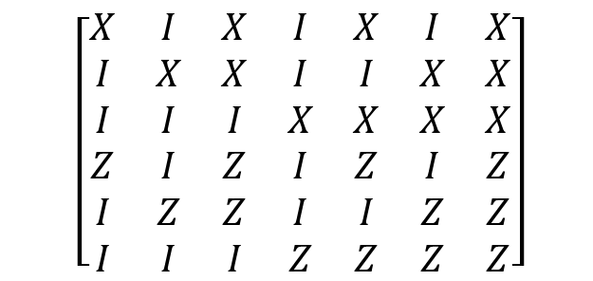
Problem - Syndrome extraction
Design a syndrome extraction circuit for the three X stabilizer generators of the quantum Hamming code.
Your circuit must use a single ancilla qubit that can be reset in the state $|0⟩$ and it must be made of the following operations: Prepare $|0⟩$ on the ancilla qubit, H, CNOT, measure a qubit in the Z basis.
Show that a fault $Z$ before a H gate is equivalent to a fault $X$ after the H gate.
Consider the gate CNOT(1, 2).
Show that a fault $Z_{2}$ before the CNOT is equivalent to a fault $Z_{1}Z_{2}$ after CNOT.
Show that the fault $Z_{1}$commute with the CNOT.
Show that a fault $Z$ before a measurement has no effect.
Assume that we run this circuit with input state $Z_{2}|ψ⟩$ where $|ψ⟩$ is a state of the quantum Hamming code. What is the fault at the end of the circuit?
$$\left[\begin{matrix}X & I & X & I & X & I & X \\ I & X & X & I & I & X & X \\ I & I & I & X & X & X & X \\ Z & I & Z & I & Z & I & Z \\ I & Z & Z & I & I & Z & Z \\ I & I & I & Z & Z & Z & Z\end{matrix}\right]$$

Slide 4
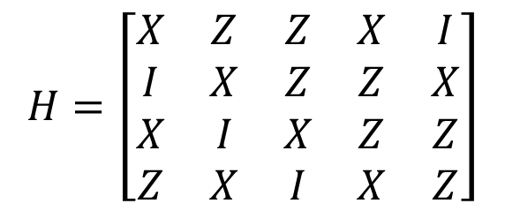
Problem – 5-qubit code
Design a syndrome extraction circuit for the 5-qubit code.
Your circuit must use a single ancilla qubit that can be reset in the state $|0⟩$ and it must be made of the following gate:
Prepare $|0⟩$ on the ancilla qubit,
H,
CNOT=CX,
CY,
CZ,
measure the ancilla qubit in the Z basis.
$$H=\left[\begin{matrix}X & Z & Z & X & I \\ I & X & Z & Z & X \\ X & I & X & Z & Z \\ Z & X & I & X & Z\end{matrix}\right]$$

Slide 5

Quantum syndrome measurement
Prove the following proposition.
Prop. Consider a system in the state $E\left|ψ\right\rangle$ where $\left|ψ\right\rangle ∈Q\left(S\right)$ and $E∈𝒫_{n}$.
The outcome of the measurement of $S_{i}$ is ${\left(−1\right)}^{σ_{i}(E)}$ with probability 1.
The state of the system after measurement is $E\left|ψ\right\rangle$.

