Slide 1
IBM QEC Summer School Lectures on quantum LDPC codes
Nicolas Delfosse – Microsoft
July 2022

Slide 2
Contact
ni.delfosse@gmail.com

Slide 3
Part 1. Classical LDPC codes

Slide 4
Overview
A brief and biased history of LDPC codes
Definition of LDPC codes
Constructions of LDPC codes
Belief Propagation decoder
Expander codes

Slide 5
Overview
A brief and biased history of LDPC codes
Definition of LDPC codes
Constructions of LDPC codes
Belief Propagation decoder
Expander codes

Slide 6
Brief (and biased) history
Asymptotic results: Shannon (1940’s)
Channel capacity: If we use a channel an infinite number of times, what is the maximum number of bits of information that we can send per use of the channel?
Basic idea: Random codes are optimal.
Problem: How to encode? How to decode?
Birth of modern coding: Elias and Gallager (1960’s)
Linear codes perform as well as random codes but encoding is easy.
Convolutional codes too.
Erasure channel as a toy model.
LDPC codes.

Slide 7
Brief (and biased) history
The comeback of modern coding: Berrou, Mackay, Neal, Richardson, Urbanke, Shorkollahi, … (1990’s):
Turbo codes
LDPC codes
Decoding is easy! But is it optimal?
Capacity achieving codes.
Proofs for the erasure channel first.
Irregular LDPC codes.
Spatially-coupled codes achieve capacity (Kudekar, Richardson, Urbanke 2013).

Slide 8
Overview
A brief and biased history of LDPC codes
Definition of LDPC codes
Constructions of LDPC codes
Belief Propagation decoder
Expander codes

Slide 9
Error correction with repetition codes
errors
001
011
encoding
errors
decoding
001
(000)(000)(111)
(001)(000)(011)
001
encoding
errors
decoding
001
(00000)(00000)(11111)
(01100)(00001)(01100)
000

Slide 10
Linear codes
Def: A linear code $C$ with length $n$ is a $Z_{2}$-linear subspace of $Z_{2}^{n}.$
Notations:
A codeword is a vector $x∈C$.
$\text{The} \text{dimension} is k=dim⁡C.$
$\text{T}\text{he} \text{minimum} \text{distance} is d =\min\left\{\left|x\right| \right| x∈C, x≠0\}.$
The parameters are [n, k, d]$.$
The rate is $R =\frac{k}{n}.$

Slide 11
Example
One can define a code from a $r×n$ binary matrix $H$ called the parity-check matrix:
$$C=\ker{H}=\left\{x∈Z_{2}^{n} \right| H x^{T}=0\}$$
Ex:
$$H=\left(\begin{matrix}1 & 1 & 0 \\ 0 & 1 & 1\end{matrix}\right)$$
$$C=\{(000, 111)\}$$
Question: What are the parameters of C?

Slide 12
Tanner graph
One can define a code from a graph $T$ with called the Tanner graph.
Each bit of x is represented by a bit node (circle).
$x∈C$ iff it satisfies the constraints represented by check nodes (square)
$x= x_{1}{ x}_{2}{ x}_{3}$ ${ x}_{4}$ ${ x}_{n}$
$…$
$…$
$$x_{1}+x_{2}+x_{4}=0$$

Slide 13
Parity-check matrix and Tanner graph
To obtain the Tanner graph construct:
One bit node per column.
One check node per row.
$$H=\left(\begin{matrix}1 & 1 & 0 \\ 0 & 1 & 1\end{matrix}\right)$$

Slide 14
Example
1
0
0
1
1
0
0
Is this a codeword?
Question: What are the codewords?
Question: What are the parameters of this code?

Slide 15
Example
0
1
1
0
1
0
0
Is this a codeword?
Question: What are the parameters of this code?
Question: Do you recognize this code?

Slide 16
LDPC codes
LDPC = Low-Density Parity-Check.
Def: LDPC codes are linear codes defined by sparse Tanner graphs.
Remark: Depending on the context sparse can mean:
$o(n)$ bits per check,
$O\left(log n\right)$ bit per check,
$O(1)$ bit per check.

Slide 17
LDPC code decoding - Intuition
Sparse checks provide an information about the locality of errors.
$x= x_{1}{ x}_{2}{ x}_{3}$ ${ x}_{4}$ ${ x}_{n}$
$…$
$…$
If $x_{1}+x_{2}+x_{4}=1$ then at least one of the three bits $x_{1},x_{2}$ or $x_{4}$ was flipped.

Slide 18
Overview
A brief and biased history of LDPC codes
Definition of LDPC codes
Constructions of LDPC codes
Belief Propagation decoder
Expander codes

Slide 19
Constructions of LDPC codes
Random constructions:
Gallager’s construction of regular LDPC codes
Ensembles of regular LDPC codes and irregular LDPC codes
Expurgated ensembles
Progressive edge growth
Explicit constructions:
Margulis’ code based on Cayley graphs
Finite geometry codes
Quasi-cyclic codes based on circulant matrices
Combinatorial design codes
Expander codes
Ramanunjan graphs codes
Protograph codes
Spatially coupled codes

Slide 20
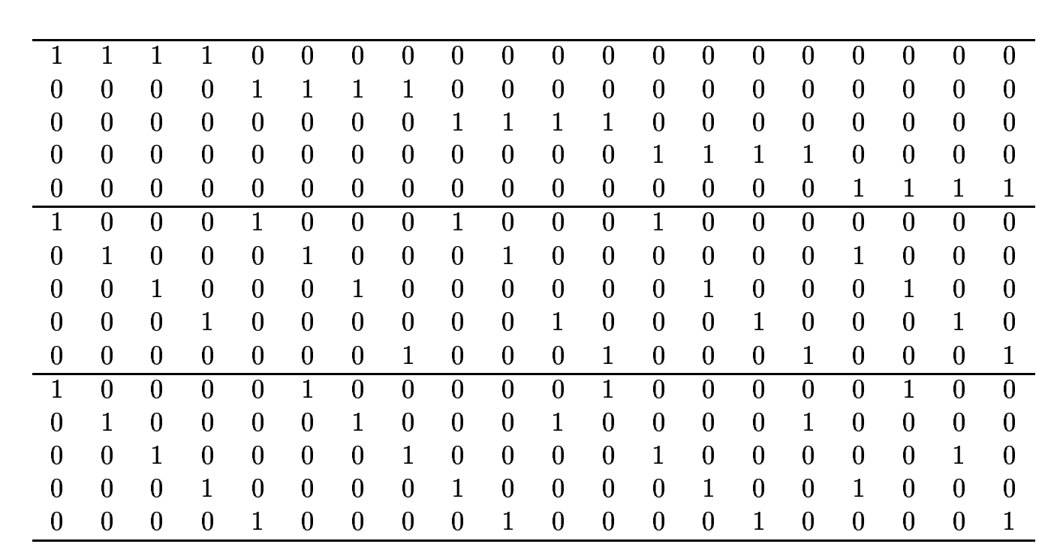
Gallager’s construction
Block with $λ=4$ symbols ‘1’ per row in descending order.
Add $ρ−1$ blocks obtained by applying a random permutation of the columns of the first block.
This produces $(λ, ρ)$LDPC codes with bit degree = $λ$ and check degree = $ρ$.

Slide 21
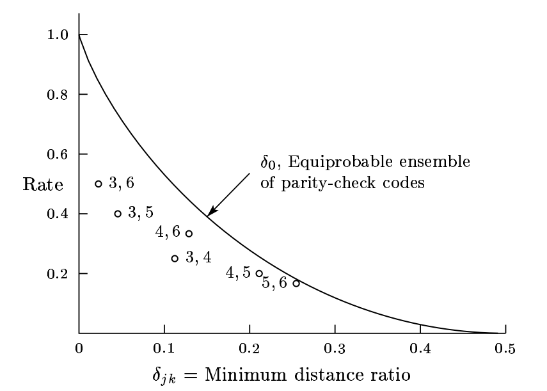
Distance of Gallager’s codes

Slide 22
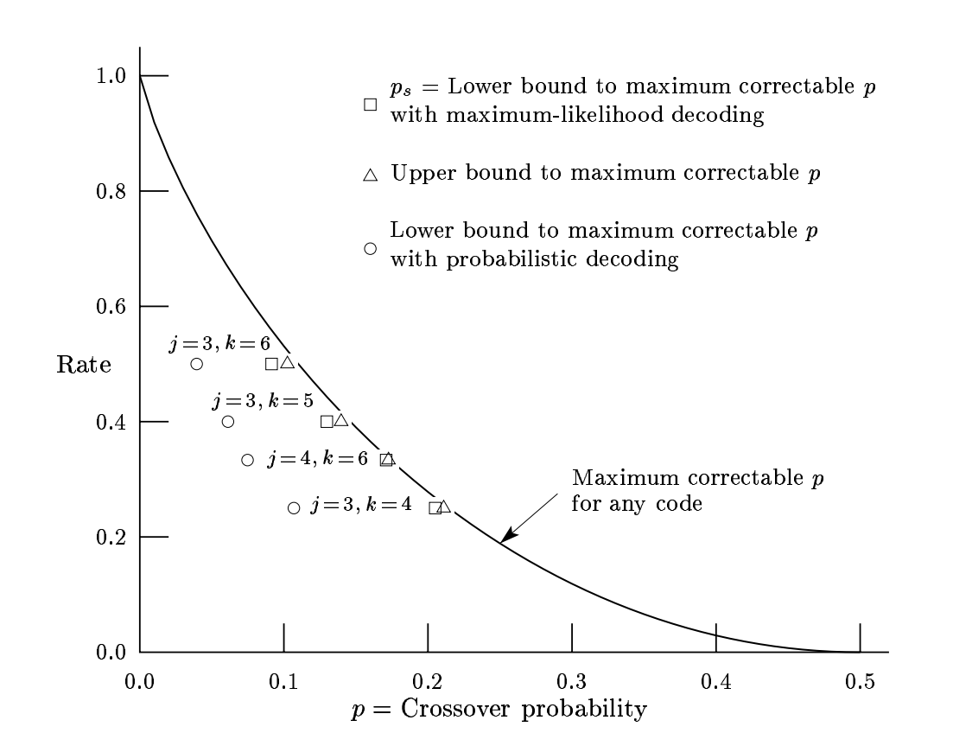
Capacity of Gallager’s codes

Slide 23
Overview
A brief and biased history of LDPC codes
Definition of LDPC codes
Constructions of LDPC codes
Belief Propagation decoder
Expander codes

Slide 24
Erasure channel
1-p
0
0
p
?
p
1
1
1-p

Slide 25
Correction of an erased bit with a (2,3)-code
?
?
?
?
?
?

Slide 26
Binary symmetric channel
1-p
0
0
p
p
1
1
1-p

Slide 27
Marginal bit-flip probability
Channel
$$x_{1}x_{2}…x_{n}$$
$$y_{1}y_{2}…y_{n}$$
Goal: Compute $P\left(x_{i}=0 \right| y)$ for all $i$.
We have
$$P\left(x_{1}=0 \right| y)=\sum_{\begin{aligned}x∈C \\ x_{1}=0\end{aligned}}{P\left(y \right| x)}=\sum_{x_{2},{ x}_{3},…,{ x}_{n}}{\prod_{i}{P\left(y_{i} \right| x_{i})}1_{x∈C}}$$
This is very expensive to evaluate: $O(2^{k}n)$ multiplications.

Slide 28
Marginal bit-flip probability
We want to evaluate
$$\sum_{x_{2},{ x}_{3},…,{ x}_{n}}{\prod_{i}{P\left(y_{i} \right| x_{i})}1_{x∈C}}$$
It a function of the form
$$\sum_{x_{2},{ x}_{3},…,{ x}_{n}}{f_{1}\left(x\right)…f_{m}(x)}$$
For LDPC codes each $f_{m}$ depends only on a small number of variables $x_{i}$.

Slide 29
Marginal computation by Belief Propagation
Example: Compute the sum
$$\sum_{x_{2},{ x}_{3},x_{4},{ x}_{5},{ x}_{6}}{f_{1}\left(x_{1}, x_{2}, x_{3}\right)f_{2}\left(x_{1}, x_{4}, x_{6}\right)f_{3}\left(x_{4}\right)f_{4}(x_{4}, x_{5})}$$
Strategy:
Represent the $f_{i}$ and their variables as a graph (called factor graph).
Use the graph topology to optimize the computation of partial sums.

Slide 30
$$\left({\sum_{x_{2}x_{3}}{f_{1}(0,x_{2},x_{3})×}\sum_{x_{4}x_{6}}{f_{2}\left(0,x_{4},x_{6}\right)}f_{3}\left(x_{4}\right)\sum_{x_{5}}{f_{4}\left(x_{4},x_{5}\right)} \atop \sum_{x_{2}x_{3}}{f_{1}(1,x_{2},x_{3})×}\sum_{x_{4}x_{6}}{f_{2}\left(1,x_{4},x_{6}\right)}f_{3}\left(x_{4}\right)\sum_{x_{5}}{f_{4}\left(x_{4},x_{5}\right)}}\right)$$
$$\left({\sum_{x_{2}x_{3}}{f_{1}(0,x_{2},x_{3})×1×1} \atop \sum_{x_{2}x_{3}}{f_{1}(1,x_{2},x_{3})×1×1}}\right)$$
$$\left({\sum_{x_{4}x_{6}}{f_{2}\left(0,x_{4},x_{6}\right)}×f_{3}\left(x_{4}\right)\sum_{x_{5}}{f_{4}\left(x_{4},x_{5}\right)×1} \atop \sum_{x_{4}x_{6}}{f_{2}\left(1,x_{4},x_{6}\right)}×f_{3}\left(x_{4}\right)\sum_{x_{5}}{f_{4}\left(x_{4},x_{5}\right)×1}}\right)$$
$$x_{1}$$
$$f_{1}$$
$$\left({f_{3}(0)×\sum_{x_{5}}{f_{4}(0,x_{5})} \atop f_{3}(1)×\sum_{x_{5}}{f_{4}(1,x_{5})}}\right)$$
$$f_{2}$$
$$\left({1 \atop 1}\right)$$
$$\left({1 \atop 1}\right)$$
$$\left({1 \atop 1}\right)$$
$$x_{2}$$
$$x_{3}$$
$$x_{4}$$
$$x_{6}$$
$$\left({f_{3}(0) \atop f_{3}(1)}\right)$$
$$\left({\sum_{x_{5}}{f_{4}(0,x_{5})×1} \atop \sum_{x_{5}}{f_{4}(1,x_{5})}×1}\right)$$
$$f_{3}$$
$$f_{4}$$
$$\left({1 \atop 1}\right)$$
$$\sum_{x_{2},{ x}_{3},x_{4},{ x}_{5},{ x}_{6}}{f_{1}\left(x_{1}, x_{2}, x_{3}\right)f_{2}\left(x_{1}, x_{4}, x_{6}\right)f_{3}\left(x_{4}\right)f_{4}(x_{4}, x_{5})}$$
$$x_{5}$$

Slide 31
Belief Propagation messages
$$f_{1}$$
$$\left({\prod_{i=2}^{m}{μ_{f_{i}→x_{1}}(0)} \atop \prod_{i=2}^{m}{μ_{f_{i}→x_{1}}(1)}}\right)$$
= product of incoming messages
$$x_{1}$$
$$…$$
$$f_{2}$$
$$f_{3}$$
$$f_{m}$$
From variables to checks

Slide 32
Belief Propagation messages
$$x_{1}$$
$$\left({\sum_{x_{2},…,x_{s}}{f_{1}(0,x_{2},…,x_{m}) \prod_{i=2}^{m}{μ_{x_{i}→f_{1}}(x_{i})}} \atop \sum_{x_{2},…,x_{s}}{f_{1}(1,x_{2},…,x_{m}) \prod_{i=2}^{m}{μ_{x_{i}→f_{1}}(x_{i})}}}\right)$$
$$f_{1}$$
= sum over all values of incoming variables
$$…$$
$$x_{2}$$
$$x_{3}$$
$$x_{m}$$
From checks to variable

Slide 33
Belief Propagation – Final comments
Applications:
In a tree: If the factor graph is a tree, BP compute exactly the bit-flip probabilities.
In a graph: If the factor graph is not a tree, BP compute an approximation of the bit-flip probabilities.
For LDPC codes: If the Tanner graph of a LDPC code has large girth (no short cycle), BP compute a good approximation of the bit-flip probabilities.
Progressive edge growth: There exist algorithms producing LDPC codes with large girth.
Implementation:
BP can be parallelized by sending messages through all edges simultaneously.
Instead of sending 2 messages per edge, we can send only 1 message using the log likelihood ratio.

Slide 34
Overview
A brief and biased history of LDPC codes
Definition of LDPC codes
Constructions of LDPC codes
Belief Propagation decoder
Expander codes

Slide 35
Expander Tanner graphs
$S$ = subset of bits
$N(S)$ = neighbors checks
For expander graph, we have $\left|N\left(S\right)\right|∝|S|$.

Slide 36
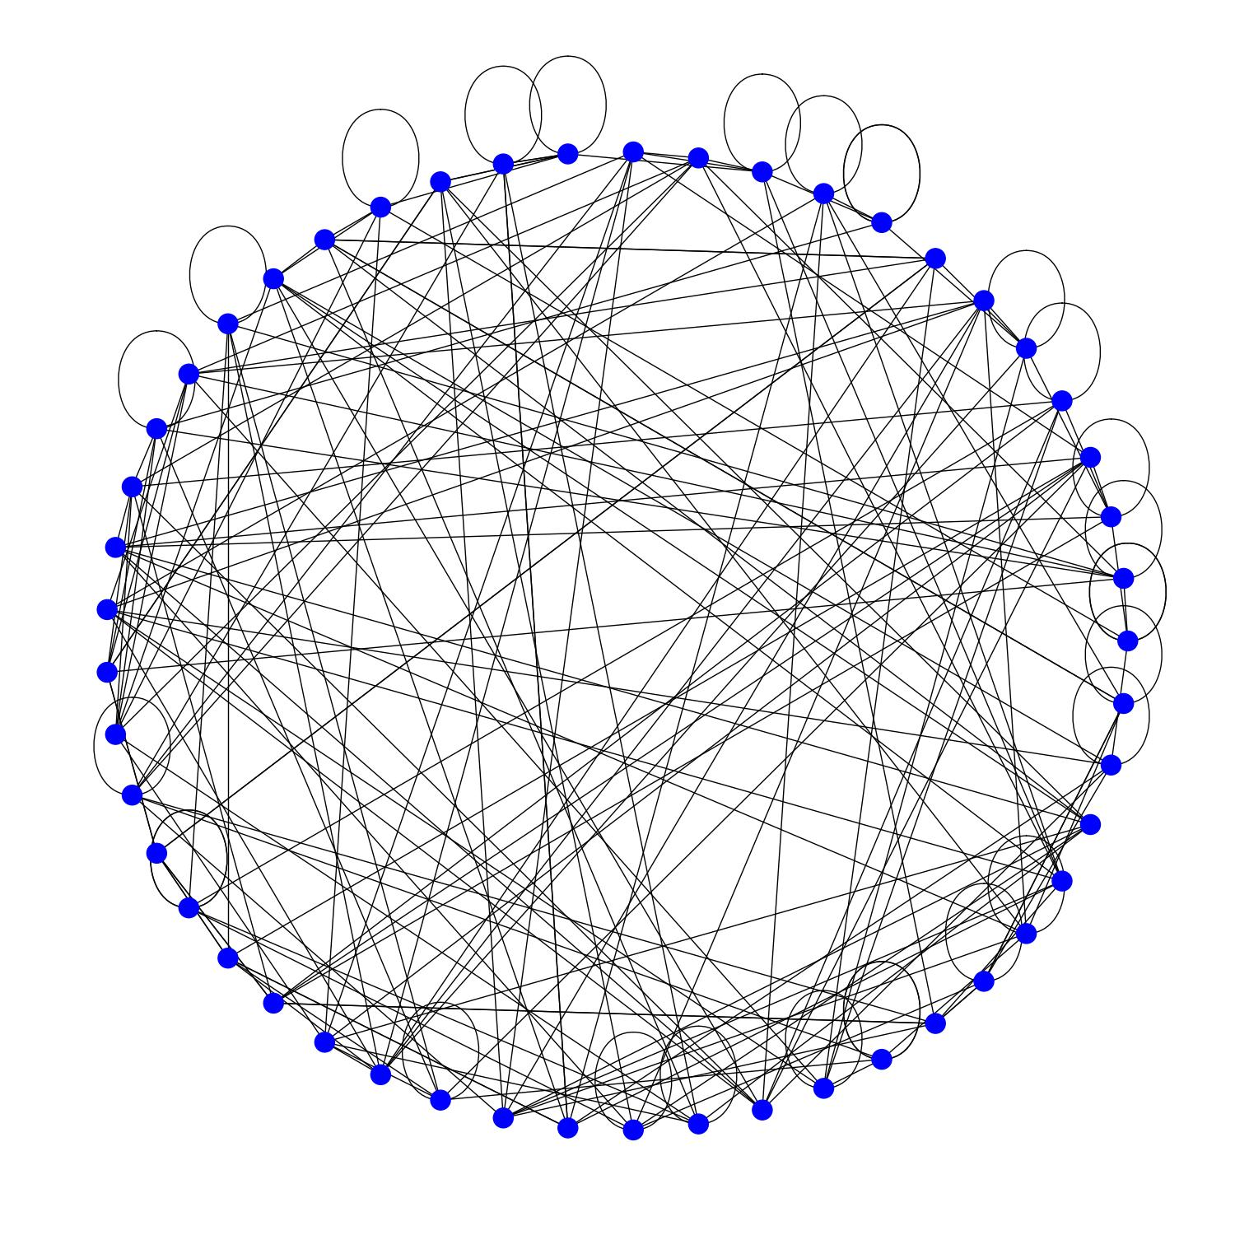
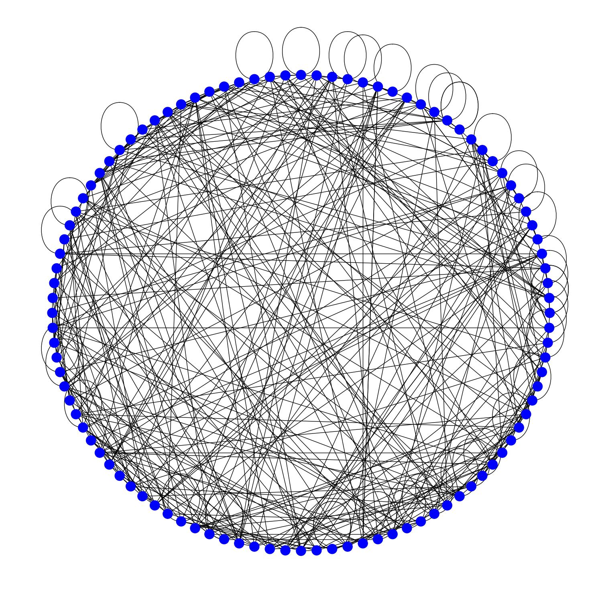
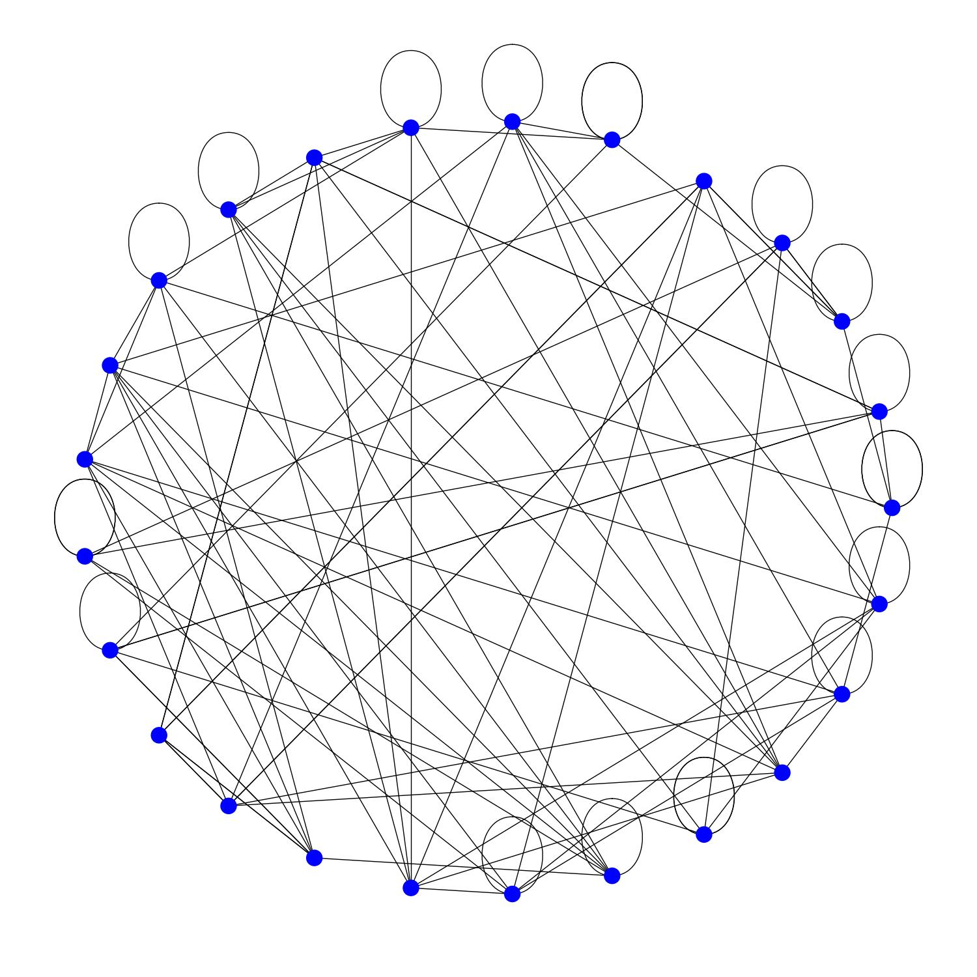
Expander graphs
Margulis expander with 25 vertices
Margulis expander with 49 vertices
Margulis expander with 100 vertices

Slide 37
Non-expander graphs

Slide 38
Expander graphs and codes
Notation: $N(S)$ = neighbors of the vertices in $S$ and $δ_{bit}$ = degree of all bit nodes.
Def. A Tanner graph with n bits and r checks is a $\left(γ, α\right)$-expander if for all subsets $S$ of bits nodes with size $\left|S\right|≤γn$ we have $\left|N\left(S\right)\right|≥α|S|$.
Remark: $α≤δ_{bit}$.
Theorem. [Capalbo, Reingold, Vadhan, and Wigderson, 2002]. $∀ε>0,∃ γ>0 and{ δ}_{bit}≥1$ such that there exists a family of $\left(γ, α\right)$-expander Tanner graphs with constant bit degree $δ_{bit}$ and $α=\left(1−ε\right)δ_{bit}$and $n→+∞$.
Moreover, ${ δ}_{bit}=Θ\left(\frac{\log\left(\#\frac{bits}{\#checks}\right)}{ε}\right)$ and $γ=Θ\left(\frac{ε \#checks }{δ_{bit} \#bits}\right)$.
The corresponding codes are called expander codes.

Slide 39
Expander code – Minimum distance
Theorem. [Sipser, Spielman, 1996]. Good expander codes exists, i.e with parameters $\left[n, Θ\left(n\right), Θ\left(n\right)\right].$
Sketch of proof. Pick the codes obtained in the Theorem with $ε>0.5.$
I$f \left|S\right|≤γn$, there are $|S|δ_{bit}$edges leaving $S$ and
$$\left|N\left(S\right)\right|≥\left(1−ε\right)δ_{bit}|S|$$
Therefore, at most $εδ_{bit}|S|$ edges reach a check incident to more than one bit of $S$.
If $U\left(S\right)$ is the set of checks incident to a single bit of $S$. Then
$$\left|U\left(S\right)\right|≥(1−2ε)|S|$$
Conclusion: $S$ cannot support a codeword, proving that $d>γn$.
One can prove that $d>2γ(1−ε)n$.

Slide 40
Expander codes – Flip min decoder
Input:
A bit value $y_{b}=0$ or 1 for each bit node.
A syndrome value $s_{c}=0$ or 1 for each check node.
Output: A corrected vector $y$.
While there exists a bit node $b$ such that $N(b)$ contains strictly more syndrome values 1 than 0.
Flip $y_{b}$.
For all $c$ in $N(b)$, flip $s_{c}$.
Return $y$.
Theorem [Sipser, Spielman, 1996]. If $ε≥3/4,$ the flip min decoder corrects any set of $γ\left(1−2ε\right)n$ bit flips.
Question: What is the complexity of this decoder? Find a linear time implementation.

Slide 41
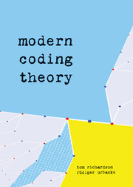
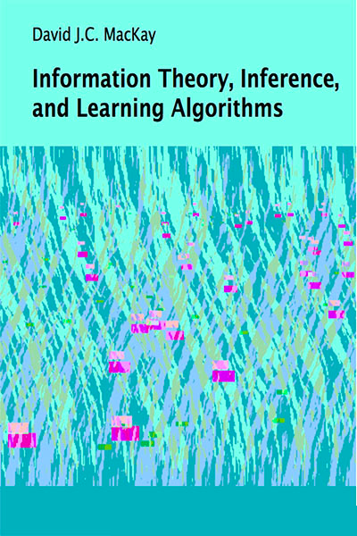
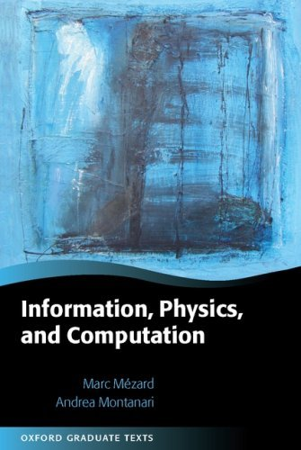
References

Slide 42
More references
Capacity:
Shannon – A Mathematical Theory of communication (1948).
LDPC codes:
Gallager’s PhD thesis – Low-Density Parity-Check codes (1963).
Tanner – A recursive approach to low complexity codes (1981).
Expander codes:
Sipser, Spielman – Expander codes (1996).
Guruswami’s lecture notes: https://www.cs.cmu.edu/~venkatg/teaching/codingtheory/notes/notes8.pdf
Anirudh Krishna’s blog: https://thescaffolding.wordpress.com/author/wifo215/
Spatially coupled codes:
Kudekar, Richardson, Urbanke - Spatially Coupled Ensembles Universally Achieve Capacity under Belief Propagation (2013)

Slide 43
Part 2. Decoding quantum LDPC codes

Slide 44
Overview
Quantum LDPC codes
Small set flip decoder for expander codes
Union-Find decoder
BP + OSD decoder
Other strategies
Numerical results

Slide 45
Overview
Quantum LDPC codes
Small set flip decoder for expander codes
Union-Find decoder
BP + OSD decoder
Other strategies
Numerical results

Slide 46
Why quantum LDPC codes?
Classical LDPC codes:
in SSD storage
The Shor code:
First quantum error-correcting code
Cost = $\frac{\# qubit used}{\# qubit stored}$
1
625
5
<1.1
9
25x25
Surface code
The Steane code:
Smallest quantum code correcting one arbitrary error

Slide 47
Classical and quantum Hamming codes
Quantum codes detect X errors and Z errors:
0
1
1
Classical code detect bit flips:
Flip
X
Z
1
0
0
1
0
1

Slide 48
Surface codes
$$=$$
3 x 3 surface code
Corrects 1 error
5 x 5 surface code
Corrects 2 errors
1. Kitaev (1997) arxiv:9707021

Slide 49
Quantum Tanner graph for stabilizer codes
Bipartite graph with qubit nodes and check nodes.
Each check nodes define a stabilizer generator.
They must commute.
Next, we focus on CSS codes. Then, we just need to correct X errors using the syndrome on Z checks.

Slide 50
Quantum erasure channel
1-p
0
0
p
p
?
1
1
1-p
1-p
$$ρ$$
$$ρ$$
Classical erasure channel
p
$$\frac{I}{2}$$
$\frac{I}{2}=\frac{1}{4}ρ+\frac{1}{4}XρX+\frac{1}{4}YρY$ $+\frac{1}{4}ZρZ$
If the qubit is erased, it suffers from a uniform Pauli error I, X, Y or Z.
Question: What is the maximum erasure rate that is correctable with non-vanishing rate?

Slide 51
Depolarizing channel
1-p
0
0
p
p
1
1
1-p
1-p
Classical binary symmetric channel
$$ρ$$
$$ρ$$
p/3
p/3
$$XρX$$
p/3
$$YρY$$
$$ZρZ$$

Slide 52
The decoding problem
Classical case:
Given a syndrome s for a set of bit flips, find a likely error with syndrome s.
The probability of a set of bit flip is
$$p^{\#bit flips}{\left(1−p\right)}^{n −\#bit flips}$$
Quantum case:
Given a syndrome s for a Pauli error, find a likely Pauli error with syndrome s, up to a stabilizer.
The probability of a Pauli error $E$ is
$${P⁡(E)=p}^{\#X+\#Y+\#Z}{\left(1−p\right)}^{n −(\#X+\#Y+\#Z)}$$
But $E$ has the same effect as $ES$ for all stabilizer $S.$
Therefore, we must use the coset probability
$$Q\left(E\right)=\sum_{S}{P(ES)}$$

Slide 53
First decoding attempt: BP
Classical case:
Use BP to compute $P\left(x_{i}=0 \right| y)$ and $P\left(x_{i}=1 \right| y)$.
Correct by selecting the most likely value $x_{i}$ $=0$ or 1.
Quantum case:
Use BP to compute $P\left(E_{i}=I \right| s),P\left(E_{i}=X \right| s),P\left(E_{i}=Y \right| s)$ and $P\left(E_{i}=Z \right| s)$.
BP does not perform well for two reasons:
The quantum Tanner graph contains many 4-cycles because of the commutation relations.
The event $E_{i}=I$ is not well defined up to a stabilizer.

Slide 54
Overview
Quantum LDPC codes
Small set flip decoder for expander codes
Union-Find decoder
BP + OSD decoder
Other strategies
Numerical results

Slide 55
Can we directly use the flip min decoder?
Basic idea: If the X Tanner graph and the Z Tanner have large expansion, we can use the classical flip min decoder twice to correct a linear number of errors.
Bad news: This cannot happen.
Proof: If the X Tanner graph has large expansion, the corresponding classical code has large minimum distance. Then, there is no low-weight Z generators.

Slide 56
Small set flip for HGP codes
Instead, we use HGP codes with parameters $[[n, Θ\left(n\right), Θ(\sqrt{n})]]$.
Qubits
Qubits
Z stabilizer
generators
X stabilizer
generators
Tillich Zémor (2009)

Slide 57
Small set flip for HGP codes
Def: A critical generator g is a Z generator whose support contains a set $S_{g}$ such that a X error on $S_{g}$ reduces the weight of the syndrome.
Input: A syndrome value $s_{c}=0$ or 1 for each Z check node.
Output: A Pauli correction E.
While there exists a critical generator $g$
X to the qubits of $S_{g}$.
Update the syndrome.
Return the Pauli error.
Theorem [Leverrier, Tillich, Zémor, 2015]. Under some conditions about the expansion of the two input graphs, the small set flip decoder corrects any set of $Θ(\sqrt{n})$ errors.
Question: What is the complexity of this decoder? Find a linear time implementation. What is the constant?

