Slide 1
Tutorial on Quantum Error Correction – Part 1
Nicolas Delfosse
Microsoft
UCLA – Mathematical and Computational Challenges in Quantum Computing
September 12th, 2023

Slide 2
Why should you care about quantum error correction?

Slide 3
What is a quantum computer?
First attempt:
A machine capable of performing quantum computations.
More accurate definition:
A machine capable of performing Quantum Error Correction and a little bit of computation.
QEC = Quantum Error Correction

Slide 4
Example - Shor’s algorithm
How many qubits are used to compute?
How many qubits with QEC?
Cost of a single entangling gate?
Cost of a single entangling gate with QEC?
$$14,238$$
$$22,325,184$$
$2$ qubits and $≈100ns$
$2,925$ qubits and $≈27,000ns$
$39,339$ qubit initialization
$39,339$ measurements
$153,090$ CNOTs
Assumptions: Time of a logical joint measurements with surface code with $d=27$ and time per meas. round = $1μs$

Slide 5
Overview
Classical error correction
Small quantum codes
Topological codes
LDPC codes
In each case we need 4 components:
Code constructions
Syndrome extraction circuit
Decoder
Fault tolerance
Discrete math, combinatorics
Chain complexes, homology, fusion categories
Graphs, expanders, high dim expander

Slide 6
Introduction: Classical error correction

Slide 7
Error correction with repetition codes
errors
001
011
encoding
errors
decoding
001
(000)(000)(111)
(001)(000)(011)
001
encoding
errors
decoding
001
(00000)(00000)(11111)
(01100)(00001)(01100)
000

Slide 8
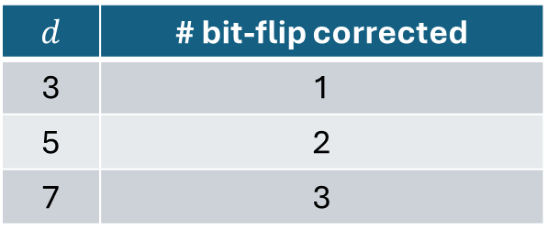
Code distance
$d$ repetitions
$$d$$ | # bit-flip corrected
3 | 1
5 | 2
7 | 3
encoding
$$x=0 or 1$$
($xx … x$)

Slide 9
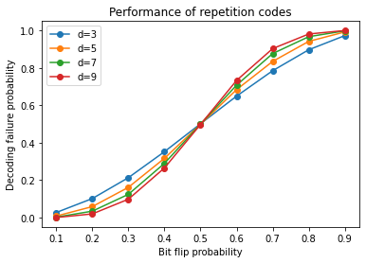
Performance plots
When $p→0$, failure probability $→0$
Code threshold = 0.5
If $p<0.5$:
Failure probability $→0$
If $p>0.5$:
Failure probability $→1$

Slide 10
Tanner graphs of repetition codes
0
0
0
0
0
0
0
1
0
0
1
1
0
0
Bits nodes
Checks
1
0
1
0
1
0
Issue: The repetition code encodes only 1 logical bit.
Solution: Use more general graphs.

Slide 11
Hamming code
Solution: Using general graphs, we can simultaneously:
encode many logical bits
correct many bit-flips
0
1
1
0
1
0
0
Flip
0
0
0
1
0
0

Slide 12
Decoding Hamming code
Lookup table decoder:
Checks | Correction
100 | Flip 4
010 | Flip 6
110 | Flip 2
001 | Flip 7
101 | Flip 3
011 | Flip 5
111 | Flip 1
Flip
1
0
0
Issue: The size of this table grows exponentially

Slide 13
Low Density Parity-Check (LDPC) codes
Solution: LDPC codes = codes defined by low degree checks
$x∈{\left\{0,1\right\}}^{n}= x_{1}{ x}_{2}{ x}_{3}$ ${ x}_{4}$ ${ x}_{n}$
$…$
$…$
$$x_{1}+x_{2}+x_{4}=0$$
With sparse graph, we get an efficient decoder.
Basic idea: if $x_{1}+x_{2}+x_{4}=1$ there is only 3 possible bit-flips
=> efficient decoding without a lookup table.
Gallager – Low-Density Parity-Check codes (1963)

Slide 14
Classical codes - Summary
Linear codes: Codes defined by parity checks on $n$ bits.
Easy to encode: Complexity $O(n^{2})$.
Hard to decode: No polynomial time algorithm in general. Only for some subfamilies of linear codes ($e.g.$ LDPC).

Slide 15
Part 1 – Small quantum codes

Slide 16
Small quantum codes
CSS codes and Stabilizer codes

Slide 17
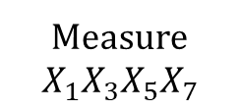
Quantum Hamming codes (Steane code)
Quantum codes detect X errors and Z errors:
Classical code detect bit flips:
0
1
1
Measure
$$X_{1}X_{3}X_{5}X_{7}$$
Flip
X
Z
1
0
0
Measure
$$Z_{1}Z_{2}Z_{3}Z_{4}$$
$$x_{1}+x_{2}+x_{3}+x_{4}$$
1
0
1
Calderbank, Shor – Good Quantum Error-Correcting codes exist arxiv:9512032
Steane – Multiple Particle Inference and Quantum Error Correction. arxiv:9601029

Slide 18
How to define quantum checks?
$$?$$
$$?$$
Requirement:
The checks must commute
$$0$$
$$0$$
$$0$$
Measure
$$Z_{1}Z_{2}Z_{3}Z_{4}$$
Is this a good choice?

Slide 19
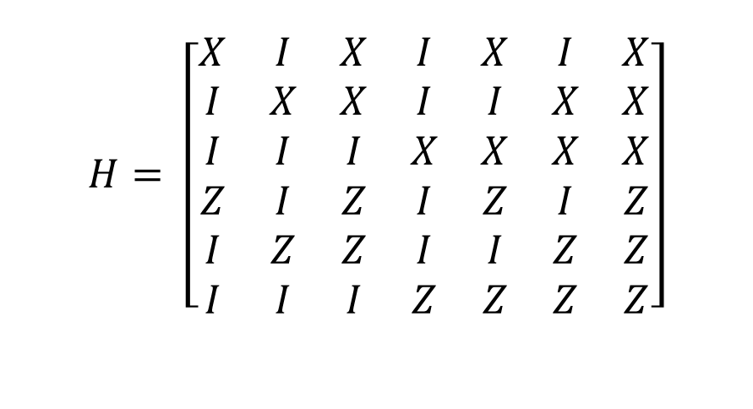
Stabilizer matrix
$$H= \left[\begin{matrix}X & I & X & I & X & I & X \\ I & X & X & I & I & X & X \\ I & I & I & X & X & X & X \\ Z & I & Z & I & Z & I & Z \\ I & Z & Z & I & I & Z & Z \\ I & I & I & Z & Z & Z & Z\end{matrix}\right]$$

Slide 20
The five-qubit code
$$H=\left[\begin{matrix}X & Z & Z & X & I \\ I & X & Z & Z & X \\ X & I & X & Z & Z \\ Z & X & I & X & Z\end{matrix}\right]$$
Exercise. Check that the rows commute.

Slide 21
Stabilizer codes – Formal definition
Def. Let $S=S_{1},S_{2},…,S_{r}$ be commuting Pauli operators.
The stabilizer code associated with $S$ is
$$Q\left(S\right)=\left\{\left|ψ\right\rangle | ∀i, { S}_{i}\left|ψ\right\rangle =\left|ψ\right\rangle \right\}$$
Remark:
$S_{i}$ are called the stabilizer generators.
The group $\left\langle S_{1},…,S_{r}\right\rangle$ is called stabilizer group.
We need $−I∉\left\langle S_{1},…,S_{r}\right\rangle$ to have $Q\left(S\right)≠∅$
Gottesman – Stabilizer codes and quantum error correction. arxiv:9705052
Calderbank, Rains, Shor, Sloane – Quantum error correction via codes over GF(4). arxiv:9608006

Slide 22
Number of logical qubits
Def. $S_{1},…,S_{r}$ are independent if the only product of these operators that is equal to $I$ is the trivial product.
Prop. If the stabilizer generators are independent, then $\dim{Q\left(S\right)}=2^{n−r}$.
Remark.
$Q\left(S\right)$encodes $k≔n−r$ logical qubits.
The code parameters are denoted $[[n, k]]$.

Slide 23

Exercise. Count the logical qubits
$$H=\left[\begin{matrix}X & Z & Z & X & I \\ I & X & Z & Z & X \\ X & I & X & Z & Z \\ Z & X & I & X & Z\end{matrix}\right]$$
$$=> [[5, 1]]$$

Slide 24

Exercise. Count the logical qubits
$$H=\left[\begin{matrix}X & X & I & I & I \\ I & X & X & I & I \\ I & I & X & X & I \\ I & I & I & X & X \\ X & I & I & I & X\end{matrix}\right]$$
$$=> [[5, 1]]$$

Slide 25

Exercise. Count the logical qubits
$$H= \left[\begin{matrix}X & I & X & I & X & I & X \\ I & X & X & I & I & X & X \\ I & I & I & X & X & X & X \\ Z & I & Z & I & Z & I & Z \\ I & Z & Z & I & I & Z & Z \\ I & I & I & Z & Z & Z & Z\end{matrix}\right]$$
$$=> [[7, 1]]$$

Slide 26
Exercise. Count the logical qubits
$$=> [[4, 2]]$$

Slide 27

Exercise. Count the logical qubits
$$\frac{\left|00\right\rangle +\left|11\right\rangle }{\sqrt{2}}$$
$$\left|0\right\rangle$$
$$=> [[2, 0]]$$

Slide 28

Commutation of Paulis
Prop. Two Pauli operators $P,Q$ either commute or anti-commute.
Ex.
$XIIZ$ and $ZIIZ$?
$XYZ$ and $ZXY$?
$XIXIXIXIIIIXXXXX$ and $XIXXIIXIIIIXXIIX$?
$XXXX$ and $YYYY$?

Slide 29
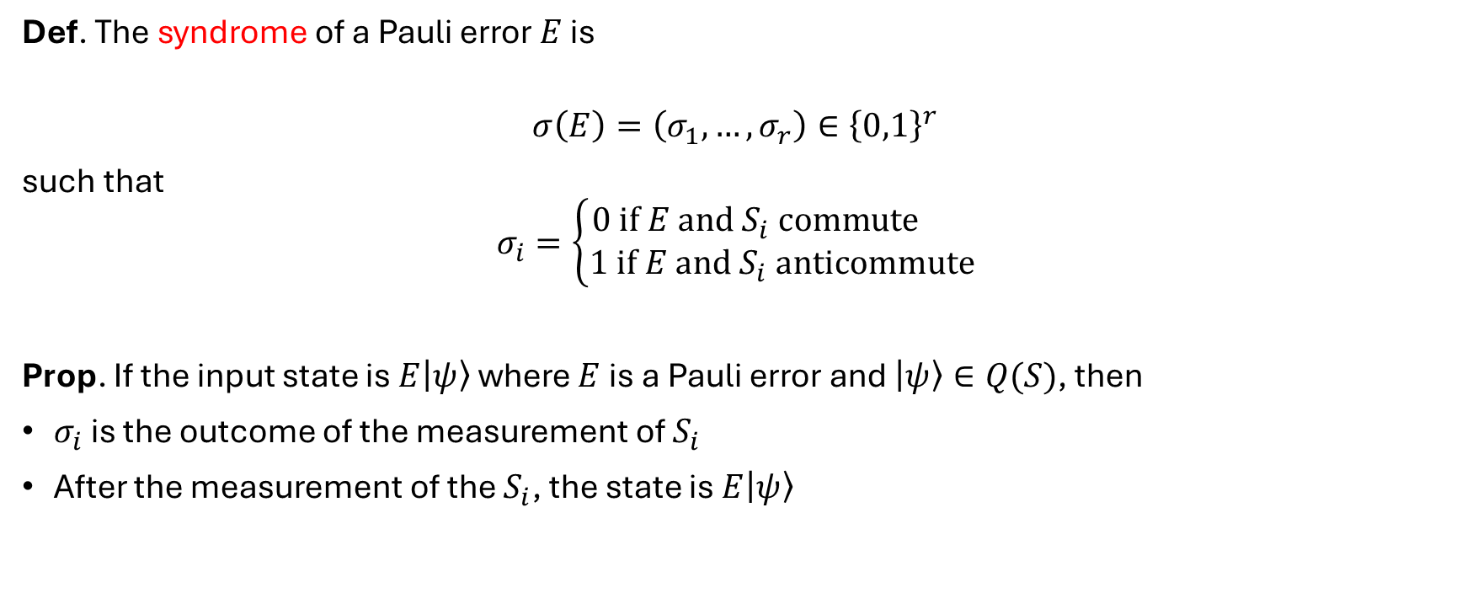
Syndrome
Def. The syndrome of a Pauli error $E$ is
$$σ\left(E\right)=\left(σ_{1},…,σ_{r}\right)∈{\left\{0,1\right\}}^{r}$$
such that
$$σ_{i}=\left\{\begin{aligned}0 if E and S_{i} commute \\ 1 if E and S_{i} anticommute\end{aligned}\right.$$
Prop. If the input state is $E\left|ψ\right\rangle$ where $E$ is a Pauli error and $\left|ψ\right\rangle ∈Q(S)$, then
$σ_{i}$ is the outcome of the measurement of $S_{i}$
After the measurement of the $S_{i}$, the state is $E\left|ψ\right\rangle$

Slide 30
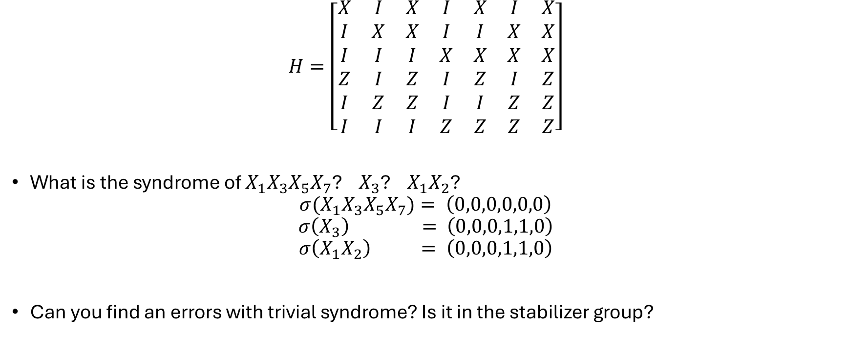
Exercise
$$H=\left[\begin{matrix}X & I & X & I & X & I & X \\ I & X & X & I & I & X & X \\ I & I & I & X & X & X & X \\ Z & I & Z & I & Z & I & Z \\ I & Z & Z & I & I & Z & Z \\ I & I & I & Z & Z & Z & Z\end{matrix}\right]$$
What is the syndrome of $X_{1}X_{3}X_{5}X_{7}$? $X_{3}$? $X_{1}X_{2}$?
$${σ(X}_{1}X_{3}X_{5}X_{7})= \left(0,0,0,0,0,0\right)$$
$$σ\left(X_{3}\right) = \left(0,0,0,1,1,0\right)$$
$$σ\left(X_{1}X_{2}\right) = \left(0,0,0,1,1,0\right)$$
Can you find an errors with trivial syndrome? Is it in the stabilizer group?

Slide 31
Minimum distance
Def. The minimum distance $d$ is the minimum weight of a Pauli error $E$ such that
$σ\left(E\right)=0$
$E∉\left\langle S_{1},…,S_{r}\right\rangle$
Remark.
When d is known, the code parameters and are denoted $[[n, k, d]]$.

Slide 32


Exercise. Find the minimum distance
$$H=\left[\begin{matrix}X & I & X & I & X & I & X \\ I & X & X & I & I & X & X \\ I & I & I & X & X & X & X \\ Z & I & Z & I & Z & I & Z \\ I & Z & Z & I & I & Z & Z \\ I & I & I & Z & Z & Z & Z\end{matrix}\right]$$
$$⇒\left[\left[7, 1, 3\right]\right]$$
$$H=\left[\begin{matrix}X & Z & Z & X & I \\ I & X & Z & Z & X \\ X & I & X & Z & Z \\ Z & X & I & X & Z\end{matrix}\right]$$
$$⇒\left[\left[5, 1, 3\right]\right]$$

Slide 33
Decoder
Def. A decoder is a map $D:{\left\{0,1\right\}}^{r}→𝒫_{n}$.
We say that the decoder corrects a Pauli error $E$ if the $D\left(σ(E)\right)=E mod S$.
Def. A minimum weight (MW) decoder is a map $D:{\left\{0,1\right\}}^{r}→𝒫_{n}$ such that for all $σ∈{\left\{0,1\right\}}^{r}$, $D(σ)$ is a minimum weight error with syndrome $σ$.
Prop. A MW decoder corrects all Pauli errors $E$ with weight $\left|E\right|≤\frac{d−1}{2}$.
In def 1, we ignore the phase of E. Otherwise, we could write $D\left(σ(E)\right)=E mod ⟨±I,S⟩$

Slide 34
Building a MW decoder using a lookup table
Input: Code + bound $M$.
Output: A MW decoder for the correction of all errors with weight $≤M$
Initialize $D\left(σ\right)=0$ for all $σ$.
For $w=1,2,…,M$ do:
Loop over Pauli errors $E$ with weight w and do:
Compute $σ(E)$
If $D\left(σ\right)=0$, set $D\left(σ\right)=E$
Return $D$
Question. What is the size of $D$?
$$\sum_{w=1,…,M}{\left(\begin{aligned}n \\ w\end{aligned}\right)3^{w} }$$
Checks | Correction
100 | Flip 4
010 | Flip 6
110 | Flip 2
001 | Flip 7
101 | Flip 3
011 | Flip 5
111 | Flip 1
LUT decoder for Hamming code

Slide 35
Example
Is there a LUT decoder in my laptop?
Claim:
The flash memory uses LDPC codes with length $n≈8,000$.
The code has distance $d≈30$
Is that feasible?
We need to store all corrections with weight up to $M=15$.
Cost: $≥\left(\begin{aligned}8,000 \\ 15\end{aligned}\right)≈{3.10}^{46}$ bits
30 trillions quetabits

Slide 36
Small quantum codes
Syndrome extraction circuit

Slide 37
Syndrome extraction in practice
$$H=\left[\begin{matrix}X & Z & Z & X & I \\ I & X & Z & Z & X \\ X & I & X & Z & Z \\ Z & X & I & X & Z\end{matrix}\right]$$
We have qubits equipped with:
Preparation: $|0⟩$ or $|+⟩$
Measurements: $M_{Z}$
Single-qubit gates: H, S, T
Two-qubit gates: CNOT = CX, CY, CZ
Goal:
We are given 5 qubits with a state $|ψ⟩$ (or $E|ψ⟩$) of the five-qubit code.
Design a circuit to measure the syndrome?

Slide 38
Measurement of the first check: XZZXI
X
Z
$E\left|ψ\right\rangle$
Z
X
$$|+>$$
$$σ_{1}$$

Slide 39

Syndrome extraction circuit
$$H=\left[\begin{matrix}X & Z & Z & X & I \\ I & X & Z & Z & X \\ X & I & X & Z & Z \\ Z & X & I & X & Z\end{matrix}\right]$$
X
X
Z
Z
X
X
$E\left|ψ\right\rangle$
Z
Z
X
X
Z
Z
X
X
Z
Z
$$|+>$$
$$σ_{1}$$
$$|+>$$
$$σ_{2}$$
$$|+>$$
$$σ_{3}$$
$$|+>$$
$$σ_{4}$$
Notes:
Here the measurement is in the X basis

Slide 40

Putting everything together
$$H=\left[\begin{matrix}X & Z & Z & X & I \\ I & X & Z & Z & X \\ X & I & X & Z & Z \\ Z & X & I & X & Z\end{matrix}\right]$$
X
X
Z
$$E′$$
Z
X
X
$E\left|ψ\right\rangle$
Z
X
Z
X
Z
Z
X
X
Z
Z
$$|+>$$
$$σ_{1}$$
$$|+>$$
$$σ_{2}$$
$$|+>$$
$$σ_{3}$$
$$|+>$$
$$σ_{4}$$
Question: Does it work in practice?
=> No
Decoder
$σ_{1}, σ_{2},σ_{3}$, $σ_{4}$
Notes:
Here the measurement is in the X basis

Slide 41
Small quantum codes
Fault tolerance

Slide 42
Standard noise models
Perfect measurement model:
Noise on data qubits
Phenomenological model:
Noise on data qubits
Noise on measurements
Circuit noise:
Noise on data qubits
Noise on measurements
Noise on ancilla qubits
Noise on gates
Noise on waiting qubits
X
Z
Z
X
$$|+>$$
$$σ_{1}$$
Dennis, Kitaev, Landhal, Preskill – Topological Quantum Memory. arxiv:0110143

Slide 43
Shor scheme for fault-tolerance
Repeat the syndrome extraction circuit.
Apply the decoder only if we see twice the syndrome consecutively.
Prop. If there is at most 1 fault, then 4 rounds are enough.
$$|+>$$
$$|+>$$
$$|+>$$
$$|+>$$
$$|+>$$
$$|+>$$
$$|+>$$
$$|+>$$
$$|+>$$
$$|+>$$
$$|+>$$
$$σ^{(1)}$$
$$σ^{(2)}$$
Shor – Fault-tolerant quantum computation. arxiv:9605011

Slide 44
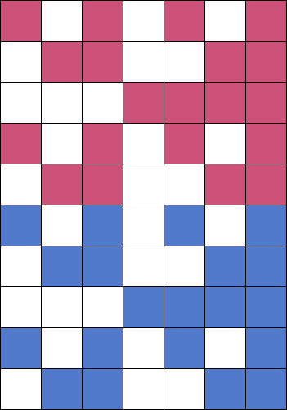
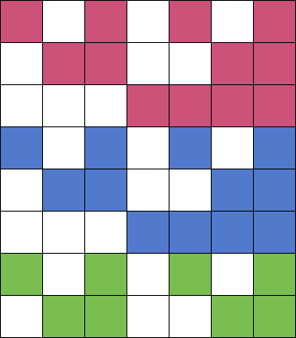
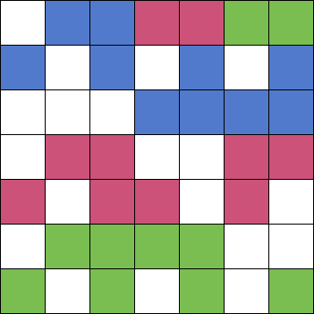
Short Shor-Style Syndrome Sequences
X
Y
Z
Shor FT with Steane code:
24 measurements
Delfosse, Reichardt – SSSSS arxiv:2008.05051
7 measurements
8 measurements
10 measurements
Steane – Active stabilization, quantum computation and quantum state synthesis. arxiv:9611027
Chao, Reichardt – QEC with only two extra qubits. arxiv:1705.02329
Huang, Brown – Between Shor and Steane. arxiv:2012.15403

