Slide 1
Quantum LDPC codes Lecture 1
Nicolas Delfosse
Microsoft
PCMI Summer School 2023
July 24th 2023

Slide 2
General goal
How to build your own fault-tolerant quantum memory based on quantum LDPC codes?
… on paper

Slide 3
Overview of lecture 1
Classical codes
Stabilizer codes
Good stabilizer exist
Examples of quantum LDPC codes

Slide 4
Classical linear codes

Slide 5
Error correction with repetition codes
errors
001
011
encoding
errors
decoding
001
(000)(000)(111)
(001)(000)(011)
001
encoding
errors
decoding
001
(00000)(00000)(11111)
(01100)(00001)(01100)
000

Slide 6
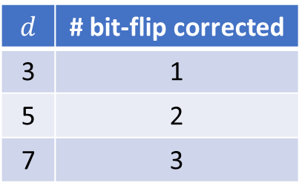
Monte-Carlo simulation of repetition codes
$$d$$ | # bit-flip corrected
3 | 1
5 | 2
7 | 3
$d$ repetitions
encoding
$$x=0 or 1$$
($xx … x$)
Monte-Carlo simulation:
Initialize N = 0.
Repeat 1,000,000 times:
Start with the encoded bit-string (00 … 0).
Flip each bit independently with probability p.
Apply a majority vote decoder.
If the decoded bit is 1, increment N.
Return N / 1,000,000

Slide 7
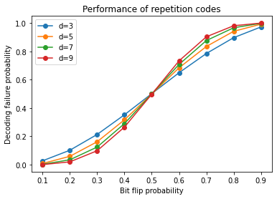
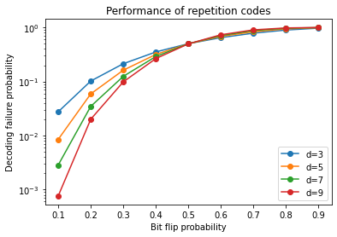
Monte-Carlo simulation of repetition codes
Code threshold = 0.5

Slide 8
Tanner graphs of repetition codes
0
0
0
0
0
0
0
1
0
0
1
1
0
0
Bit nodes
Check nodes
0
0
0
0
0
0
1
0
1
0
1
0
Issue: The repetition code encodes only 1 logical bit.
Solution: Use more general graphs.

Slide 9
Hamming code
Solution: Using general graphs, we can simultaneously:
encode many logical bits
correct many bit-flips
0
1
1
0
1
0
0
Flip
0
0
0
1
0
0

Slide 10
Decoding Hamming code
Lookup table decoder:
Checks | Correction
100 | Flip 4
010 | Flip 6
110 | Flip 2
001 | Flip 7
101 | Flip 3
011 | Flip 5
111 | Flip 1
Flip
1
0
0
Issue: There is no known polynomial time decoding algorithm for general graphs.
Solution: Use sparse graph

Slide 11
Low Density Parity-Check (LDPC) codes
Solution: LDPC codes = codes defined by low degree checks
$x∈{\left\{0,1\right\}}^{n}= x_{1}{ x}_{2}{ x}_{3}$ ${ x}_{4}$ ${ x}_{n}$
$…$
$…$
$$x_{1}+x_{2}+x_{4}=0$$
With sparse graph, we get an efficient decoder.
Basic idea: if $x_{1}+x_{2}+x_{4}=1$ there is only 3 possible bit-flips
=> local decoding.
Gallager – Low-Density Parity-Check codes (1963)

Slide 12
Quantum generalization
Requirements:
Encode many logical qubits,
Correct many Pauli errors,
Efficient decoder,
Fault-tolerant: Can be implemented with very noisy quantum hardware,
=> Quantum LDPC codes

Slide 13
Quantum stabilizer codes
Gottesman – Stabilizer codes and quantum error correction. arxiv:9705052
Calderbank, Rains, Shor, Sloane – Quantum error correction via codes over GF(4). arxiv:9608006

Slide 14

Pauli operators
Ex.
$\left(−i\right)X⊗I⊗Y⊗X$
$ZZZ$
$−X_{1}X_{3}X_{5}X_{7}$
Notation.
$𝒫_{n}$: Set of all $n$-qubit Pauli operators.

Slide 15
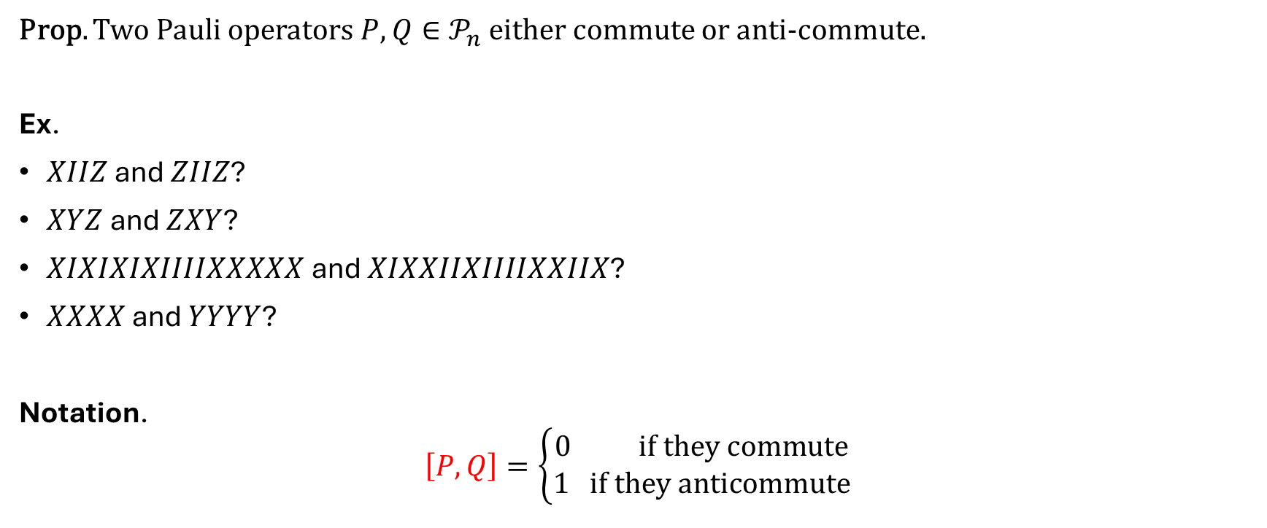
Commutation
Prop. Two Pauli operators $P,Q∈𝒫_{n}$ either commute or anti-commute.
Ex.
$XIIZ$ and $ZIIZ$?
$XYZ$ and $ZXY$?
$XIXIXIXIIIIXXXXX$ and $XIXXIIXIIIIXXIIX$?
$XXXX$ and $YYYY$?
Notation.
$$\left[P, Q\right]=\left\{\begin{aligned}0 if they commute \\ 1 if they anticommute\end{aligned}\right.$$

Slide 16
Stabilizer codes
Def. A stabilizer code is defined to be a subspace $Q\left(S\right)$ of ${\left(ℂ^{2}\right)}^{⊗n}$ fixed by a set $S$ of Pauli operators.
Prop. The set $S$ is a commutative subgroup of $P_{n}$ that does not contain $−I$. Conversely, we can define a stabilizer code for each commutative subgroup of $P_{n}$ that does not contain $−I$.
Remark:
A commutative subgroup of $P_{n}$ that does not contain $−I$ is called a stabilizer group.
The elements of $S$ are called stabilizers.
If $S=⟨S_{1},…,S_{r}⟩$, its generators $S_{i}$ are called stabilizer generators.
Exercise. Prove the proposition.

Slide 17
Stabilizer matrix
Ex. The five-qubit code is defined by the stabilizer matrix:
$$H=\left[\begin{matrix}X & Z & Z & X & I \\ I & X & Z & Z & X \\ X & I & X & Z & Z \\ Z & X & I & X & Z\end{matrix}\right]$$
Exercise. Check that the rows of this matrix generate a stabilizer group.

Slide 18
Number of logical qubits
Def. A set of Pauli operators $\{S_{1},…,S_{r}\}$ is independent if the only product of these operators that is equal to $I$ is the trivial product.
Prop. If $S=⟨S_{1},…,S_{r}⟩$ is generated by $r$ independent generators, then $Q\left(S\right)$ encodes $k≔n−r$ logical qubits, i.e $\dim{Q\left(S\right)}=2^{n−r}$.
Proof. Problem session.
Remark.
$n$ is called the code length.
The code parameters are denoted $[[n, k]]$.

Slide 19
Example
Exercise. Count the number of logical qubits for the following stabilizer codes:
$H=\left[\begin{matrix}X & Z & Z & X & I \\ I & X & Z & Z & X \\ X & I & X & Z & Z \\ Z & X & I & X & Z \\ Z & Z & X & I & X\end{matrix}\right]$
=> [[5, 1]]
$H= \left[\begin{matrix}X & I & X & I & X & I & X \\ I & X & X & I & I & X & X \\ I & I & I & X & X & X & X \\ Z & I & Z & I & Z & I & Z \\ I & Z & Z & I & I & Z & Z \\ I & I & I & Z & Z & Z & Z\end{matrix}\right]$
=> [[7, 1]]
A code with only X type or Z type rows is called a CSS code.

Slide 20
Measurement of the syndrome of an error
Def. Given a stabilizer group $S=⟨S_{1},…,S_{r}⟩,$ the syndrome of a Pauli error $E∈𝒫_{n}$ is the vector $σ\left(E\right)=(σ_{1},..,σ_{r})∈{\left\{0,1\right\}}^{r}$ such that $σ_{i}=[E, S_{i}]$.
Prop. Consider a system in the state $E\left|ψ\right\rangle$ where $\left|ψ\right\rangle ∈Q\left(S\right)$ and $E∈𝒫_{n}$.
The outcome of the measurement of $S_{i}$ is ${\left(−1\right)}^{σ_{i}(E)}$ with probability 1.
The state of the system after measurement is $E\left|ψ\right\rangle$.
Proof. Exercise.
Hint. What is the projector onto the ${\left(−1\right)}^{a}$-eigenspace of $S_{i}$?

Slide 21
Example
Exercise. Consider the stabilizer code:
$$H=\left[\begin{matrix}X & I & X & I & X & I & X \\ I & X & X & I & I & X & X \\ I & I & I & X & X & X & X \\ Z & I & Z & I & Z & I & Z \\ I & Z & Z & I & I & Z & Z \\ I & I & I & Z & Z & Z & Z\end{matrix}\right]$$
What is the syndrome of $X_{1}X_{3}X_{5}X_{7}$? $X_{3}$? $X_{1}X_{2}$?
${σ(X}_{1}X_{3}X_{5}X_{7})=\left(0,0,0,0,0,0\right)$
$σ\left(X_{3}\right) = \left(0,0,0,1,1,0\right)$
$σ\left(X_{1}X_{2}\right) =\left(0,0,0,1,1,0\right)$
Can you find an errors with trivial syndrome? Is it a stabilizer?

Slide 22
Logical basis
Def. A logical error for a stabilizer code is a Pauli error with trivial syndrome.
It is a non-trivial logical error if it is a logical error and not a stabilizer¹.
Prop. For all $[[n, k]]$ stabilizer code, there exists a set of logical error of the form
$$\overline{X_{1}},\overline{Z_{1}},…,\overline{X_{k}}, \overline{Z_{k}}$$
such that
$\left[\overline{X_{i}}\text{, }\overline{Z_{j}}\right]=δ_{i,j}$
$\left[\overline{X_{i}}\text{, }\overline{X_{j}}\right]=\left[\overline{Z_{i}}\text{, }\overline{Z_{j}}\right]=0$
Proof. Exercise.
Hint. Apply on Gram-Schmidt process.
1. up to a phase

Slide 23
Example
$H=\left[\begin{matrix}X & Z & Z & X & I \\ I & X & Z & Z & X \\ X & I & X & Z & Z \\ Z & X & I & X & Z\end{matrix}\right]$
Find a logical basis?
$\overline{X_{1}}=XXXXX$
$\overline{Z_{1}}=ZZZZZ$

Slide 24

Minimum distance
Def. The minimum distance of a stabilizer code, denoted $d$, is the minimum weight of a non-trivial logical error, i.e.
$$d=min\left\{\left|E\right| such that E∈𝒫_{n}\backslash S, σ\left(E\right)=0\right\}$$

Slide 25
Example
Exercise. Compute the parameters of the following codes.
$$H=\left[\begin{matrix}X & I & X & I & X & I & X \\ I & X & X & I & I & X & X \\ I & I & I & X & X & X & X \\ Z & I & Z & I & Z & I & Z \\ I & Z & Z & I & I & Z & Z \\ I & I & I & Z & Z & Z & Z\end{matrix}\right]$$
[[7, 1, 3]]
Remark.
When d is known, the code parameters and are denoted [[n, k, d]].

Slide 26
Decoder
Def. A decoder is a map $D:{\left\{0,1\right\}}^{r}→𝒫_{n}$. We say that the decoder corrects a Pauli error $E$ if the $D\left(σ(E)\right)=E mod S$.
Def. A minimum weight (MW) decoder is a map $D:{\left\{0,1\right\}}^{r}→𝒫_{n}$ such that for all $σ∈{\left\{0,1\right\}}^{r}$, $D(σ)$ is a minimum weight error with syndrome $σ$.
Prop. A MW decoder corrects all Pauli errors $E$ with weight $\left|E\right|≤\frac{d−1}{2}$.
Proof.
Assume that an error E occurs with $\left|E\right|≤\frac{d−1}{2}$.
The decoder returns a correction $E′$ with syndrome $σ\left(E^{′}\right)=σ\left(E\right).$
$σ\left(EE^{′}\right)=σ\left(E\right)+σ\left(E^{′}\right)=0$ and $\left|EE^{′}\right|≤\left|E\right|+\left|E^{′}\right|≤d−1$.
Therefore, $EE^{′}∈S$ and the decoder correct $E$.
In def 1, we ignore the phase of E. Otherwise, we could write $D\left(σ(E)\right)=E mod ⟨±I,S⟩$

Slide 27
Example
How many errors can we correct with the following code?
$$H=\left[\begin{matrix}X & I & X & I & X & I & X \\ I & X & X & I & I & X & X \\ I & I & I & X & X & X & X \\ Z & I & Z & I & Z & I & Z \\ I & Z & Z & I & I & Z & Z \\ I & I & I & Z & Z & Z & Z\end{matrix}\right]$$

Slide 28
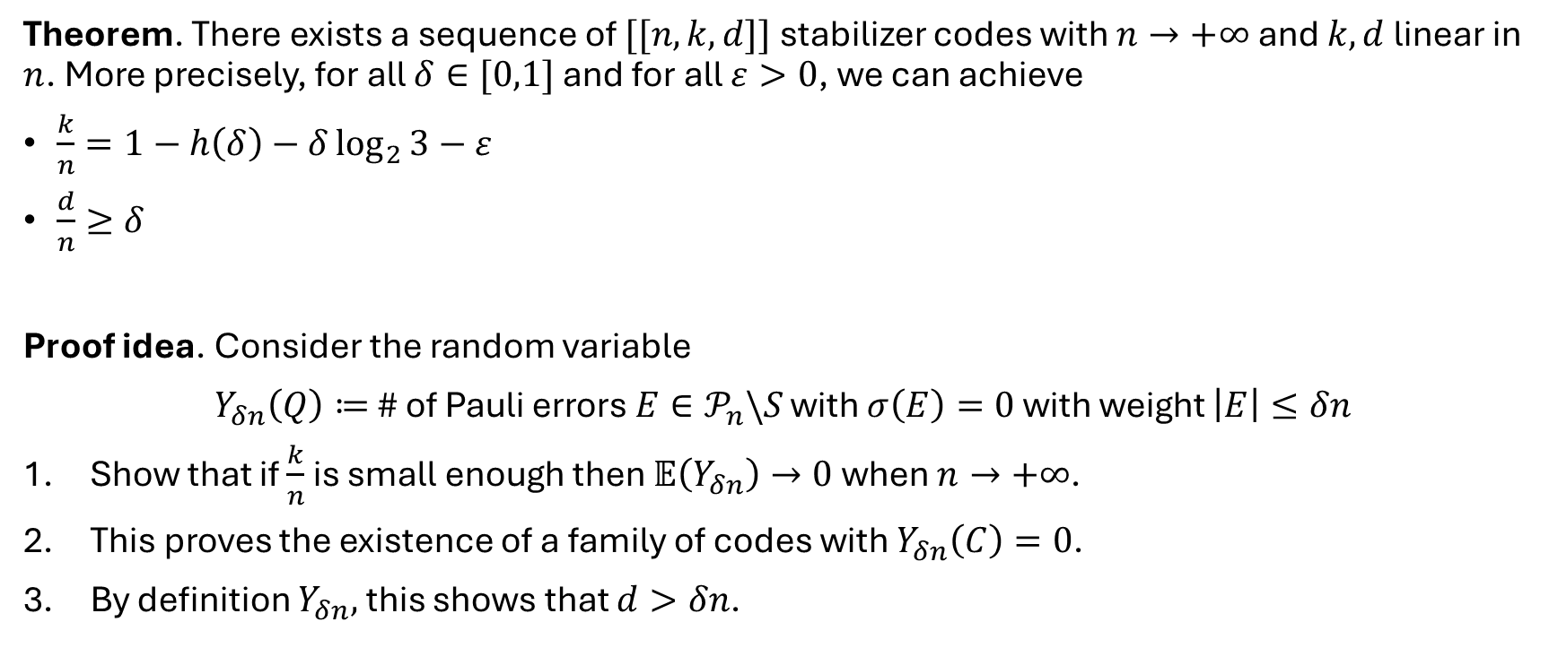
Good stabilizer codes
Theorem. There exists a sequence of $[[n, k,d]]$ stabilizer codes with $n→+∞$ and $k, d$ linear in $n$. More precisely, for all $δ∈[0,1]$ and for all $ε>0$, we can achieve
$\frac{k}{n}=1−h\left(δ\right)−δ\log_{2}{3}−ε$
$\frac{d}{n}≥δ$
Proof idea. Consider the random variable
$Y_{δn}\left(Q\right)≔$ # of Pauli errors $E∈𝒫_{n}\backslash S$ with $σ\left(E\right)=0$ with weight $\left|E\right|≤δn$
Show that if $\frac{k}{n}$ is small enough then $𝔼\left(Y_{δn}\right)→0$ when $n→+∞$.
This proves the existence of a family of codes with $Y_{δn}\left(C\right)=0$.
By definition $Y_{δn},$ this shows that $d>δn$.
Calderbank, Shor – Good quantum error correcting codes exist. arxiv:9512032

Slide 29
Lemmas – Counting stabilizer codes
A stabilizer group for a $[[n, k]]$ stabilizer code is of the form $S=⟨S_{1},…,S_{n−k}⟩$.
Lemma. The number of $[[n, k]]$ stabilizer code is
$$2^{n−k}\prod_{i=0,…, n−k−1}{\frac{\left(2^{2n−i}−2^{i}\right)}{\left(2^{n−k}−2^{i}\right)}}$$
Proof. # stabilizer codes = $\frac{\text{\# }\text{sets} \text{of} \text{n}\text{−}\text{k} \text{independent} \text{stabilizer} \text{generators}}{\text{\#} \text{generating} \text{sets} \text{of} \text{a} \text{fixed} \text{stabilizer} \text{group}}$
$2^{n−k}$ = # choices for the phase $±1$ of each $S_{i}$
# choices for the 1st generator = $2^{2n}−1.$
# choices for the 2nd generator = $2^{2n−1}−2$.
# choices for the 2nd generator = $2^{2n−2}−4$.
…
=> $\text{\# }\text{generating} \text{set} \text{of} \text{n}\text{−}\text{k} \text{independent} \text{stabilizer} \text{generators}$ = $\frac{2^{n−k}\prod_{i=0,…, n−k−1}{\left(2^{2n−i}−2^{i}\right)}}{\left(n−k\right)!}$
$\text{\#} \text{generating} \text{sets} \text{of}$ $⟨S_{1},…,S_{n−k}⟩$ = $\frac{\prod_{i=0,…, n−k−1}{\left(2^{n−k}−2^{i}\right)}}{\left(n−k\right)!}$

Slide 30
Lemmas – Counting stabilizer codes
Lemma. The number of $[[n, k]]$ stabilizer code is
$$2^{n−k}\prod_{i=0,…, n−k−1}{\frac{\left(2^{2n−i}−2^{i}\right)}{\left(2^{n−k}−2^{i}\right)}}$$
Lemma. Let $E≠I$. The number of $[\left[n, k\right]]$ stabilizer group such that $σ\left(E\right)=0$ is
$$2^{n−k}\prod_{i=0,…, n−k−1}{\frac{\left(2^{2n−i−1}−2^{i}\right)}{\left(2^{n−k}−2^{i}\right)}}$$
Proof. Similar.

Slide 31

Good stabilizer codes - Proof
Proof. We can write $Y_{δn}\left(Q\right)$ as
$$Y_{δn}\left(Q\right)=\sum_{\begin{aligned}E∈𝒫_{n}\backslash S \\ \left|E\right|≤δn\end{aligned}}{X_{E}\left(Q\right)}$$
where
$$X_{E}\left(Q\right)=\left\{\begin{aligned}0 if σ\left(E\right)≠0 \\ 1 if σ\left(E\right)=0\end{aligned}\right.$$
By linearity of the expectation, we have
$$𝔼(Y_{δn})=\sum_{\begin{aligned}E∈𝒫_{n}\backslash S \\ \left|E\right|≤δn\end{aligned}}{𝔼\left(X_{E}\left(Q\right)\right)}$$
Moreover, $𝔼\left(X_{E}\left(Q\right)\right)=ℙ(σ\left(E\right)=0)$.

Slide 32
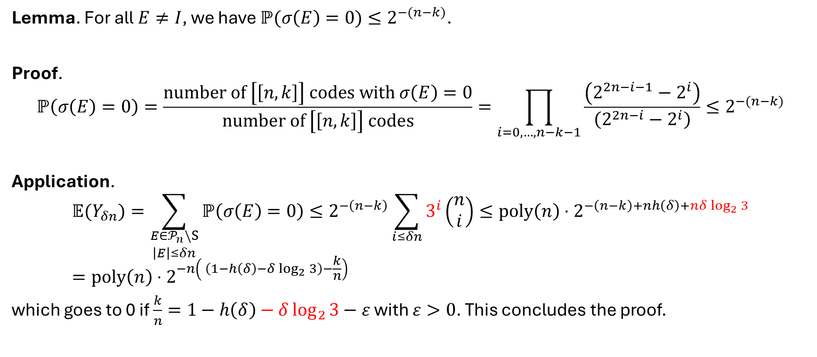
Good stabilizer codes - Proof
Lemma. For all $E≠I$, we have $ℙ(σ\left(E\right)=0)≤2^{−(n−k)}$.
Proof.
$$ℙ\left(σ\left(E\right)=0\right)=\frac{number of \left[\left[n, k\right]\right] codes with σ\left(E\right)=0}{number of \left[\left[n, k\right]\right] codes}=\prod_{i=0,…, n−k−1}{\frac{\left(2^{2n−i−1}−2^{i}\right)}{\left(2^{2n−i}−2^{i}\right)}}≤2^{−(n−k)}$$
Application.
$$𝔼(Y_{δn})=\sum_{\begin{aligned}E∈𝒫_{n}\backslash S \\ \left|E\right|≤δn\end{aligned}}{ℙ\left(σ\left(E\right)=0\right)}≤2^{−\left(n−k\right)}\sum_{i≤δn}{3^{i}\left(\begin{aligned}n \\ i\end{aligned}\right)}≤poly{\left(n\right)⋅2}^{−\left(n−k\right)+nh\left(δ\right)+nδ\log_{2}{3}}=poly{\left(n\right)⋅2}^{−n\left( \left(1−h\left(δ\right)−δ\log_{2}{3}\right)−\frac{k}{n}\right)}$$
which goes to 0 if $\frac{k}{n}=1−h\left(δ\right)−δ\log_{2}{3}−ε$ with $ε>0$. This concludes the proof.

Slide 33
Example of LDPC codes

Slide 34
Example – Kitaev’s toric code
Consider a cellulation of the torus.
Place a qubit on each edge.
Define a X generator for each vertex.
Define a Z generator for each face.
Z
Z
Z
X
Z
X
X
X
Kitaev –Fault-tolerant quantum computation by anyons. arxiv:9707021

Slide 35
Example - 3D toric code
Consider a cellulation of a 3-dim manifold.
Place a qubit on each face.
Define a X generator for each edge.
Define a Z generator for each 3-cell.
Or
Place a qubit on each edge.
Define a X generator for each vertex.
Define a Z generator for each face.

Slide 36
Example – Hypergraph product code
Consider two bipartite graph.
Take their cartesian product.
Place a qubit on each circle-circle.
Place a qubit on each square-square.
Define a X generator for each square-circle.
Define a Z generator for each circle-square.
What is n?
n=11
What is the first stabilizer generator?
III XII XII XI
X
Z
Z
Z
X
X
Z
Tillich, Zémor – Quantum LDPC codes with positive rate and minimum distance proportional to $n^{1/2}$. arxiv:0903.0566

Slide 37
Comparison of the parameters
Code | $$k$$ | $$d$$
2D toric codes | constant | $$∝\sqrt{n}$$
3D toric codes | constant | $$∝n^{1/3}$$
HGP codes | $$∝n$$ | $$∝\sqrt{n}$$

Slide 38
Hypergraph Product (HGP) Codes
Tillich, Zémor – Quantum LDPC codes with positive rate and minimum distance proportional to $n^{1/2}$. arxiv:0903.0566

Slide 39
Linear code and transposed code
Linear code parameters $[n, k, d]$
$n$ = # bits,
$r$ = # checks
$k=\dim{C}$
$d=\min\left\{\left|x\right|, x∈C, x≠0\right\}$
is the minimum distance.
Transposed code with parameters $[n^{T}, k^{T}, d^{T}]$
$n^{T}=r$
$r^{T}=n$
$k^{T}=k−n+r$

Slide 40
Parameters of HGP codes
Theorem. For HGP($C_{1}$, $C_{2}$) codes, we have
${n=n_{1}n}_{2}+r_{1}r_{2}$
$k=k_{1}k_{2}+k_{1}^{T}k_{2}^{T}$
$d≥\min\left(d_{1},d_{2},d_{1}^{T},d_{2}^{T}\right)$
If $k_{1}>0$, then $d≤d_{2}$
If $k_{1}^{T}>0$, then $d≤d_{2}^{T}$
By selected random sparse graph we can achieve $k∝n$ and $d∝\sqrt{n}$.

