Slide 1
Quantum LDPC codes Lecture 4
Nicolas Delfosse
Microsoft
PCMI Summer School 2023
July 28th 2023

Slide 2
Overview
Brief overview of quantum Tanner code
Conclusion:
Should we abandon surface codes?

Slide 3
Quantum Tanner codes

Slide 4
Some constructions of QLDPC codes
Topological codes:
1997: Kitaev. $d∝\sqrt{n}$ but $k=1$.
2002: Freedman, Meyer, Luo $d∝\sqrt{n\sqrt{\log{n}}}$
2009: Bravyi, Poulin, Terhal bound: ${kd}^{2}≤constant×n$
Hypergraph-product codes and generalizations:
2009: Tillich, Zémor. HGP $d∝\sqrt{n}$ with $k∝n$
2013: Bravyi, Hastings. Homological products $d, k∝n$ but weights $∝\sqrt{n}$
2020: Hastings, Haah, O’Donnell: Fiber bundle codes $d∝\frac{n^{\frac{3}{5}}}{polylog}$
2020: Panteleev, Kalachev: Lifted products $d∝\frac{n^{1−ε}}{\log{n}}$
2020: Breuckmann and Eberhardt: Balanced products $d∝n^{\frac{3}{5}}$

Slide 5
Good LDPC codes
Good LDPC codes:
2021: Panteleev and Kalachev. Good QLDPC codes
2021: Dinur, Evra, Livne, Lubotzky, and Mozes. LTC codes
2022: Leverrier, Zémor
Linear-time decoders for good quantum LDPC codes:
2022: Gu, Pattison, Tang
2022: Dinur, Hsieh, Lin, VIdick
2022: Leverrier, Zémor

Slide 6
Left-Right Cayley Complex
$$\left(a_{2}gb_{1}, 0\right)$$
Input:
A finite group $G$
Two subsets $A, B$ of $G$ such that $A^{−1}=A$ and $B^{−1}=B$.
Output:
A complex $X=(V, E, F)$ where:
$V=V_{0}∪V_{1}$ where $V_{i}=G×\left\{i\right\}$
$E=E_{A}∪E_{B}$ where $E_{A}=\{\left(g, 0\right), (ag,1)\}$ and $E_{B}=\{\left(g, 0\right), (gb,1)\}$
$F=$ set of squares $f\left(g,a,b\right)≔\left\{\left(g,0\right), \left(ag,1\right),\left(gb,1\right),(agb,0)\right\}$
$$\left(a_{1}gb_{1}, 0\right)$$
$$⋮$$
$$\left(a_{2}g, 1\right)$$
$$\left(a_{1}g, 1\right)$$
$$\left(g, 0\right)$$
$$\left(gb_{1}, 1\right)$$
$$\left(gb_{2}, 1\right)$$
$$⋮$$

Slide 7
Local structure
$$\left(gb, 1\right)$$
$$\left(agb, 0\right)$$
$G=\left\{g_{1},g_{2},…\right\}$
$A=\left\{a_{1},a_{2},…\right\}⊆G$
$B=\left\{b_{1},b_{2},…\right\}⊆G$
$$\left(g, 0\right)$$
$$\left(ag, 1\right)$$
Type A edge:
$$a×⋅$$
$$V=$$
$$⋮$$
$$⋮$$
Type B edge:
$$⋅×b$$
$$G×\{0\}$$
$$G×\{1\}$$

Slide 8
Neighborhood of a vertex
Consider $v=\left(g, 0\right)$
Neighboring vertices: $\left(ag, 1\right)$ with $a∈A$ and $\left(gb, 1\right)$ for $b∈B$
Neighboring faces: $\left\{\left(g,0\right), \left(ag,1\right),\left(gb,1\right),(agb,0)\right\}$ for each pair $\left(a, b\right)∈A×B$.
Abstract representation the faces neighboring $v$:
$$A$$
$$F\left(v\right)=A×B=$$
$$B$$

Slide 9
Intersection of two neighborhoods
$$\left(gb, 1\right)$$
$$\left(agb, 0\right)$$
Question. What is $F\left(v\right)∩F(v^{′})$ for two vertices $v=\left(g,0\right)$ and $v′=\left(g′,1\right)$?
If $F\left(v\right)∩F\left(v^{′}\right)≠∅$, then $v$ and $v^{′}$ must share an edge.
Why?
If they share a type A edge: $v=\left(g,0\right)$ and $v′=\left(ag,1\right)$
Then $F\left(v\right)∩F\left(v^{′}\right)$ is the set of faces:
$\left\{\left(g,0\right), \left(ag,1\right),\left(gb,1\right),(agb,0)\right\}$ for $b∈B$
If they share a type B edge:
$$\left(g, 0\right)$$
$$\left(ag, 1\right)$$
$$A$$
$$B$$
$$F\left(v\right)∩F\left(v^{′}\right)=B=$$

Slide 10
Tensor codes of two classical codes
Def. A codeword of $C_{1}⊗C_{2}$ is bitstring forming a $n_{1}×n_{2}$ matrix $x$ such that
each column of $x$ is in $C_{1}$,
each row of $x$ is in $C_{2}$,
Ex.
is in the product of the Hamming code and the 3-repetition code.
Prop. The code $C_{1}⊗C_{2}$ has parameters $[n_{1}n_{2}, k_{1}k_{2}]$.
0
1
1
0
1
0
0
0
1
1
0
1
0
0
0
1
1
0
1
0
0
0
1
1
0
1
0
0

Slide 11
Definition of quantum Tanner codes
Select a finite group $G$.
Select $A, B⊆G$ such that $A^{−1}=A$ and $B^{−1}=B$.
Select two codes $C_{A}$ and $C_{B}$ with length $\left|A\right|$ and $\left|B\right|$.
Place a qubit on each face of the left-right Cayley complex $(V,E,F)$
For each $v=\left(g,0\right)$, for each $c∈C_{A}⊗C_{B}$, define a X generator on $F(v)$ acting on the support of $c$.
For each $v=\left(g,1\right)$, for each $c∈C_{A}^{⊥}⊗C_{B}^{⊥}$, define a Z generator on $F(v)$ acting on the support of $c$.
Prop. The generators commute because $F\left(v\right)∩F\left(v^{′}\right)$ is either empty, or a row of $F\left(v\right)$ or a column of $F\left(v\right)$.
$$A$$
$$F(v)=$$
$$B$$
The sets $G, A, B$ must satisfy the TNC condition for all $a, g, b$: $ag≠gb$

Slide 12
Example of Cayley graphs
$G=ℤ,$
$A=\{±1\}$
-2
-1
0
1
2

Slide 13
Example of Cayley graphs
$G=ℤ^{2}, A=\{\left(±1,0\right), (0,±1)\}$
$G=ℤ^{2}, A=\{\left(±1,0\right), \left(0,±1\right), (±1,±1)\}$
$G=ℤ_{8}, A=\{±3\}$
Why do we need $A=A^{−1}$?

Slide 14
Double cover of a Cayley graph
It is the graph with
$V =V_{0}∪V_{1}$ with $V_{0}=G×\{0\}$ and $V_{1}=G×\{1\}$
Two types of edges: $\{\left(g,0\right), \left(ag, 1\right)\}$ and $\{\left(g,1\right), \left(ag, 0\right)\}$
Ex. $G=ℤ, A=\{±2\}$
$$G×\left\{0\right\}=$$
$$G×\left\{1\right\}=$$

Slide 15
Example
$$G=ℤ_{6}, A=\left\{±1\right\}, B=\left\{±2\right\}$$
0
0
1
1
0
2
2
3
3
1
4
4
2
3
5
5
$$G×\{0\}$$
$$G×\{1\}$$
A square

Slide 16
Example - $G=ℤ_{9}$
$$G=ℤ_{9}, A=\left\{±1\right\}, B=\left\{±2\right\}$$
(6,1)
Type A edge:
(3,1)
(4,0)
(5,1)
$$(+1,flip)$$
(2,1)
(0,1)
(1,0)
(2,1)
(3,0)
(4,1)
$$(−1, flip)$$
(8,1)
(0,0)
(1,1)
(6,1)
(7,0)
(8,1)
(0,0)
(1,1)
(2,0)
(3,1)
Type B edge:
(7,1)
(5,1)
(6,0)
(7,1)
(8,0)
(0,1)
(4,1)
(5,0)
(6,1)
(3,1)
$$(+2,flip)$$
$$(−2,flip)$$
What is this shape?

Slide 17
Example - $G=ℤ_{3}×ℤ_{3}$
$$G=ℤ_{3}×ℤ_{3}, A=\left\{(±1,0)\right\}, B=\left\{(0,±1)\right\}$$
Type A edge:
(0,0,1)
$$(+1,0,flip)$$
(2,1,1)
(0,1,0)
(1,1,1)
$$(−1,0,flip)$$
(0,2,1)
(1,2,1)
(2,2,0)
(0,2,1)
(1,2,0)
(2,2,1)
(2,0,1)
(0,0,0)
(1,0,1)
(0,0,0)
(0,0,1)
(1,0,0)
(2,0,1)
(0,0,0)
(1,0,1)
(2,0,0)
(0,0,1)
Type B edge:
(0,1,1)
(1,1,1)
(2,1,0)
(0,1,1)
(1,1,0)
(2,1,1)
(2,2,1)
(0,2,0)
(1,2,1)
(0,0,1)
$$(+1,0,flip)$$
$$(−1,0,flip)$$

Slide 18
Example - $G=ℤ_{3}×ℤ_{3}$
Construction:
Qubits are on faces
For $v=\left(g,0\right)$, $c∈C_{A}⊗C_{B}$, define a X generator on $F(v)$ acting on the support of $c$.
For $v=\left(g,1\right)$, $c∈C_{A}^{⊥}⊗C_{B}^{⊥}$, define a Z generator on $F(v)$ acting on the support of $c$.
(0,0,1)
(2,1,1)
(0,1,0)
(1,1,1)
$=\left(g, 0\right)=$ X stabilizer generators
(1,2,1)
(2,2,0)
(0,2,1)
(1,2,0)
(2,2,1)
Z
Z
$$F\left(v\right)=A×B=$$
X
X
(0,0,1)
(1,0,0)
(2,0,1)
(0,0,0)
(1,0,1)
(2,0,0)
(0,0,1)
Z
Z
X
X
(1,1,1)
(2,1,0)
(0,1,1)
(1,1,0)
(2,1,1)
We need to a tensor code $C_{A}⊗C_{B}$ on $A×B:$
$$⇒C_{A}=C_{B}=\left\{00, 11\right\}$$
(2,2,1)
(0,2,0)
(1,2,1)
$$C_{A}⊗C_{B}=$$
0
0
1
1
0
0
1
1
(0,0,1)
X
X
$⇒$ X stabilizer generator:
X
X
We recover the toric code.

Slide 19
How to get good LDPC codes
Take:
$G={PSL}_{2}\left(q^{i}\right)$
$C_{A}=random code$
$C_{B}=random code$
This leads to a family of good quantum LDPC codes.
Question: Should we replace HGP codes in our scheme by good quantum LDPC codes?
We need explicit construction (remove the randomness).
We need small examples (n=O(10,000)) with better parameters than HGP codes.

Slide 20
Conclusion

Slide 21
Overview of the whole scheme
code
Syndrome extraction circuit
X syndrome of E
0
1
1
Pauli error E
$$\left|ψ\right\rangle ∈stabilizer code$$
Correction of E
Decoder
$$E\left|ψ\right\rangle$$
Syndrome extraction circuit
1
0
1
Z syndrome of E
circuit
layout

Slide 22
Overview of the whole scheme
code
circuit
decoder
layout
Select two random Tanner graphs with
4s bits with degree 3.
3s checks with degree 4.
girth $≥8$
Construct their HGP.
Estimate the performance of the HGP code using the SSF decoder.
Select the best HGP code out of 50 – 1000 samples.
[Follows Grospellier, Krishna 2018]
Compute the Tanner graph T of the code.
Compute an edge coloration of T
Construct the color-based syndrome extraction circuit.
Compute a layered decomposition of the Tanner graph.
Compute an edge coloration of T
Construct the color-based syndrome extraction circuit.
We use BP for decoding in a single shot manner.
We estimate the logical error rate over 10 rounds of syndrome extraction.
To check if a logical error occurs, we use SSF decoder to correct the residual error.
[SSF decoder from
Leverrier, Tillich, Zémor - arXiv:1504.00822 (2015)]

Slide 23
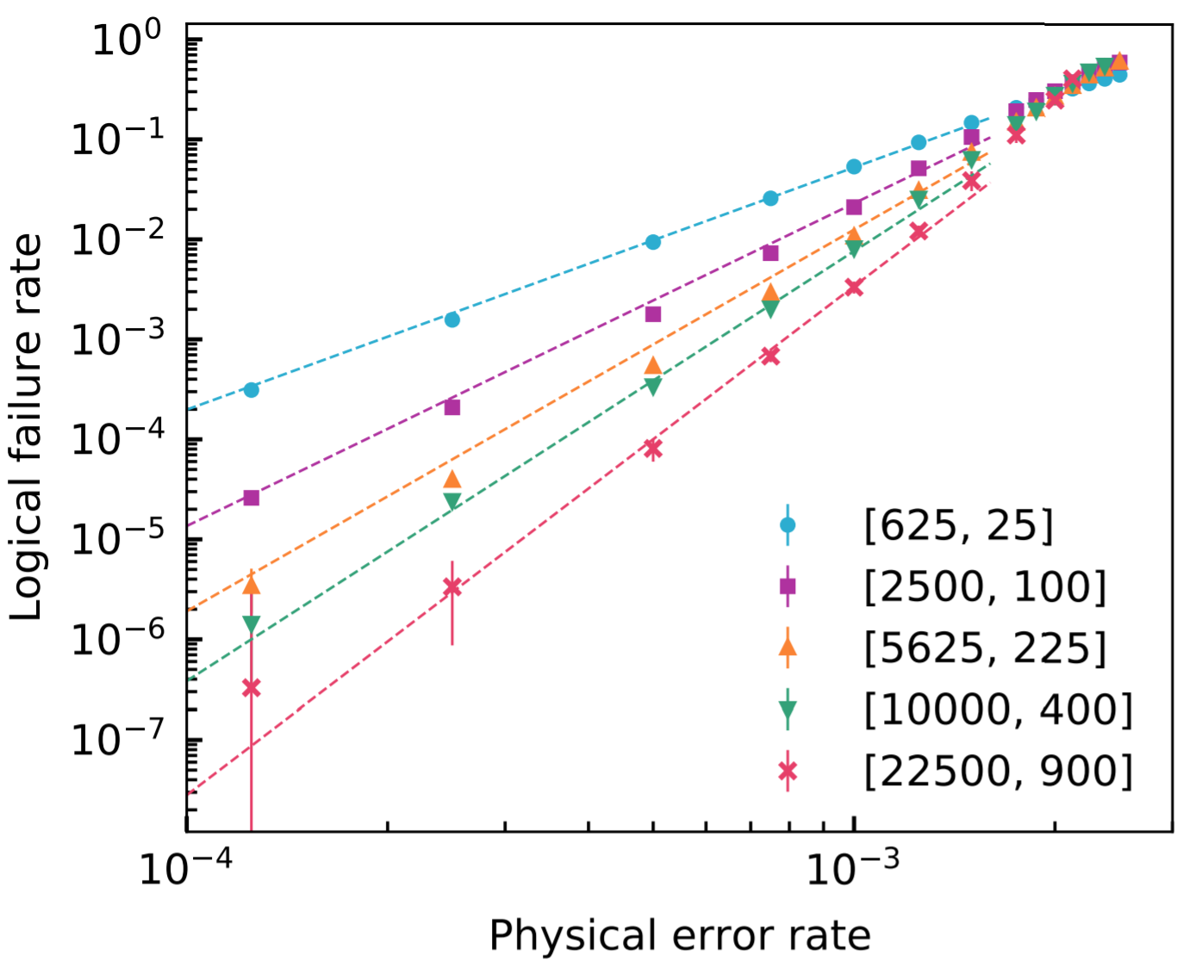
Numerical results
Noise threshold:
0.28% (instead of 0.7% for surface codes)
# physical qubits per logical qubit:
49 (instead of thousands for surface codes)
Tremblay, Delfosse, Beverland – Constant overhead quantum error correction with thin plan connectivity. arxiv:2109.14609

Slide 24
Is our scheme fault-tolerant?
X
Z
$E\left|ψ\right\rangle$
Z
Z
Syndrome extraction:
What is this circuit?
Are there ‘bad’ faults for this circuit?
What is the effect of a X fault on the ancilla qubit?
Can we avoid that?
Should we avoid that?
Decoder:
BP corrects each qubits independently based on marginal probability. Is it a problem?
The decoder uses noisy syndrome data. Is it a problem?
Conclusion:
Practical FT $≠$ Theoretical FT
X
X
$$|+>$$
X
X
X
X
Z
$$E|ψ⟩$$
Z
X
$$\left|0000\right\rangle +|1111⟩$$

Slide 25
What could be improved?
code
Improve the code:
linear distance,
reduced code length,
denser family.
Improve the circuit:
the circuit is not FT (reduced distance).
Improve the decoder:
better logical error rate,
linear complexity,
hardware optimization.
Improve the simulation:
Refine the numerical estimate of the logical error rate.
Simulate longer lifetime.
circuit
layout
decoder

Slide 26
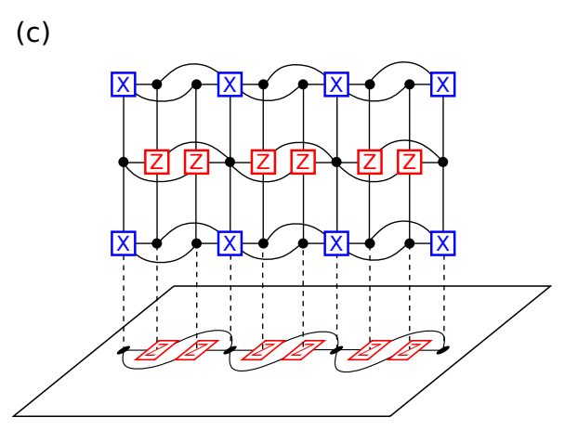
What about computation?
2013: Gottesman - Fault-Tolerant Quantum Computation with constant overhead.
Other proposals for fault-tolerant logical gates in QLDPC codes^{1,2, 3, 4}.
1. Jochym-O’Connor, arxiv:1807.09783
2. Krishna, Poulin, arxiv:1909.07424
3. Cohen, Kim, Bartlett, Brown, arxiv: 2110.10794
4. Breuckmann, Burton, arxiv:2202.06647
Figure from ref 3.

Slide 27
What could go wrong with this approach?
Noise could be correlated.
Noise could be non-Pauli.
The blocks could be too big ($n=900,000$).
The decoder could be too slow.
Fault-tolerant operations may be expensive.
We may be unable to build sufficiently reliable hardware (need $p={10}^{4}$).
We may be unable to build the required long-range connections.
We may need too many long-range connections.
Building insulated layers of long-range connections may be challenging.

Slide 28
Other encoding strategies
Surface codes
Hyperbolic codes:
Higgott, Breuckmann (2020)
Breuckmann, Vuillot, Campbell, Krishna, Terhal (2017)
Floquet codes:
Haah, Hastings (2021)
Spacetime codes:
Delfosse, Paetznick (2023)

