Slide 1
Quantum LDPC codes Lecture 2
Nicolas Delfosse
Microsoft
PCMI Summer School 2023
July 25th 2023

Slide 2
Overview of lecture 2
Examples of quantum LDPC codes
Syndrome extraction circuits for surface codes
Syndrome extraction circuits for LDPC codes
Performance of QLDPC codes

Slide 3
Classical and quantum Hamming codes
Quantum codes detect X errors and Z errors:
Classical code detect bit flips:
0
1
1
Measure
$$X_{1}X_{3}X_{5}X_{7}$$
Flip
X
Z
1
0
0
1
0
1
$$x_{1}+x_{2}+x_{3}+x_{4}$$
Measure
$$Z_{1}Z_{2}Z_{3}Z_{4}$$

Slide 4
Design flow
Pick a cellulation
Kitaev
Only used to define the code
Define qubits and stabilizer generators
Build the Tanner graph
Pick a pair of Tanner graph
HGP

Slide 5
The rotated surface code
Bravyi, Kitaev – Quantum code on a lattice with boundary. arxiv:9811052
Freedman, Meyer – Projective plane and planar quantum codes. arxiv:9810055

Slide 6
Planar cellulation
Instead of a torus, we consider a planar region:
No identification of the opposite side.
Rotate the square grid.
Remove top and bottom vertices

Slide 7
Definition of the rotated surface code
We use Kitaev’s construction with the rotated planar cellulation:
Place a qubit on each edge.
Define a X stabilizer generator for each vertex.
Define a Z stabilize generator for each face.
Remark.
The boundary vertices and faces define weight-2 generators.
X
X
X
X
Z
Z
Z
Z

Slide 8
Tanner graphs of the rotated surface code
$$=$$
3 x 3 surface code
Corrects 1 error
5 x 5 surface code
Corrects 2 errors
5 x 5 surface code
Alternative representation
The problem with surface codes: The encode only 1 logical qubit.

Slide 9
Hypergraph Product (HGP) Codes
Tillich, Zémor – Quantum LDPC codes with positive rate and minimum distance proportional to $n^{1/2}$. arxiv:0903.0566

Slide 10
Example – Hypergraph product code
Consider two bipartite graph.
Take their cartesian product.
Place a qubit on each circle-circle.
Place a qubit on each square-square.
Define a X generator for each square-circle.
Define a Z generator for each circle-square.
What is n?
n=11
What is the first stabilizer generator?
III XII XII XI
X
Z
Z
Z
X
X
Z

Slide 11
Linear code and transposed code
Linear code parameters $[n, k, d]$
$n$ = # bits,
$r$ = # checks
$k=\dim{C}$
$d=\min\left\{\left|x\right|, x∈C, x≠0\right\}$
is the minimum distance.
Transposed code with parameters $[n^{T}, k^{T}, d^{T}]$
$n^{T}=r$
$r^{T}=n$
$k^{T}=k−n+r$

Slide 12
Parameters of HGP codes
Theorem. For HGP($C_{1}$, $C_{2}$) codes, we have
${n=n_{1}n}_{2}+r_{1}r_{2}$
$k=k_{1}k_{2}+k_{1}^{T}k_{2}^{T}$
$d≥\min\left(d_{1},d_{2},d_{1}^{T},d_{2}^{T}\right)$
If $k_{1}>0$, then $d≤d_{2}$
If $k_{1}^{T}>0$, then $d≤d_{2}^{T}$
By selected random sparse graph we can achieve $k∝n$ and $d∝\sqrt{n}$.

Slide 13
A family of LDPC codes with constant rate
Select two random Tanner graphs with
4s bits with degree 3.
3s checks with degree 4.
We get HGP codes with
$n=25s^{2}$
$k=s^{2}$
Generator degree $=7$
Qubit degree $=$ 6 or 8
We also impose girth $≥8$ and we select the best code out of 50 – 1000 samples.

Slide 14
Surface codes vs LDPC codes
Code | Surface codes | LDPC codes
# logical qubits k | $$1$$ | $$\frac{n}{25}$$
Measurement weight | $$4$$ | $$7$$
# ancilla qubits | $$n$$ | ?

Slide 15
Syndrome extraction circuits

Slide 16
Classical vs Quantum error correction
Bit flips
0
1
1
1
1
0
0
0
1
1
0
1
0
0
Correction
Highly reliable classical machine
0
0
0
1
0
0

Slide 17
Classical vs Quantum error correction
Highly reliable Quantum machine
0
1
1
Pauli error E
$$\left|ψ\right\rangle ∈stabilizer code$$
$$E\left|ψ\right\rangle$$
Correction
Highly reliable Quantum machine
What is the issue?
Reliable quantum machines do not exist.
Instead, we use additional noisy qubits.
1
0
1

Slide 18
Measurement of a X check
$$|+>$$

Slide 19
Standard Pauli noise models
Perfect measurement model:
Noise on data qubits
Phenomenological model:
Noise on data qubits
Noise on measurements
Circuit noise:
Noise on data qubits
Noise on measurements
Noise on ancilla qubits
Noise on gates
Noise on waiting qubits
$$|+>$$
Dennis, Kitaev, Landhal, Preskill – Topological quantum memory. arxiv:0110143

Slide 20
The problem with high random stabilizer codes
Question.
Can we use this noisy circuit with random stabilizer codes?
Strategy:
Suppose that we have 1000 qubits.
Pick a random [[1000, 500]] stabilizer code.
Measure the 500 stabilizers generators.
$$|+>$$

Slide 21
Syndrome extraction circuits for surface codes

Slide 22
Syndrome extraction circuit
$$|+>$$
$$|+>$$
$$|+>$$
$$|+>$$
Z
Z
flip
$$|+>$$
$$|+>$$
$$|+>$$
$$|+>$$
X plaquette circuit
$$|+>$$

Slide 23
Surface codes
25x25 surface code:
Physical error rate: ${10}^{−3}⇒$ Logical error rate: ${10}^{−12}$
Why surface codes?
High noise threshold (about 1%).
Implemented with 2D local gates.
Main issue:
Thousands of physical qubits per logical qubit.
Here: 1250 physical qubits
Dennis, Kitaev, Landhal, Preskill – Topological quantum memory. arxiv:0110143
Raussendorf, Harrington – Fault-Tolerant quantum computation with high threshold in two dimensions. arxiv:0610082
Fowler, Mariantoni, Martinis, Cleland – Surface code: Toward practical large-scale quantum computation. arxiv:1208.0928

Slide 24
Syndrome extraction circuits for LDPC codes

Slide 25
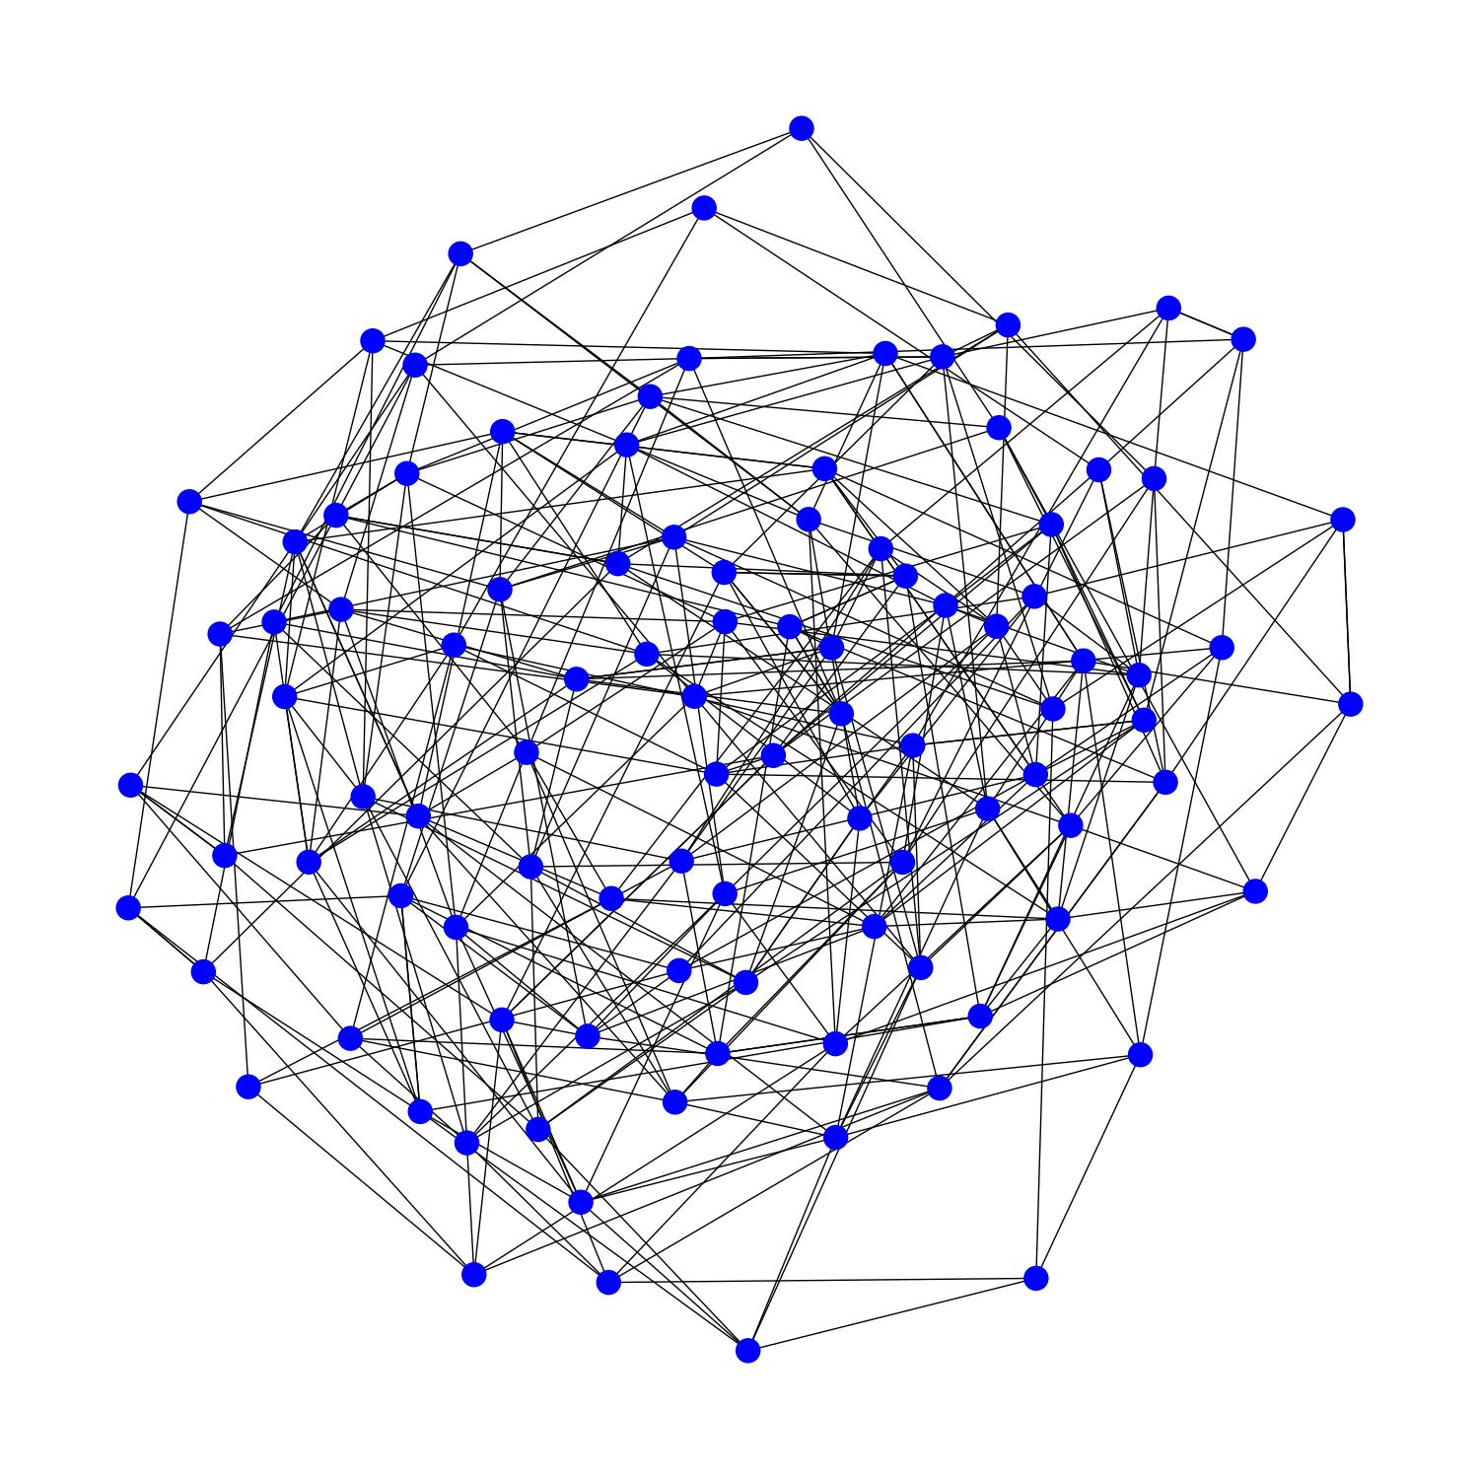
Can we implement quantum LDPC codes?
Typical LDPC code
Typical quantum computer

Slide 26
Main results
With 2D local gates¹:
Need large depth circuits or many ancilla qubits.
Numerically: poor performance.
With long-range connections²:
Layout based on only a few planar layers.
Numerically outperform surface codes.
1. Delfosse, Beverland, Tremblay – Bounds on stabilizer measurement circuits and obstruction to local implementations of quantum LDPC codes. arxiv2109.14599
2. Tremblay, Delfosse, Beverland – Constant overhead quantum error correction with thin plan connectivity. arxiv:2109.14609

Slide 27
Bounds on syndrome extraction circuits
For surface codes: depth = 6.
Theorem¹. (informal) For quantum LDPC codes² implemented with 2D local gates:
depth $≥constant×\frac{n}{\sqrt{q}}$
where q = total number of qubit used.
 | Constant depth | Constant qubit overhead
Bound | # ancilla $≥constant× n^{2}$ | Depth $≥constant×\sqrt{n}$
Saturating circuit | Switch-based circuit (next slide) | HGP code circuit
Delfosse, Beverland, Tremblay – Bounds on stabilizer measurement circuits and obstruction to local implementations of quantum LDPC codes. arxiv2109.14599
Proved for constant rate QLDPC codes with some form of local expansion.

Slide 28
2D local circuits
Delfosse, Beverland, Tremblay – Bounds on stabilizer measurement circuits and obstruction to local implementations of quantum LDPC codes. arxiv2109.14599

Slide 29
Simultaneous measurement of all the X checks
Construct an edge coloration
Prepare a readout qubits in $|+⟩$ for each check.
For each color c do:
Apply a CNOT on each edge with color c
Measure readout qubits in the X basis.
$$|+>$$
$$|+>$$
$$|+>$$

Slide 30
Switch-based circuit
3
4
5
1
6
2
7
3 4 1 5 2 6 7
3 1 4 2 5 6 7
1 3 2 4 5 6 7
1 2 3 4 5 6 7
1 2 3 4 5 6 7
Bell
1 2 3 4 5 6 7
Bell
1
2
3

Slide 31
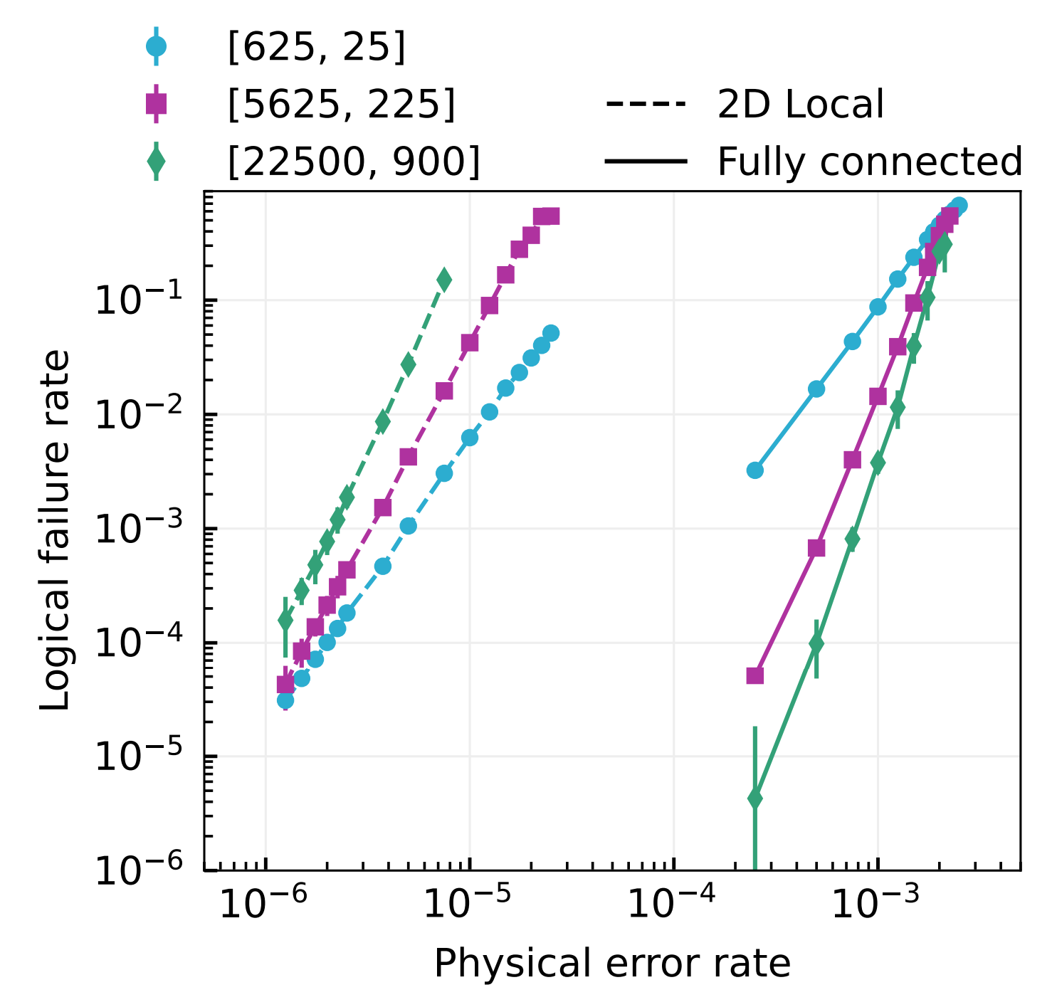
2D local vs fully connected implementation
With fully connected qubits:
# ancillas:$O(n)$
depth: $O\left(1\right)$
With 2D local gates:
# ancilla qubits: $O(n)$
Depth $O(\sqrt{n})$
Cost of locality

Slide 32
With long-range gates
Tremblay, Delfosse, Beverland – Constant overhead quantum error correction with thin plan connectivity. arxiv:2109.14609

Slide 33
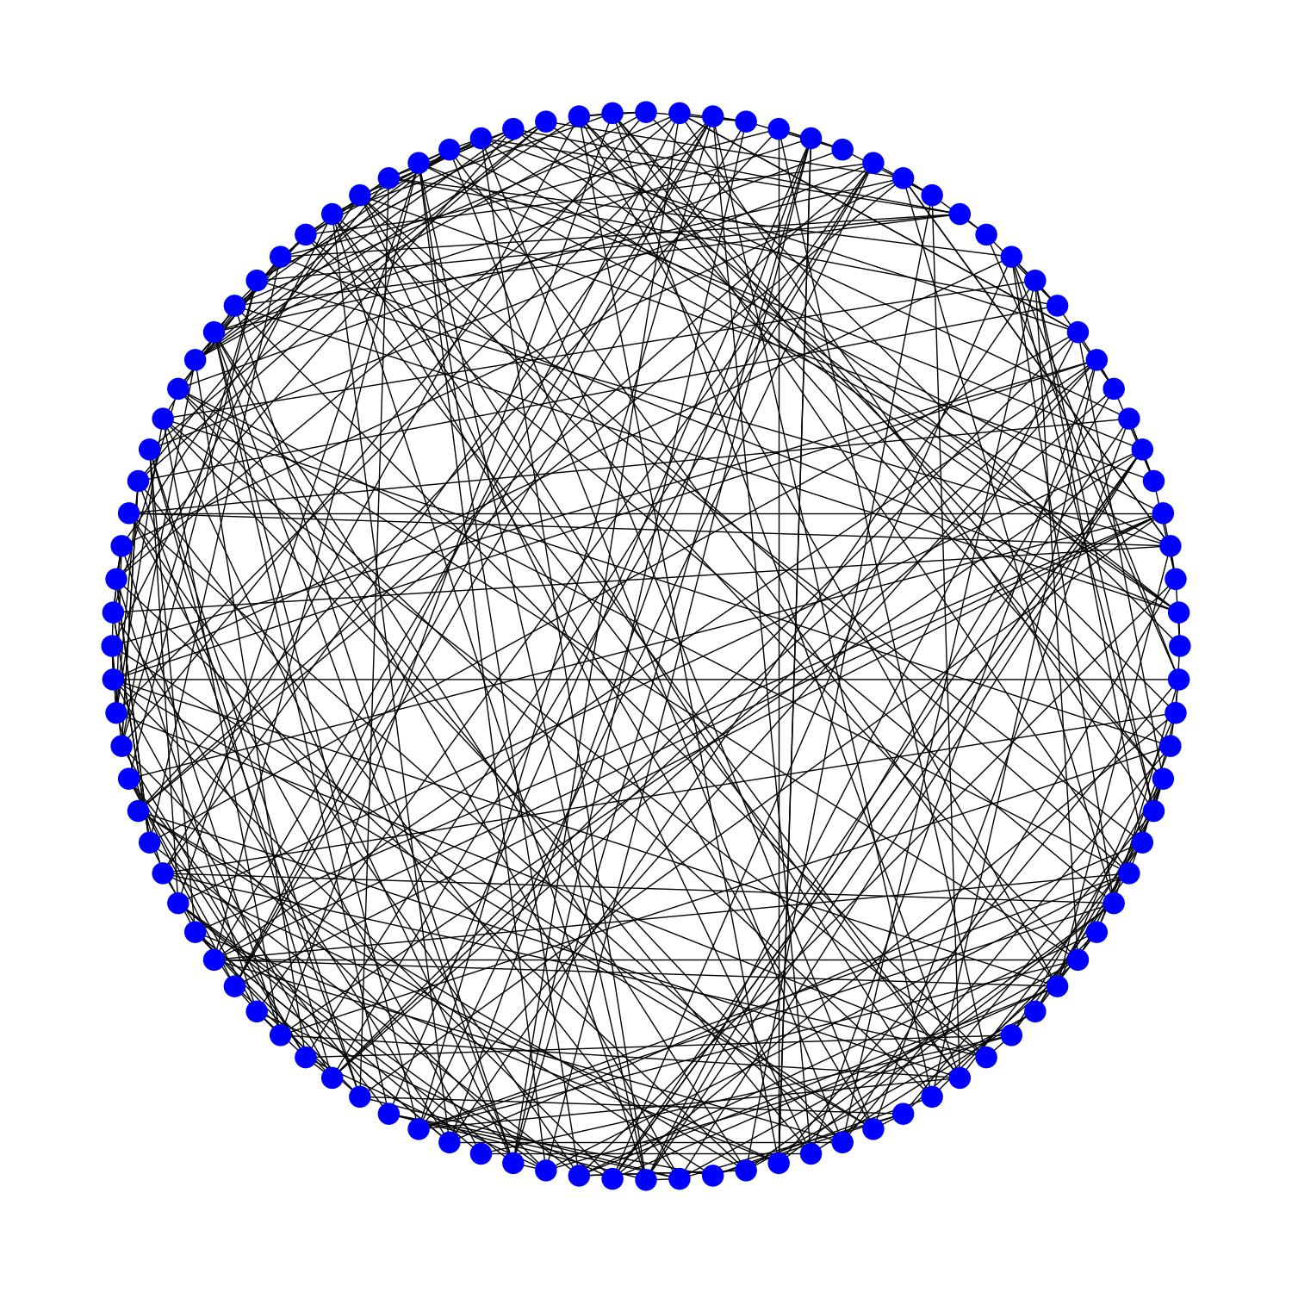
Naïve layout with long-range connectivity
Issue:
Crossing gates may induce correlated errors.
Goal:
A small number of crossing gates.
Short depth.
Graph with 100 vertices with degree 8

Slide 34
Planar decomposition of the Tanner graph
Degree = 4
# planar layers = 2

Slide 35
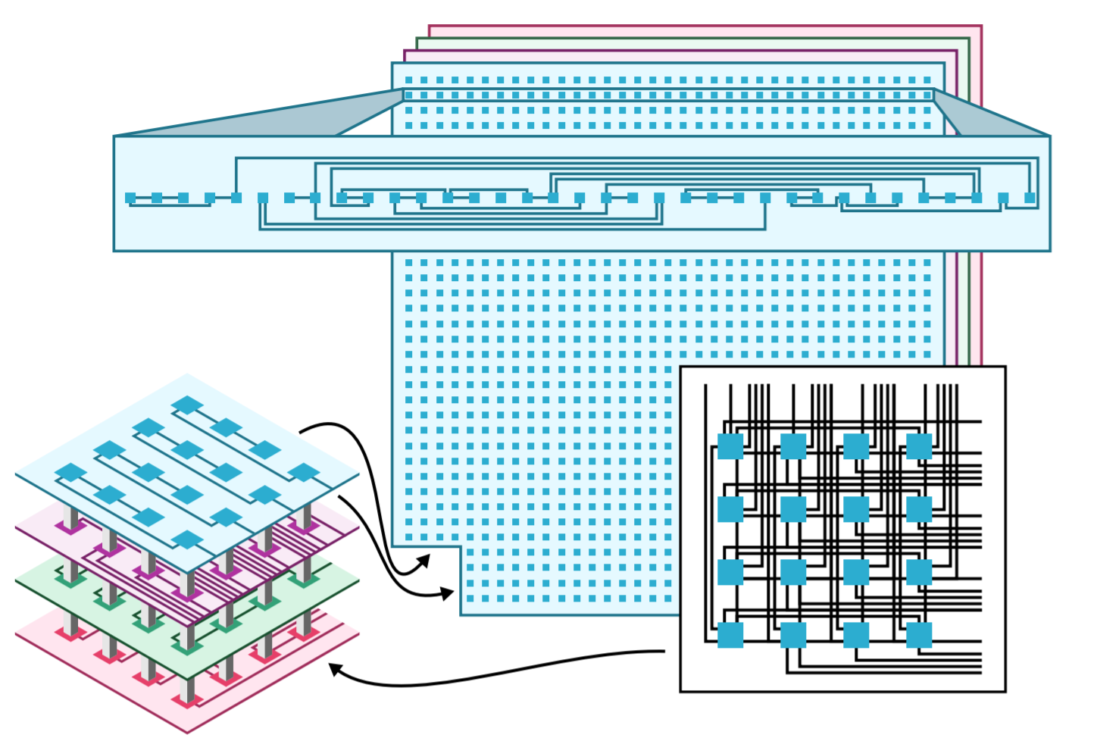
$ℓ$-planar layout
Assumptions:
CSS code.
Degree(Tanner graph) = $δ$.
We constructed a syndrome extraction circuit with:
$\left\lceil \frac{δ}{2}\right\rceil$ planar layers of gates.
Depth = 2 $δ+2$.
Improved depth for HGP codes.

Slide 36
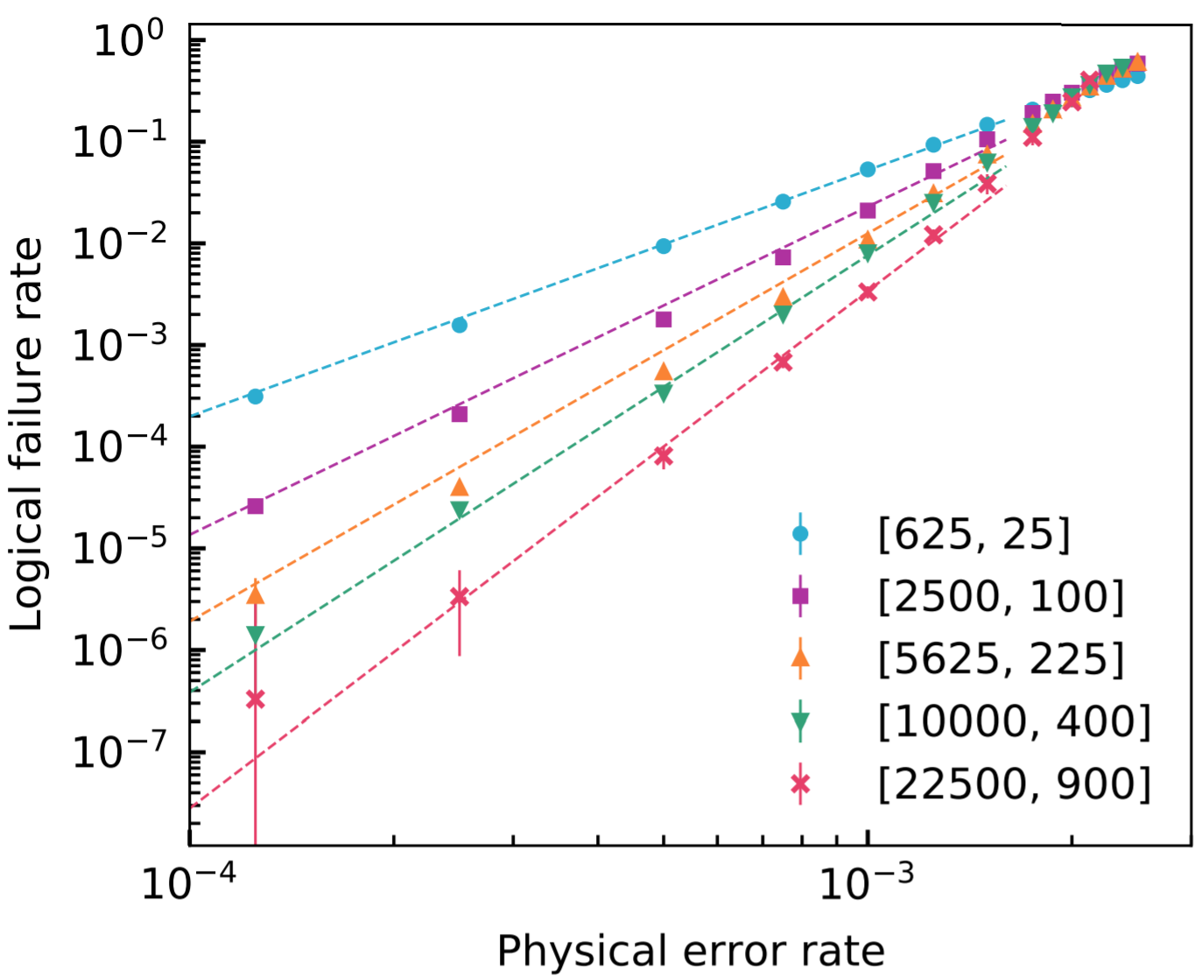
Numerical results
Noise threshold:
0.28% (instead of 0.7% for surface codes)
# physical qubits per logical qubit:
49 (instead of thousands for surface codes)

