Slide 1
Tutorial on Quantum Error Correction – Part 3
Nicolas Delfosse
Microsoft
UCLA – Mathematical and Computational Challenges in Quantum Computing
September 14th 2023

Slide 2
Bonus part – Quantum Tanner codes

Slide 3
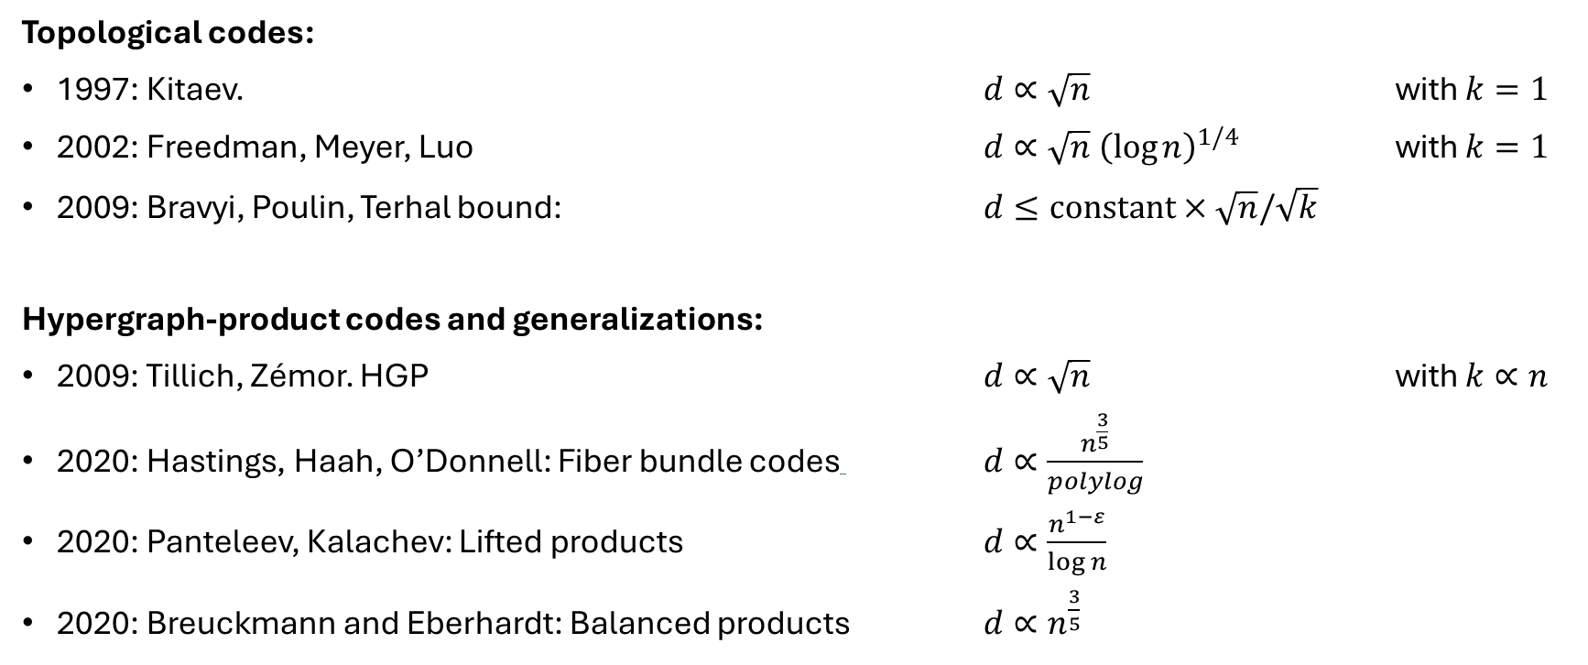
Some constructions of QLDPC codes
Topological codes:
1997: Kitaev. $d∝\sqrt{n}$ with $k=1$
2002: Freedman, Meyer, Luo $d∝\sqrt{n} {\left(\log{n}\right)}^{1/4}$ with $k=1$
2009: Bravyi, Poulin, Terhal bound: $d≤constant×\sqrt{n}/\sqrt{k}$
Hypergraph-product codes and generalizations:
2009: Tillich, Zémor. HGP $d∝\sqrt{n}$ with $k∝n$
2020: Hastings, Haah, O’Donnell: Fiber bundle codes $d∝\frac{n^{\frac{3}{5}}}{polylog}$
2020: Panteleev, Kalachev: Lifted products $d∝\frac{n^{1−ε}}{\log{n}}$
2020: Breuckmann and Eberhardt: Balanced products $d∝n^{\frac{3}{5}}$

Slide 4
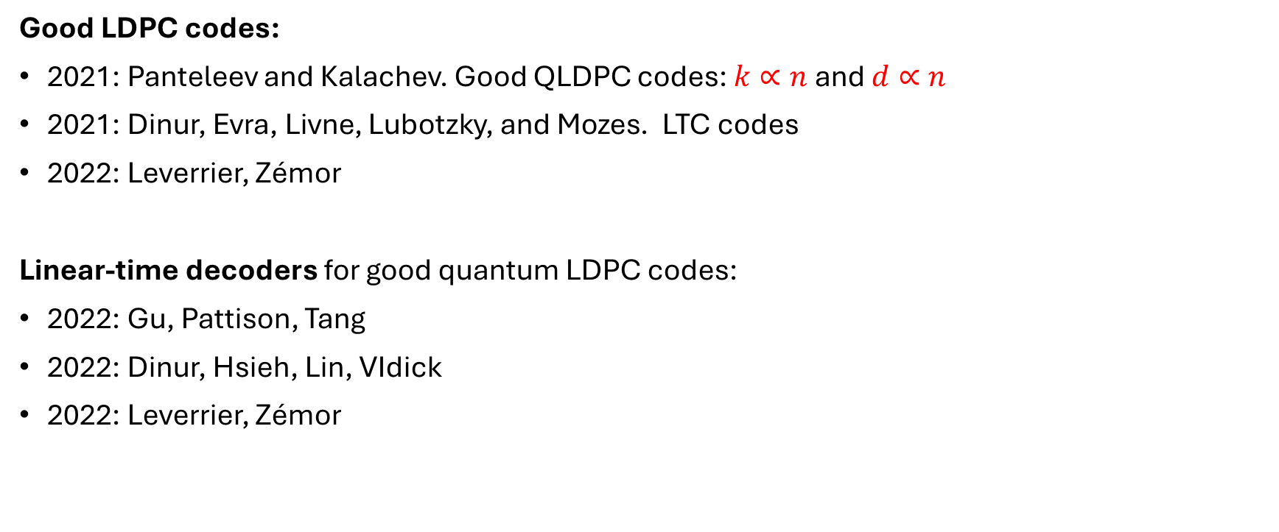
Good LDPC codes
Good LDPC codes:
2021: Panteleev and Kalachev. Good QLDPC codes: $k∝n$ and $d∝n$
2021: Dinur, Evra, Livne, Lubotzky, and Mozes. LTC codes
2022: Leverrier, Zémor
Linear-time decoders for good quantum LDPC codes:
2022: Gu, Pattison, Tang
2022: Dinur, Hsieh, Lin, VIdick
2022: Leverrier, Zémor

Slide 5

Left-Right Cayley Complex
$$\left(a_{2}gb_{1}, 0\right)$$
Input:
A finite group $G$
Two subsets $A, B$ of $G$ with $A^{−1}=A$ and $B^{−1}=B$
Output:
A complex $X=(V, E, F)$ where:
$V=V_{0}∪V_{1}$ where $V_{i}=G×\left\{i\right\}$
$E=E_{A}∪E_{B}$ where $E_{A}=\{\left(g, 0\right), (ag,1)\}$ and $E_{B}=\{\left(g, 0\right), (gb,1)\}$
$F=$ set of squares $f\left(g,a,b\right)≔\left\{\left(g,0\right), \left(ag,1\right),\left(gb,1\right),(agb,0)\right\}$
$$\left(a_{1}gb_{1}, 0\right)$$
$$⋮$$
$$\left(a_{2}g, 1\right)$$
$$\left(a_{1}g, 1\right)$$
$$\left(g, 0\right)$$
$$\left(gb_{1}, 1\right)$$
$$\left(gb_{2}, 1\right)$$
$$⋮$$

Slide 6
Local structure
$$\left(gb, 1\right)$$
$$\left(agb, 0\right)$$
$G=\left\{g_{1},g_{2},…\right\}$
$A=\left\{a_{1},a_{2},…\right\}⊆G$
$B=\left\{b_{1},b_{2},…\right\}⊆G$
$$\left(g, 0\right)$$
$$\left(ag, 1\right)$$
Type A edge:
$$a×⋅$$
$$V=$$
$$⋮$$
$$⋮$$
Type B edge:
$$⋅×b$$
$$G×\{0\}$$
$$G×\{1\}$$

Slide 7


Neighborhood of a vertex
Consider $v=\left(g, 0\right)$
Neighboring vertices:
$\left(ag, 1\right)$ with $a∈A$ and $\left(gb, 1\right)$ for $b∈B$
Neighboring faces:
$\left\{\left(g,0\right), \left(ag,1\right),\left(gb,1\right),(agb,0)\right\}$ for each pair $\left(a, b\right)∈A×B$.
Abstract representation the faces neighboring $v$:
$$A$$
$$F\left(v\right)=A×B=$$
$$B$$

Slide 8
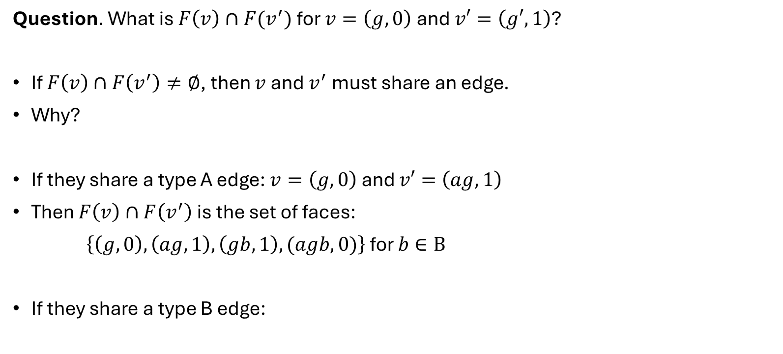
Intersection of two neighborhoods
$$\left(gb, 1\right)$$
$$\left(agb, 0\right)$$
Question. What is $F\left(v\right)∩F(v^{′})$ for $v=\left(g,0\right)$ and $v′=\left(g′,1\right)$?
If $F\left(v\right)∩F\left(v^{′}\right)≠∅$, then $v$ and $v^{′}$ must share an edge.
Why?
If they share a type A edge: $v=\left(g,0\right)$ and $v′=\left(ag,1\right)$
Then $F\left(v\right)∩F\left(v^{′}\right)$ is the set of faces:
$\left\{\left(g,0\right), \left(ag,1\right),\left(gb,1\right),(agb,0)\right\}$ for $b∈B$
If they share a type B edge:
$$\left(g, 0\right)$$
$$\left(ag, 1\right)$$
$$A$$
$$B$$
$$F\left(v\right)∩F\left(v^{′}\right)=B=$$

Slide 9
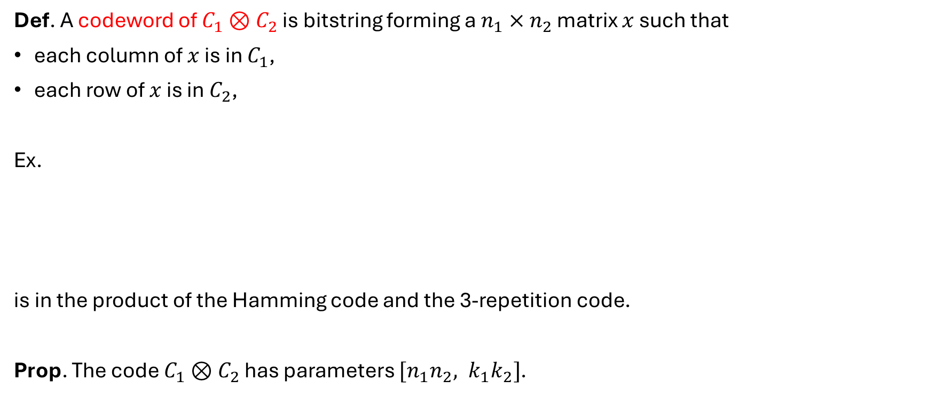
Tensor codes of two classical codes
Def. A codeword of $C_{1}⊗C_{2}$ is bitstring forming a $n_{1}×n_{2}$ matrix $x$ such that
each column of $x$ is in $C_{1}$,
each row of $x$ is in $C_{2}$,
Ex.
is in the product of the Hamming code and the 3-repetition code.
Prop. The code $C_{1}⊗C_{2}$ has parameters $[n_{1}n_{2}, k_{1}k_{2}]$.
0
1
1
0
1
0
0
0
1
1
0
1
0
0
0
1
1
0
1
0
0
0
1
1
0
1
0
0

Slide 10

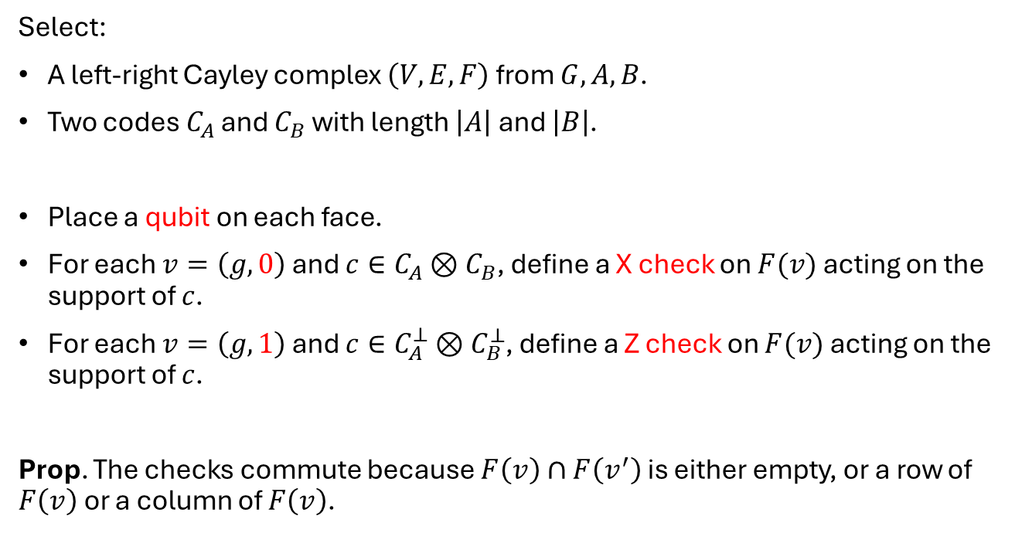


Definition of quantum Tanner codes
Select:
A left-right Cayley complex $\left(V,E,F\right)$ from $G, A, B$.
Two codes $C_{A}$ and $C_{B}$ with length $\left|A\right|$ and $\left|B\right|$.
Place a qubit on each face.
For each $v=\left(g,0\right)$ and $c∈C_{A}⊗C_{B}$, define a X check on $F(v)$ acting on the support of $c$.
For each $v=\left(g,1\right)$ and $c∈C_{A}^{⊥}⊗C_{B}^{⊥}$, define a Z check on $F(v)$ acting on the support of $c$.
Prop. The checks commute because $F\left(v\right)∩F\left(v^{′}\right)$ is either empty, or a row of $F\left(v\right)$ or a column of $F\left(v\right)$.
$$A$$
$$F(v)=$$
$$B$$
The sets $G, A, B$ must satisfy $A^{−1}=A$ and $B^{−1}=B$ and the TNC condition for all $a, g, b$: $ag≠gb$

Slide 11
Example of Cayley graphs
$G=ℤ,$
$A=\{±1\}$
-2
-1
0
1
2

Slide 12
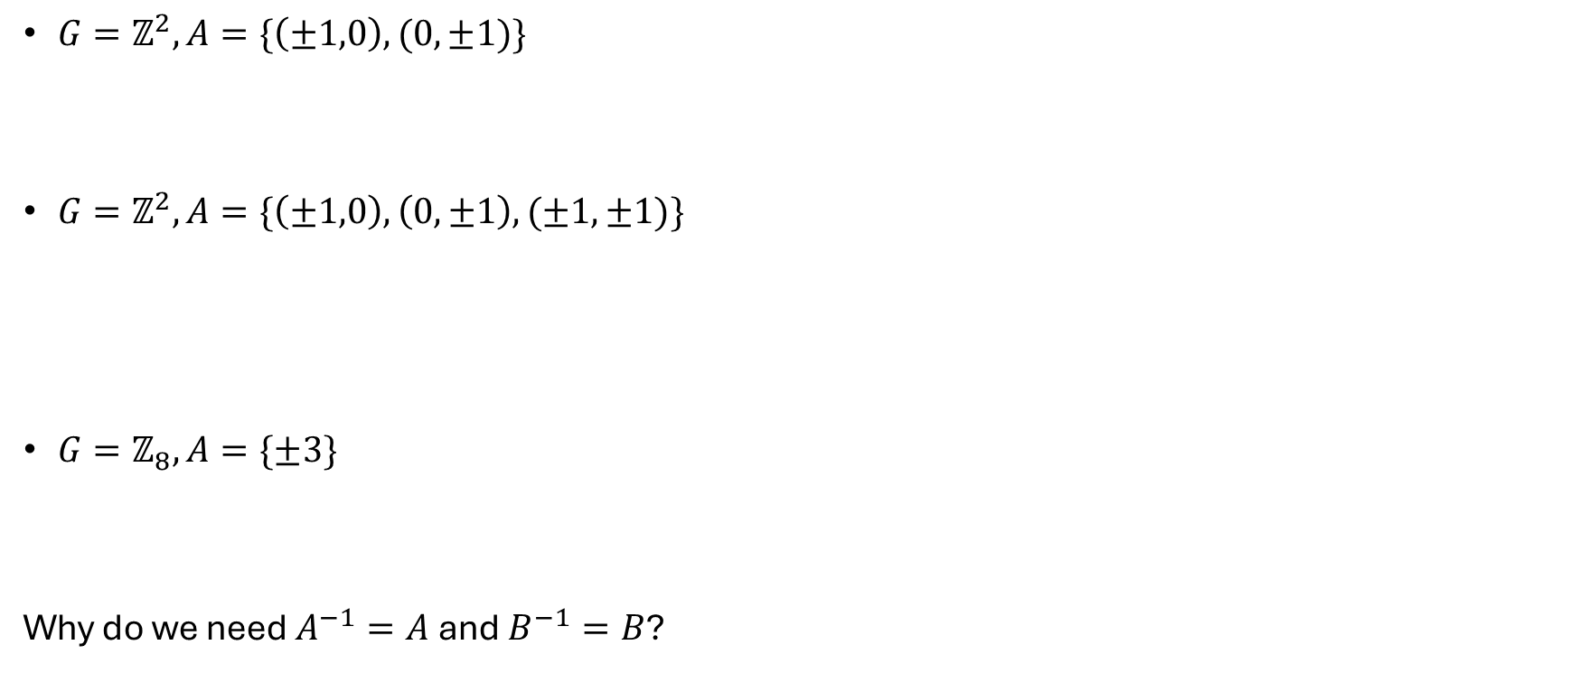
Example of Cayley graphs
$G=ℤ^{2}, A=\{\left(±1,0\right), (0,±1)\}$
$G=ℤ^{2}, A=\{\left(±1,0\right), \left(0,±1\right), (±1,±1)\}$
$G=ℤ_{8}, A=\{±3\}$
Why do we need $A^{−1}=A$ and $B^{−1}=B$?

Slide 13

Double cover of a Cayley graph
It is the graph with
$V =\left(G×\left\{0\right\}\right)$ ∪ $\left(G×\left\{1\right\}\right)$
Two types of edges: $\{\left(g,0\right), \left(ag, 1\right)\}$ and $\{\left(g,1\right), \left(ag, 0\right)\}$
Ex. $G=ℤ, A=\{±2\}$
$$G×\left\{0\right\}=$$
$$G×\left\{1\right\}=$$

Slide 14
Example
$$G=ℤ_{6}, A=\left\{±1\right\}, B=\left\{±2\right\}$$
0
0
1
1
0
2
2
3
3
1
4
4
2
3
5
5
$$G×\{0\}$$
$$G×\{1\}$$
A square

Slide 15
Example - $G=ℤ_{9}$
$$G=ℤ_{9}, A=\left\{±1\right\}, B=\left\{±2\right\}$$
(6,1)
Type A edge:
(3,1)
(4,0)
(5,1)
$$(+1,flip)$$
(2,1)
(0,1)
(1,0)
(2,1)
(3,0)
(4,1)
$$(−1, flip)$$
(8,1)
(0,0)
(1,1)
(6,1)
(7,0)
(8,1)
(0,0)
(1,1)
(2,0)
(3,1)
Type B edge:
(7,1)
(5,1)
(6,0)
(7,1)
(8,0)
(0,1)
(4,1)
(5,0)
(6,1)
(3,1)
$$(+2,flip)$$
$$(−2,flip)$$
What is this shape?

Slide 16



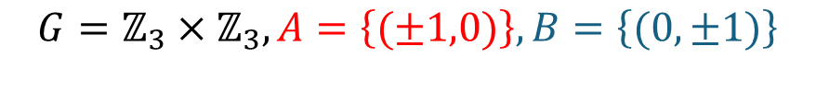
Example - $G=ℤ_{3}×ℤ_{3}$
$$G=ℤ_{3}×ℤ_{3}, A=\left\{(±1,0)\right\}, B=\left\{(0,±1)\right\}$$
Type A edge:
(0,0,1)
$$(+1,0,flip)$$
(2,1,1)
(0,1,0)
(1,1,1)
$$(−1,0,flip)$$
(0,2,1)
(1,2,1)
(2,2,0)
(0,2,1)
(1,2,0)
(2,2,1)
(2,0,1)
(0,0,0)
(1,0,1)
(0,0,0)
(0,0,1)
(1,0,0)
(2,0,1)
(0,0,0)
(1,0,1)
(2,0,0)
(0,0,1)
Type B edge:
(0,1,1)
(1,1,1)
(2,1,0)
(0,1,1)
(1,1,0)
(2,1,1)
(2,2,1)
(0,2,0)
(1,2,1)
(0,0,1)
$$(0,+1,flip)$$
$$(0,−1,flip)$$

Slide 17
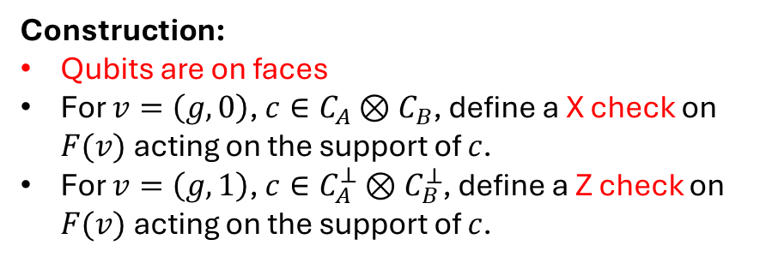
Example - $G=ℤ_{3}×ℤ_{3}$
Construction:
Qubits are on faces
For $v=\left(g,0\right)$, $c∈C_{A}⊗C_{B}$, define a X check on $F(v)$ acting on the support of $c$.
For $v=\left(g,1\right)$, $c∈C_{A}^{⊥}⊗C_{B}^{⊥}$, define a Z check on $F(v)$ acting on the support of $c$.
(0,0,1)
(2,1,1)
(0,1,0)
(1,1,1)
$=\left(g, 0\right)=$ X stabilizer generators
(1,2,1)
(2,2,0)
(0,2,1)
(1,2,0)
(2,2,1)
Z
Z
$$F\left(v\right)=A×B=$$
X
X
(0,0,1)
(1,0,0)
(2,0,1)
(0,0,0)
(1,0,1)
(2,0,0)
(0,0,1)
Z
Z
X
X
(1,1,1)
(2,1,0)
(0,1,1)
(1,1,0)
(2,1,1)
We need to a tensor code $C_{A}⊗C_{B}$ on $A×B:$
$$⇒C_{A}=C_{B}=\left\{00, 11\right\}$$
(2,2,1)
(0,2,0)
(1,2,1)
$$C_{A}⊗C_{B}=$$
0
0
1
1
0
0
1
1
(0,0,1)
X
X
$⇒$ X stabilizer generator:
X
X
We recover the toric code.

Slide 18
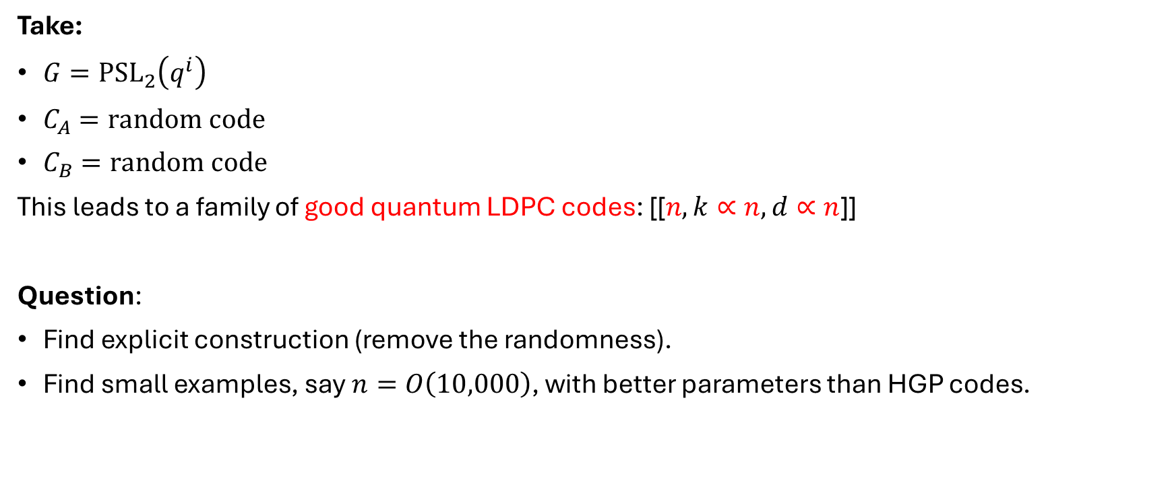
How to get good LDPC codes
Take:
$G={PSL}_{2}\left(q^{i}\right)$
$C_{A}=random code$
$C_{B}=random code$
This leads to a family of good quantum LDPC codes: [[$n, k∝n, d∝n$]]
Question:
Find explicit construction (remove the randomness).
Find small examples, say $n=O\left(10,000\right)$, with better parameters than HGP codes.

