Slide 1
IBM QEC Summer School
Lectures on quantum LDPC codes
Nicolas Delfosse – Microsoft
July 2022

Slide 2
Contact
nicolas.delfosse@microsoft.com
ni.delfosse@gmail.com

Slide 3
Part 2. Decoding quantum LDPC codes

Slide 4
Overview
Quantum LDPC codes
Small set flip decoder for expander codes
Union-Find decoder
BP + OSD decoder
Other strategies

Slide 5
Overview
Quantum LDPC codes
Small set flip decoder for expander codes
Union-Find decoder
BP + OSD decoder
Other strategies

Slide 6
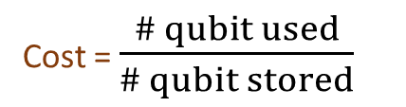
Why quantum LDPC codes?
Classical LDPC codes:
in SSD storage
The Shor code:
First quantum error-correcting code
Cost = $\frac{\# qubit used}{\# qubit stored}$
1
625
5
<1.1
9
25x25
Surface code
The five-qubit code:
Smallest quantum code correcting one arbitrary error

Slide 7
Classical and quantum Hamming codes
Quantum codes detect X errors and Z errors:
0
1
1
Classical code detect bit flips:
Flip
X
Z
1
0
0
1
0
1

Slide 8

First decoding attempt: BP
BP does not perform well for two reasons:
  The quantum Tanner graph contains many 4-cycles because of the commutation relations.
  The event $E_{i}=I$ is not well defined up to a stabilizer.

Slide 9
Overview
Quantum LDPC codes
Small set flip decoder for expander codes
Union-Find decoder
BP + OSD decoder
Other strategies

Slide 10
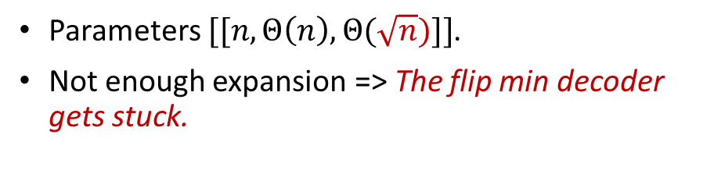
Hypergraph Product codes
Parameters $[[n, Θ\left(n\right), Θ(\sqrt{n})]]$.
Not enough expansion => The flip min decoder gets stuck.
Qubits
Qubits
Z stabilizer generators
X stabilizer generators
Tillich, Zémor - arXiv:0903.0566 (2009)

Slide 11
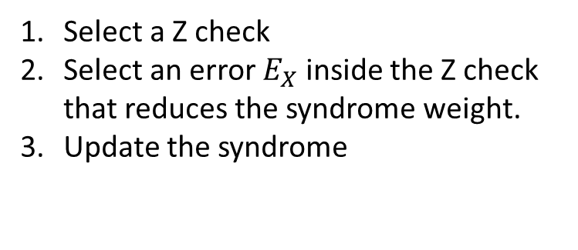
Small Set Flip decoder – Basic idea
0
0
0
1
0
0
1
1
Select a Z check
Select an error $E_{X}$ inside the Z check that reduces the syndrome weight.
Update the syndrome
1
1
0
0
1
0
Z checks
X
I
X
Leverrier, Tillich, Zémor - arXiv:1504.00822 (2015)

Slide 12
Small Set Flip decoder – Basic idea
Syndrome weight
Decoder iterations
Leverrier, Tillich, Zémor - arXiv:1504.00822 (2015)

Slide 13
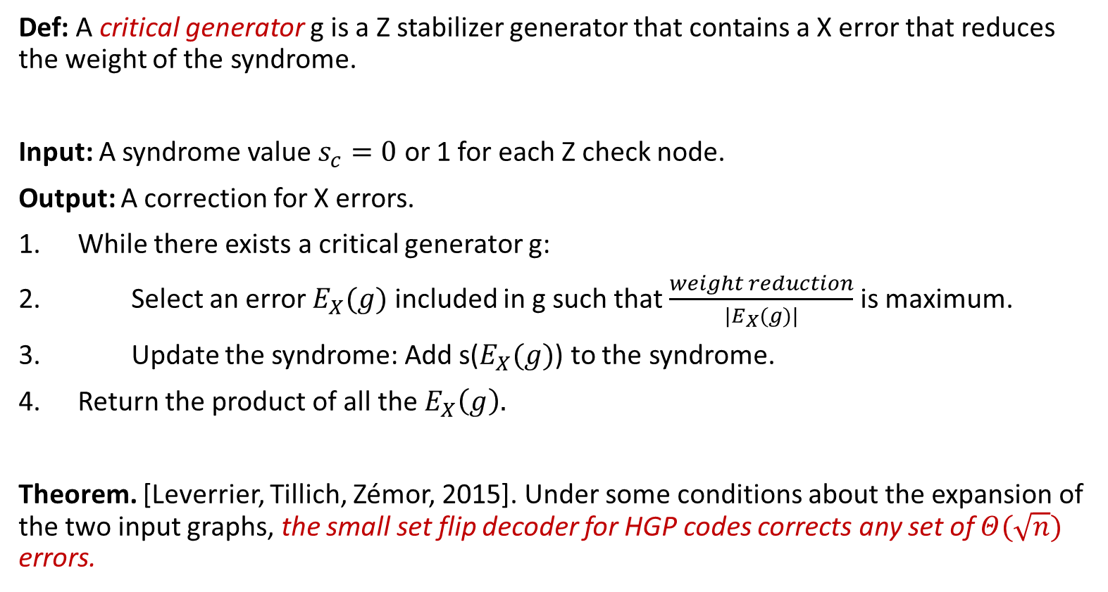
Small set flip decoder
Def: A critical generator g is a Z stabilizer generator that contains a X error that reduces the weight of the syndrome.
Input: A syndrome value $s_{c}=0$ or 1 for each Z check node.
Output: A correction for X errors.
While there exists a critical generator g:
Select an error $E_{X}(g)$ included in g such that $\frac{weight reduction}{|E_{X}(g)|}$ is maximum.
Update the syndrome: Add s($E_{X}(g)$) to the syndrome.
Return the product of all the $E_{X}\left(g\right).$
Theorem. [Leverrier, Tillich, Zémor, 2015]. Under some conditions about the expansion of the two input graphs, the small set flip decoder for HGP codes corrects any set of $Θ(\sqrt{n})$ errors.

Slide 14

Small set flip decoder - Complexity
Complexity: $O(2^{w}n)$
Notation:
n = code length.
w = max. degree of a check (max. weight of a stabilizer generator).
Remark:
Linear-time complexity for bounded degree Tanner graphs.
May be slow in practice for large w.

Slide 15
Overview
Quantum LDPC codes
Small set flip decoder for expander codes
Union-Find decoder
BP + OSD decoder
Other strategies

Slide 16
Union-Find decoder
Union-Find decoder:
Grow clusters around check with value 1.
Stop growing a cluster when it becomes correctable.
Correct each cluster independently.
Remark:
We track the growing cluster using a Union-Find data structure which leads to an almost-linear complexity.
Delfosse, Nickerson (2017) arxiv1709.06218

Slide 17
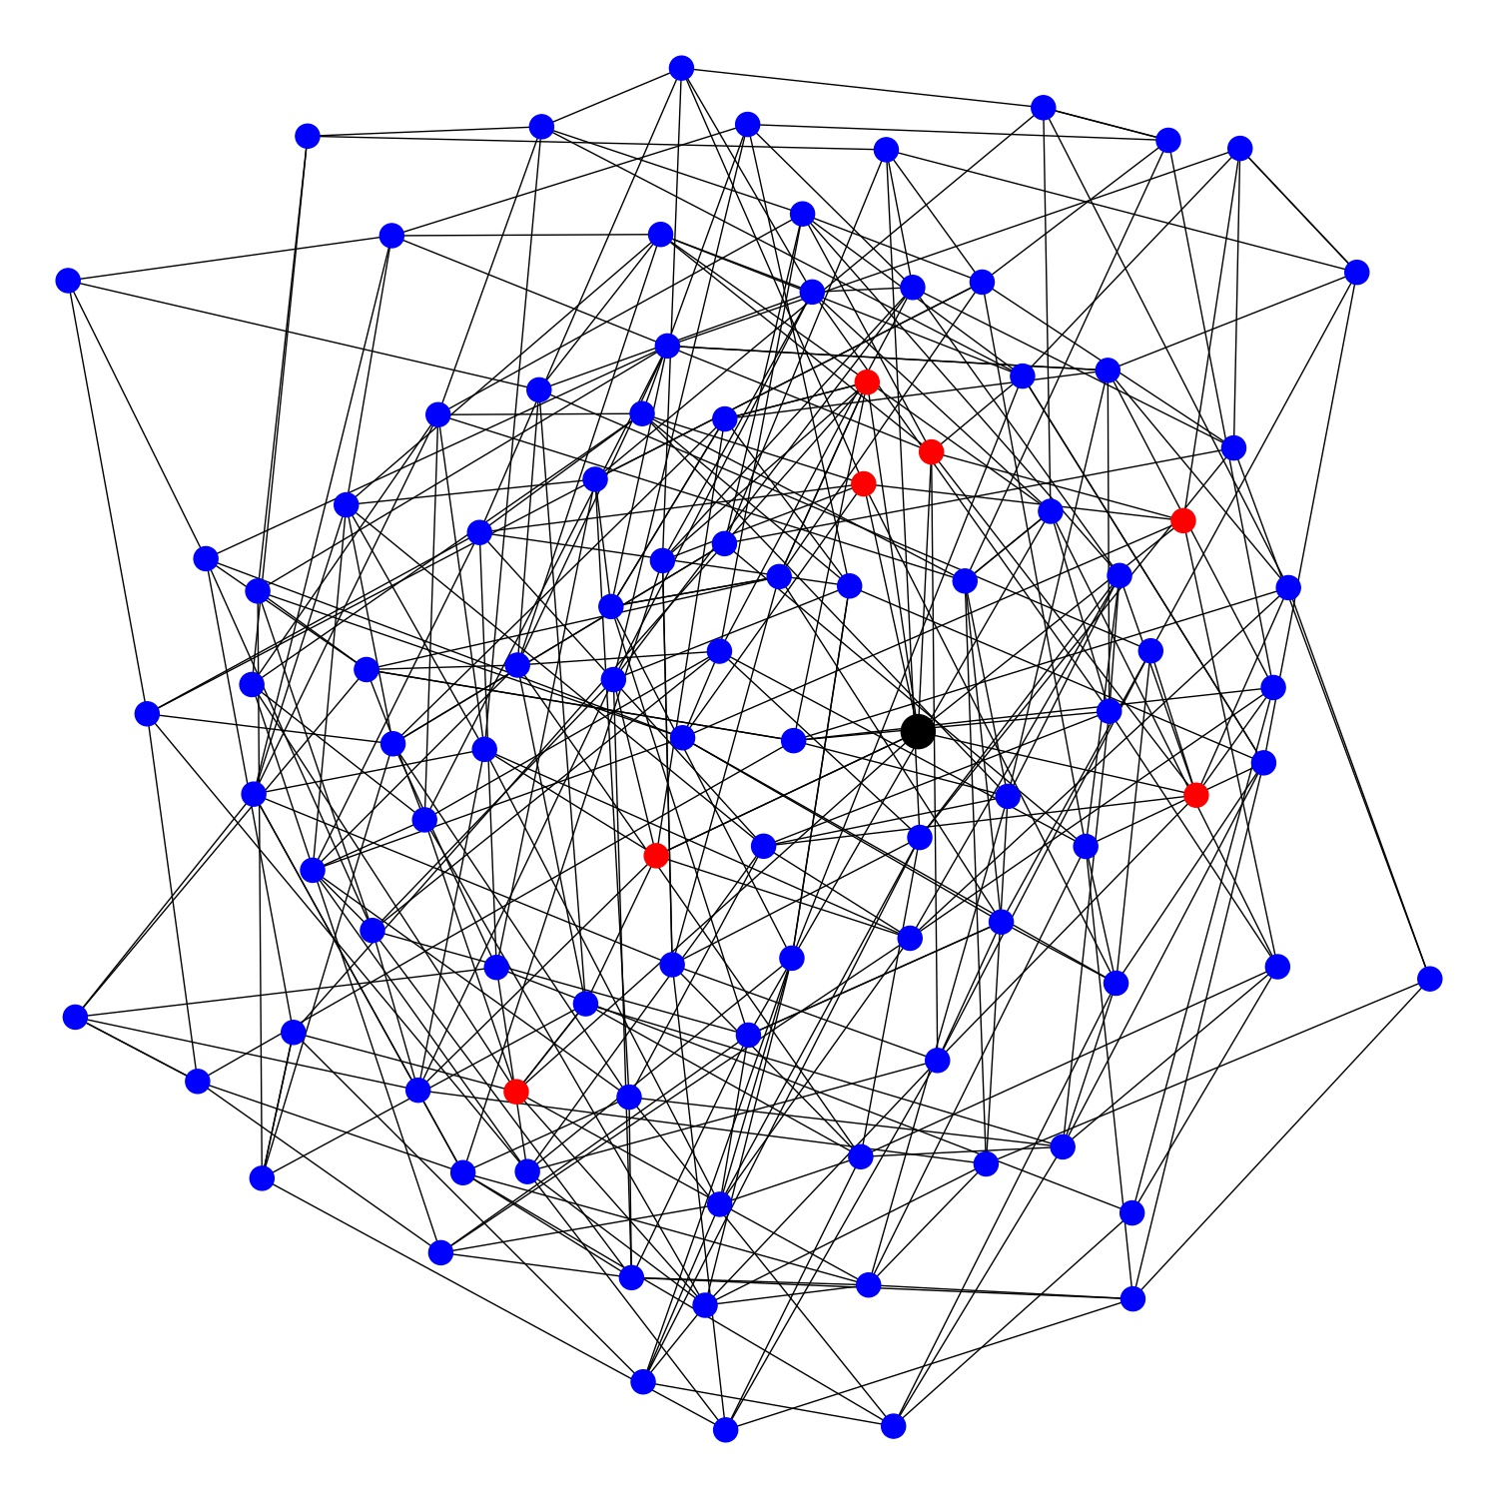
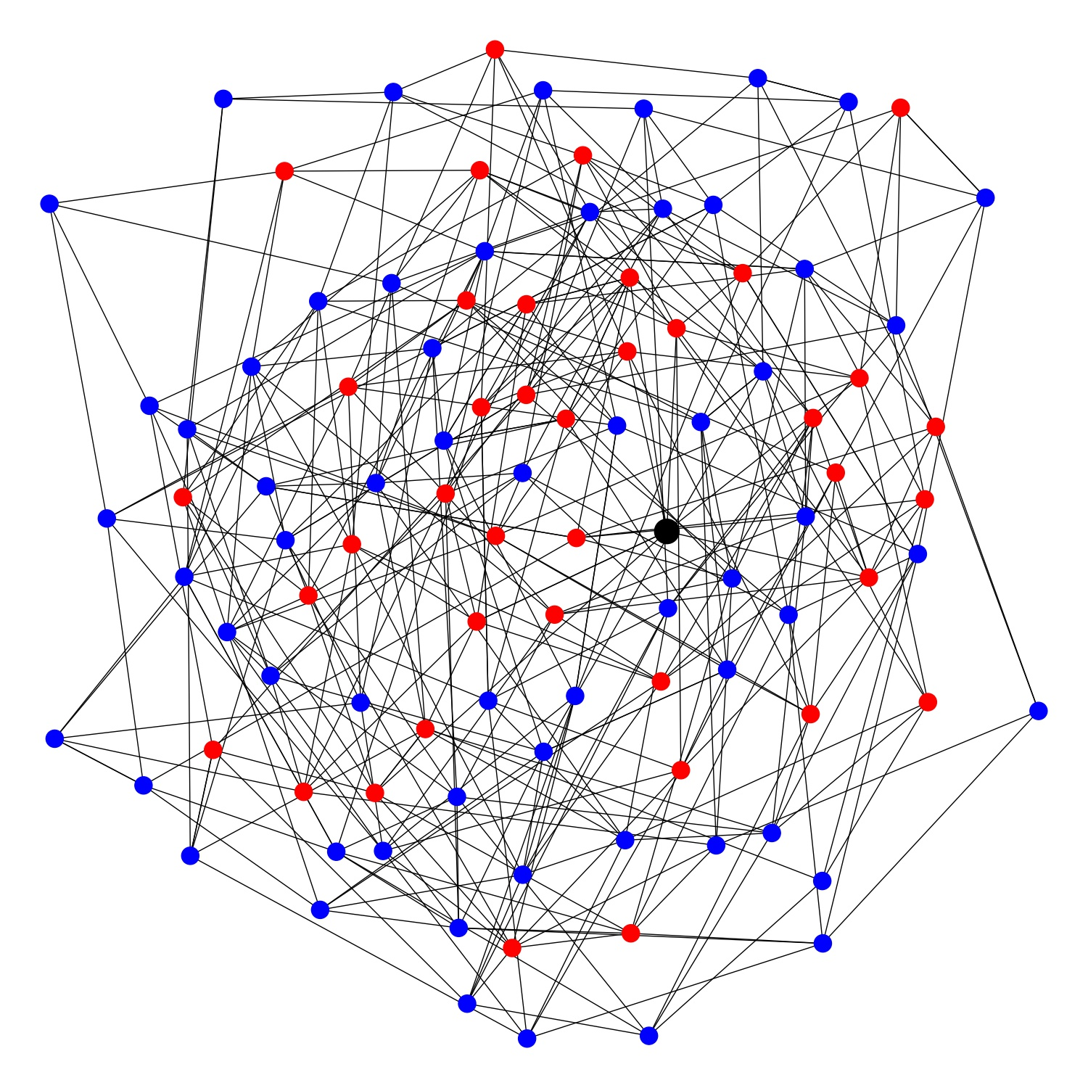
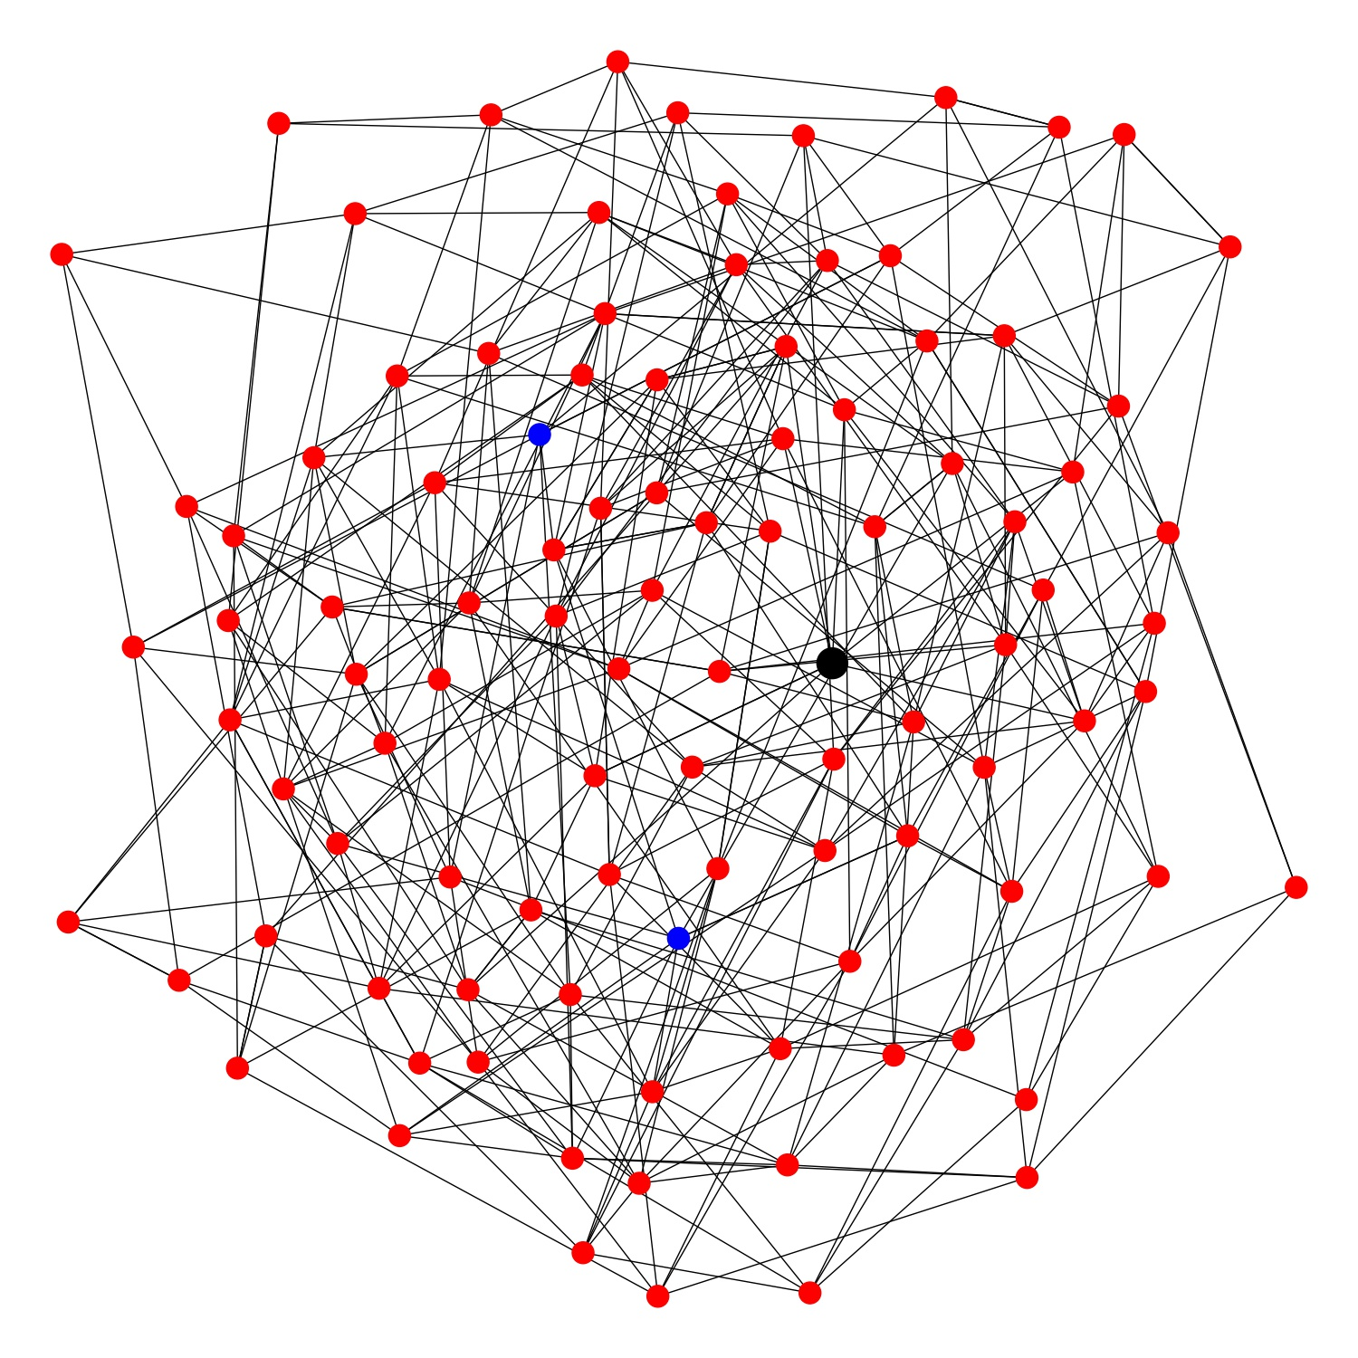
The problem with LDPC codes
Clusters grow too fast!

Slide 18
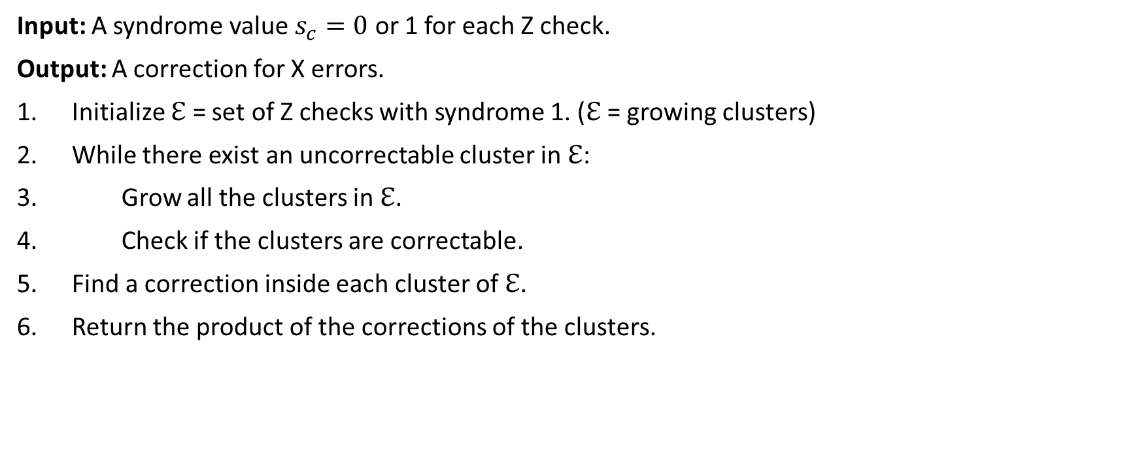
Union-Find decoder for QLDPC codes
Input: A syndrome value $s_{c}=0$ or 1 for each Z check.
Output: A correction for X errors.
Initialize $ℇ$ = set of Z checks with syndrome 1. ($ℇ$ = growing clusters)
While there exist an uncorrectable cluster in $ℇ$:
Grow all the clusters in $ℇ$.
Check if the clusters are correctable.
Find a correction inside each cluster of $ℇ$.
Return the product of the corrections of the clusters.
Delfosse, Londe, Beverland (2021) arxiv:2103.08049

Slide 19
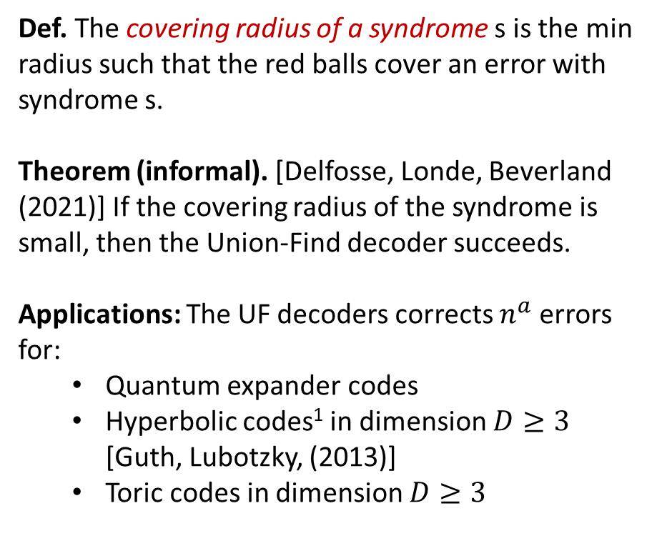
The covering radius
Def. The covering radius of a syndrome s is the min radius such that the red balls cover an error with syndrome s.
Theorem (informal). [Delfosse, Londe, Beverland (2021)] If the covering radius of the syndrome is small, then the Union-Find decoder succeeds.
Applications: The UF decoders corrects $n^{a}$ errors for:
  Quantum expander codes
  Hyperbolic codes¹ in dimension $D≥3$ [Guth, Lubotzky, (2013)]
  Toric codes in dimension $D≥3$
error
detection
Delfosse, Londe, Beverland (2021) arxiv:2103.08049

Slide 20

Union-Find decoder - Complexity
Complexity:
For surface codes and color codes: $O(nα(n))$.
$α(n)$ is the inverse of Ackermann’s function.
For LDPC codes: $O(n^{4})$.
Research question: Improve the complexity of the UF decoder for LDPC codes.
Research question: Design a UF decoder that corrects (d-1)/2 errors for toric codes in all dim $D≥3$.
See section 7 of arxiv:2103.08049.

Slide 21
Overview
Quantum LDPC codes
Small set flip decoder for expander codes
Union-Find decoder
BP + OSD decoder
Other strategies

Slide 22
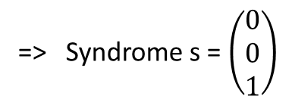
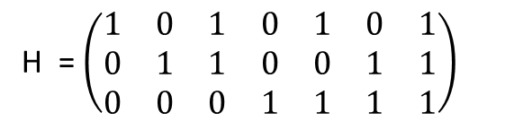
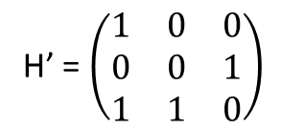
BP+OSD₀ decoder
error = ( 0 0 0 1 0 0 0 )
H = $\left(\begin{matrix}1 & 0 & 1 & 0 & 1 & 0 & 1 \\ 0 & 1 & 1 & 0 & 0 & 1 & 1 \\ 0 & 0 & 0 & 1 & 1 & 1 & 1\end{matrix}\right)$
=> Syndrome s = $\left(\begin{matrix}0 \\ 0 \\ 1\end{matrix}\right)$
Goal: Find a likely error x with H x = s
Estimate all bit flip probabilities using BP.
Select a basis H’ of columns made with highest probability columns.
Solve H’ x’ = s.
Construct x from x’.
(.26 .17 .05 .31 .32 .06 .01 )
H’ = $\left(\begin{matrix}1 & 0 & 0 \\ 0 & 0 & 1 \\ 1 & 1 & 0\end{matrix}\right)$
=> x’ = ( 0 1 0 )
=> x = ( 0 0 0 1 0 0 0 )
Panteleev, Kalachev - arXiv:1904.02703.

Slide 23
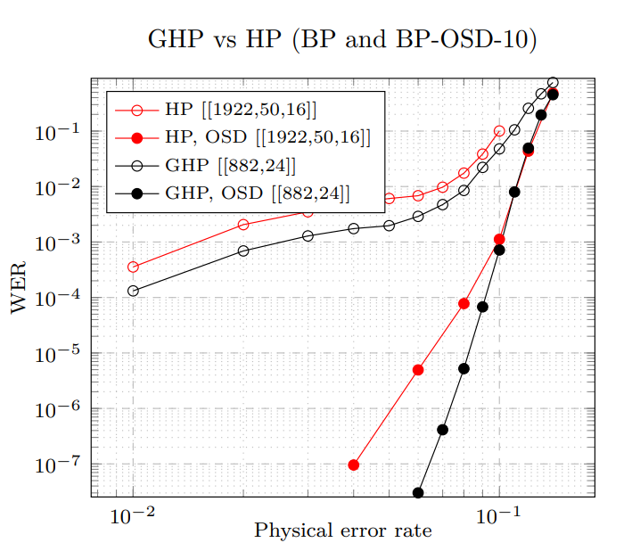

BP+OSD₀ decoder - Complexity
Complexity:
with OSD₀$: O(n^{3})$.
with OSD_{w}$: O({2^{w}n}^{3})$.
Panteleev, Kalachev - arXiv:1904.02703.

Slide 24
Overview
Quantum LDPC codes
Small set flip decoder for expander codes
Union-Find decoder
BP + OSD decoder
Other strategies

Slide 25
Other strategies
Combining hard and soft decoders for hypergraph product codes - Grospellier, Groues, Krishna, Leverrier (2020)
Decoding Across the Quantum LDPC Code Landscape - Roffe, White, Burton, Campbell (2020)
ReShape: a decoder for hypergraph product codes - Quintavalle, Campbell (2021)
Stabilizer Inactivation for Message-Passing Decoding of Quantum LDPC Codes - Du Crest, Mhalla, Savin (2022)
Ultimate Goal: Linear complexity + performance close to optimal.

Slide 26
Part 3. Layout for QLDPC codes
Based on joint work with Maxime Tremblay and Michael Beverland
arxiv:2109.14599 and arxiv:2109.14609

Slide 27
Overview
Motivation
Surface code
LDPC codes with 2D local gates
Circuit bound - Proof technique
LDPC codes with long range gates
Concatenation: Surface code + LDPC codes

Slide 28
Overview
Motivation
Surface code
LDPC codes with 2D local gates
Circuit bound - Proof technique
LDPC codes with long range gates
Concatenation: Surface code + LDPC codes

Slide 29
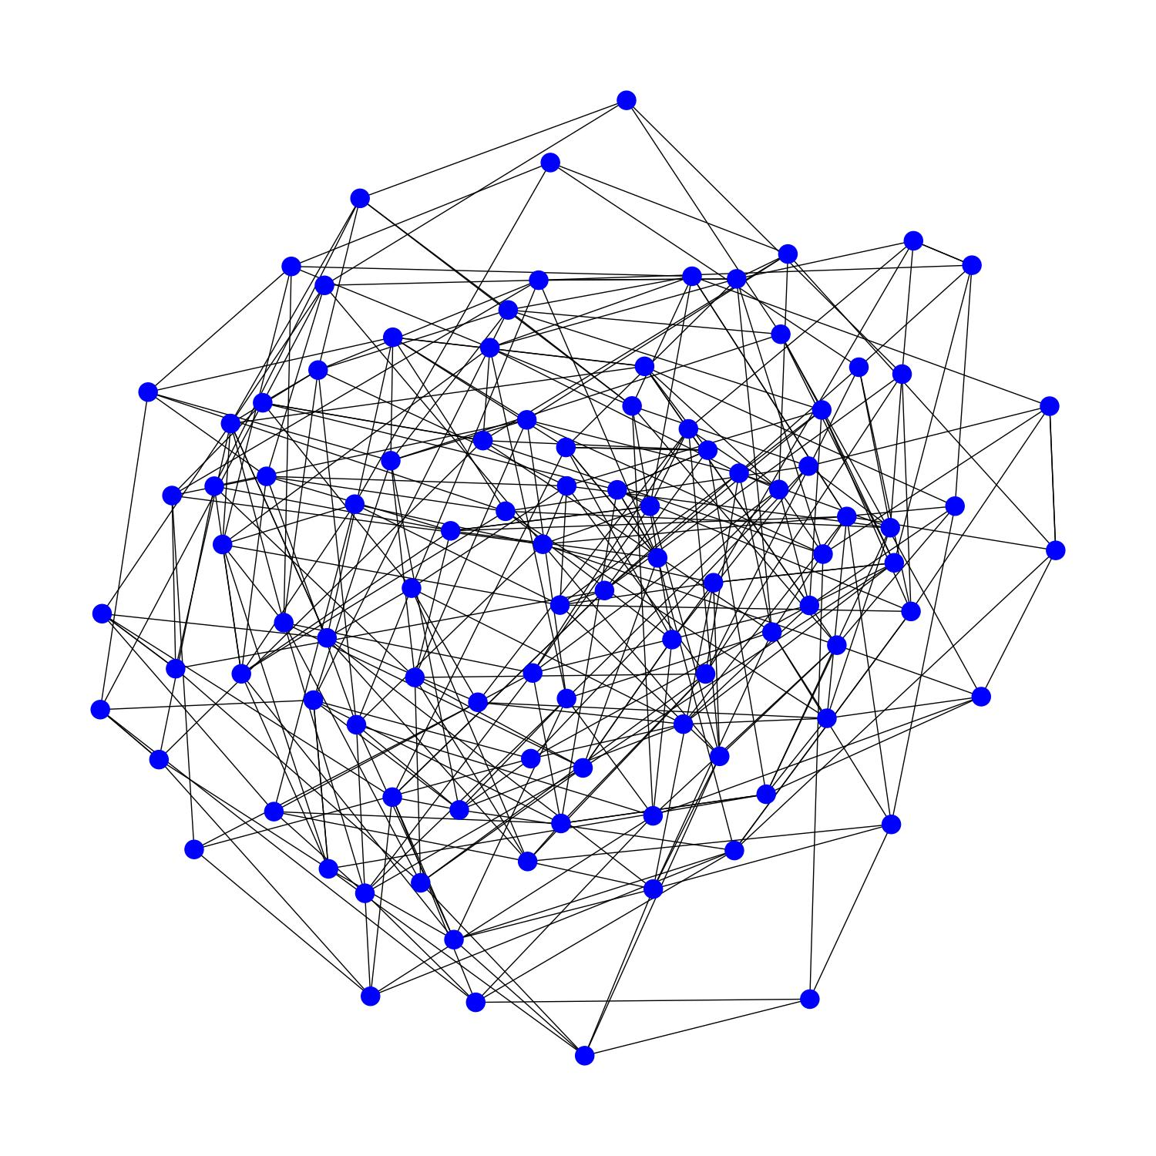
Can we implement quantum LDPC codes?
Typical LDPC code
Typical quantum computer

Slide 30
Main results
With 2D local gates:
  Need either large depth circuits or many ancilla qubits.
  Numerical simulations show poor performance.
With long-range connections:
  Layout based on only a few planar layers.
  Numerical simulation show that they outperform surface codes.
arxiv:2109.14599
arxiv:2109.14609

Slide 31
Overview
Motivation
Surface code
LDPC codes with 2D local gates
Circuit bound - Proof technique
LDPC codes with long range gates
Concatenation: Surface code + LDPC codes

Slide 32
Syndrome extraction circuit
$$|+>$$
$$|+>$$
$$|+>$$
$$|+>$$
Z
Z
flip
$$|+>$$
$$|+>$$
$$|+>$$
$$|+>$$
X plaquette circuit
$$|+>$$

Slide 33

Three standard noise models
Perfect measurement:
Noise on data qubits
Phenomenological:
Noise on data qubits
Noise on measurements
Circuit noise:
Noise on data qubits
Noise on measurements
Noise on ancilla qubits
Noise on gates
Noise on waiting qubits
$$|+>$$
X check circuit

Slide 34
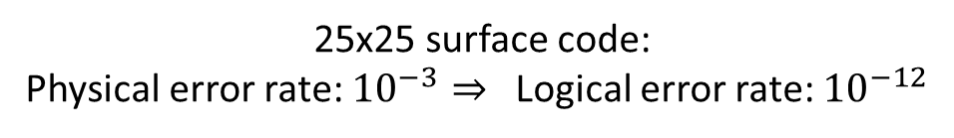
Surface codes
Why surface codes?
High noise threshold (about 1%).
Implement with 2D local gates.
Main issue:
Thousands of physical qubits per logical qubit. (Here 1250 physical qubits)
What is the threshold of QLDPC codes?
25x25 surface code:
Physical error rate: ${10}^{−3}⇒$ Logical error rate: ${10}^{−12}$

Slide 35
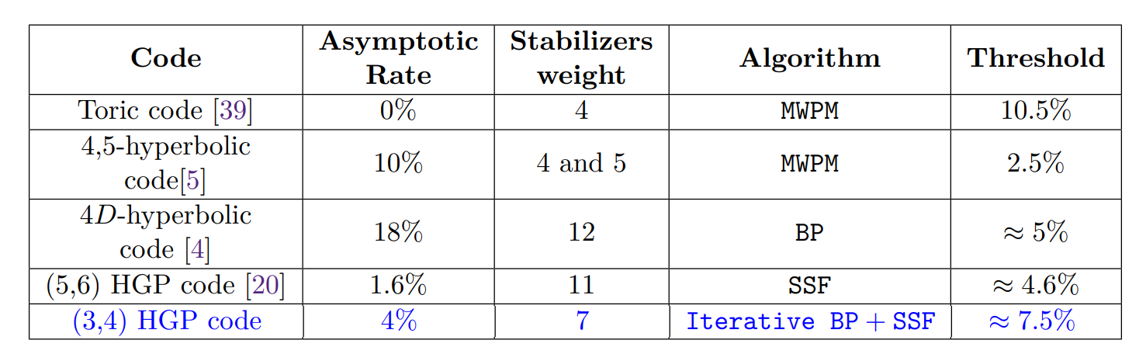
Threshold comparison – perfect measurement noise
Table I from Grospellier, Groues, Krishna, Leverrier (2020) - arXiv:2004.11199

Slide 36
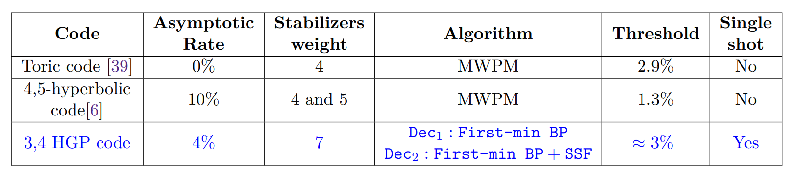
Threshold comparison – phenomenological noise
Table II from Grospellier, Groues, Krishna, Leverrier (2020) - arXiv:2004.11199

Slide 37
Overview
Motivation
Surface code
LDPC codes with 2D local gates
Circuit bound - Proof technique
LDPC codes with long range gates
Concatenation: Surface code + LDPC codes

Slide 38
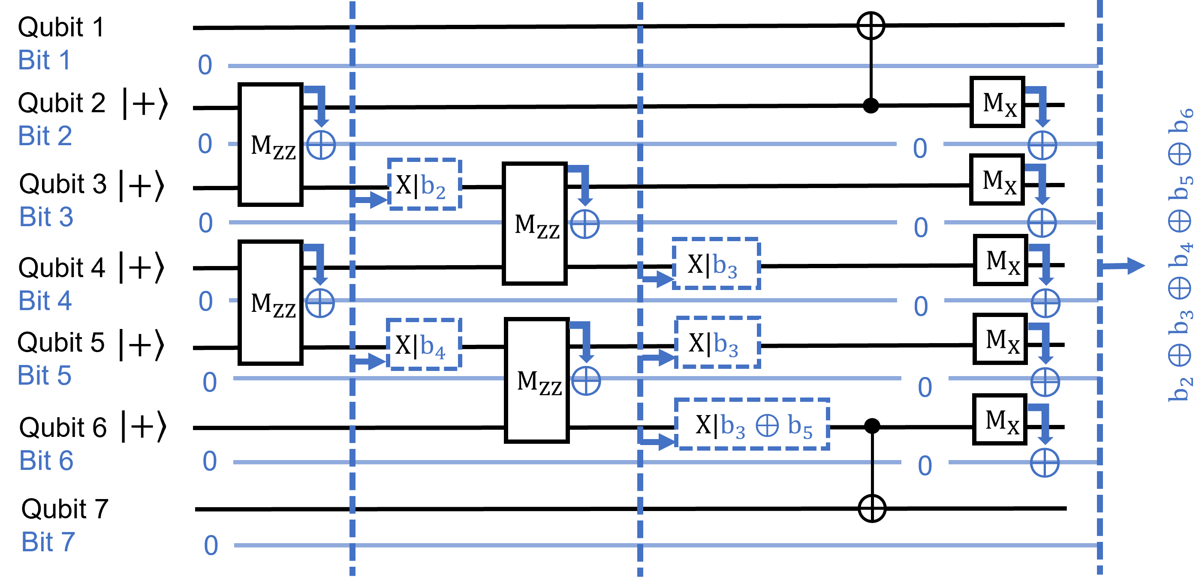
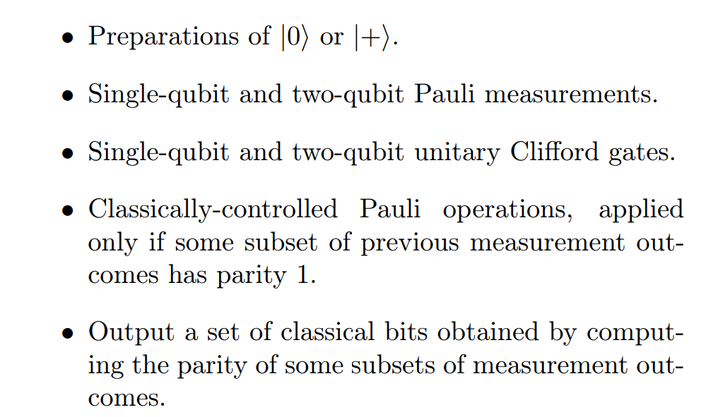
Syndrome measurement circuits
Allowed operations:

Slide 39
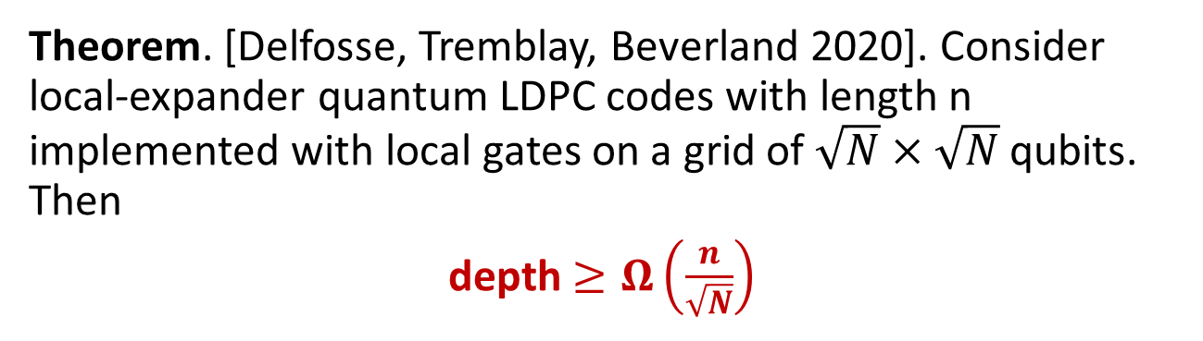
Bounds on syndrome extraction circuits
Theorem. [Delfosse, Tremblay, Beverland 2020]. Consider local-expander quantum LDPC codes with length n implemented with local gates on a grid of $\sqrt{N}×\sqrt{N}$ qubits. Then
depth $≥Ω\left(\frac{n}{\sqrt{N}}\right)$
For surface codes depth = 6
 | Constant depth | Constant overhead
Bound: | # ancilla ≥ $Ω(n^{2})$ | Depth ≥ $Ω(\sqrt{n})$
Saturating circuits: | Switch-based circuits (next slide) | HGP code circuits
Research question: We proved a generalization of this bound in D dimension. Is it tight?

Slide 40
Measurement of a single X check
$$|+>$$

Slide 41
Simultaneous measurement of all X checks
Construct an edge coloration
Prepare a readout qubits in $|+⟩$ for each check.
For each color c do:
Apply a CNOT on each edge with color c
Measure readout qubits in the X basis.
$$|+>$$
$$|+>$$
$$|+>$$

Slide 42
Switch-based circuit
3
4
5
1
6
2
7
3 4 1 5 2 6 7
3 1 4 2 5 6 7
1 3 2 4 5 6 7
1 2 3 4 5 6 7
1 2 3 4 5 6 7
Bell
1 2 3 4 5 6 7
Bell
1
2
3

Slide 43
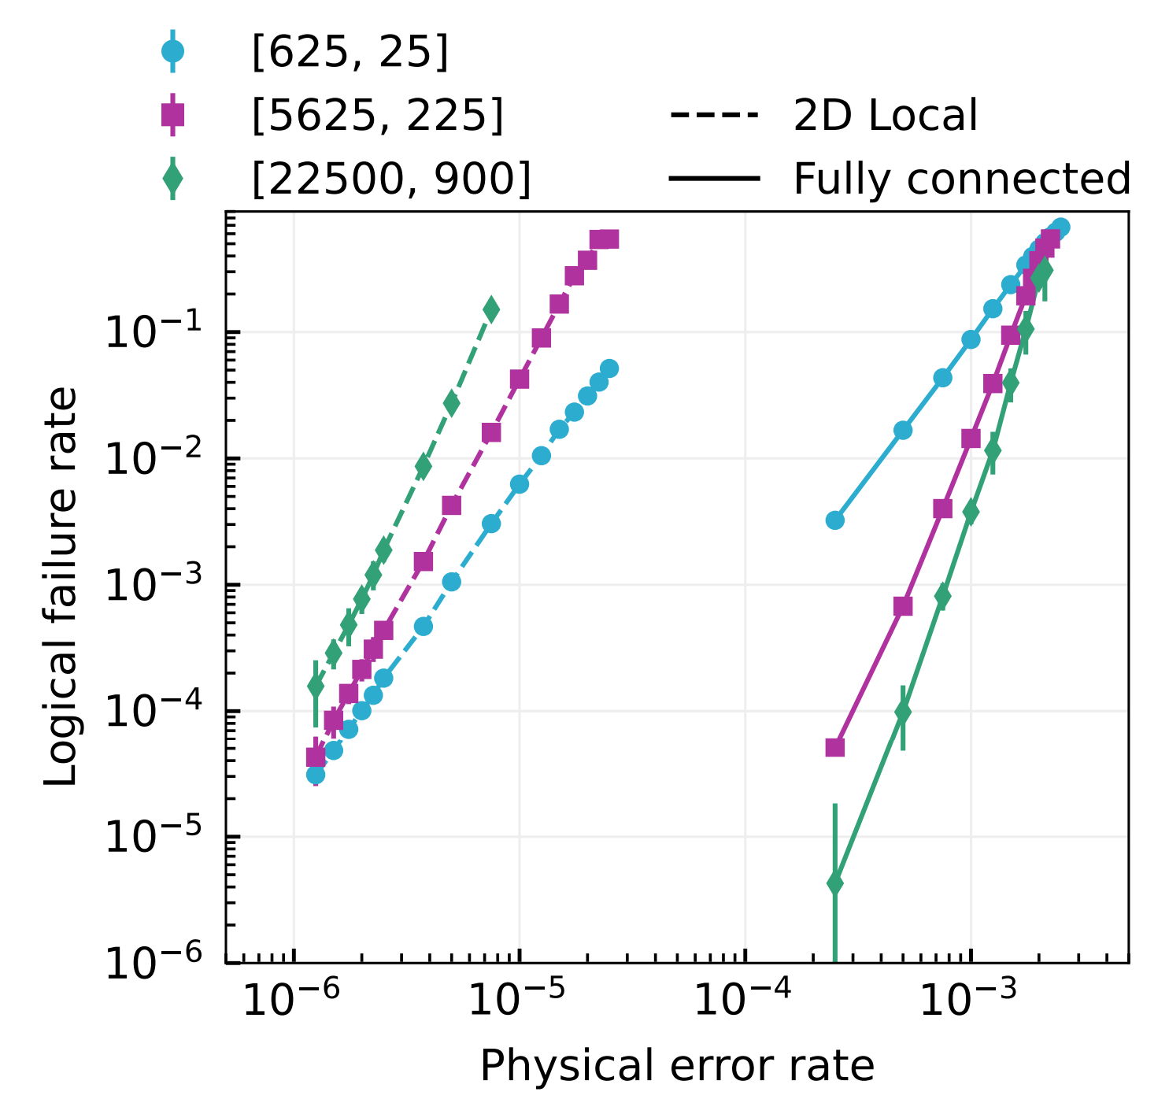
2D local vs fully connected implementation
2D local syndrome extraction circuit with:
  n ancilla qubits
  optimal depth$Ω(\sqrt{n})$.
Simulation with circuit-level noise
Cost of locality

Slide 44
Overview
Motivation
Surface code
LDPC codes with 2D local gates
Circuit bound - Proof technique
LDPC codes with long range gates
Concatenation: Surface code + LDPC codes

Slide 45
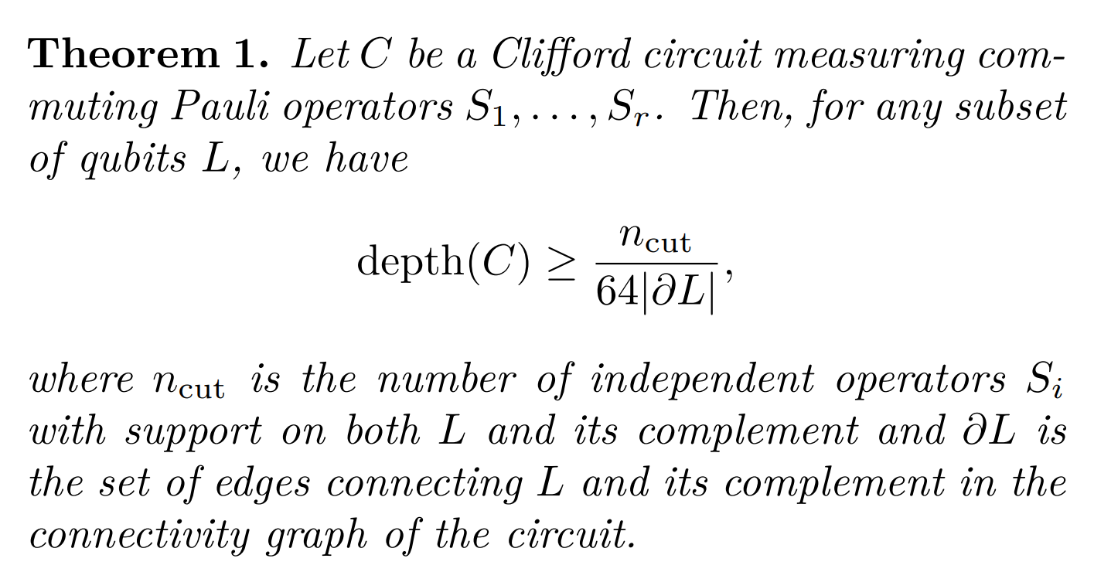
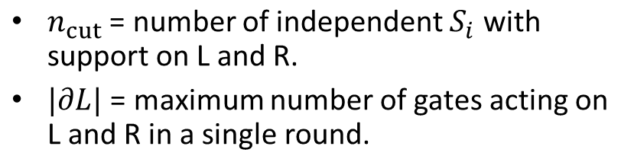
Main technical result
Cut
L
R
$$∂L$$
$n_{cut}$ = number of independent $S_{i}$ with support on L and R.
$|∂L|$ = maximum number of gates acting on L and R in a single round.
$$S_{i}$$
The previous bounds are corollaries of this result.

Slide 46
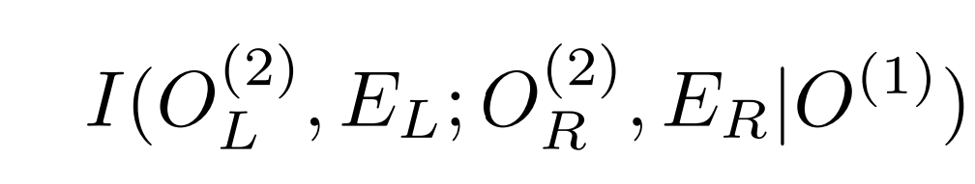
Proof strategy
Cut
Consider the correlations between L and R
Lemma 1 (Informal version)
# bits of correlations $≤32 \left|∂L\right|depth$
Lemma 2 (Informal version)
# bits of correlations $≥\frac{n_{cut}}{2}$
Application: $depth≥$ $\frac{n_{cut}}{64\left|∂L\right|}$
Main difficulty: Find the right notion of correlation¹:
L
R
$$∂L$$
$$S_{i}$$
1. See Section 4.1 of arxiv:2109.14599 for the complete proof strategy.

Slide 47
First Lemma: Upper bound on correlations
Cut
L
R
Lemma 1 (Informal version)
# bits of correlations $≤32 |∂L| depth$
Sketch of proof:
Only crossing gates (gates supported on L and R) can introduce correlations.
The circuit contains $|∂L| depth$ crossing gates.
Each crossing gate introduces a bounded amount of correlation.
crossing gate

Slide 48
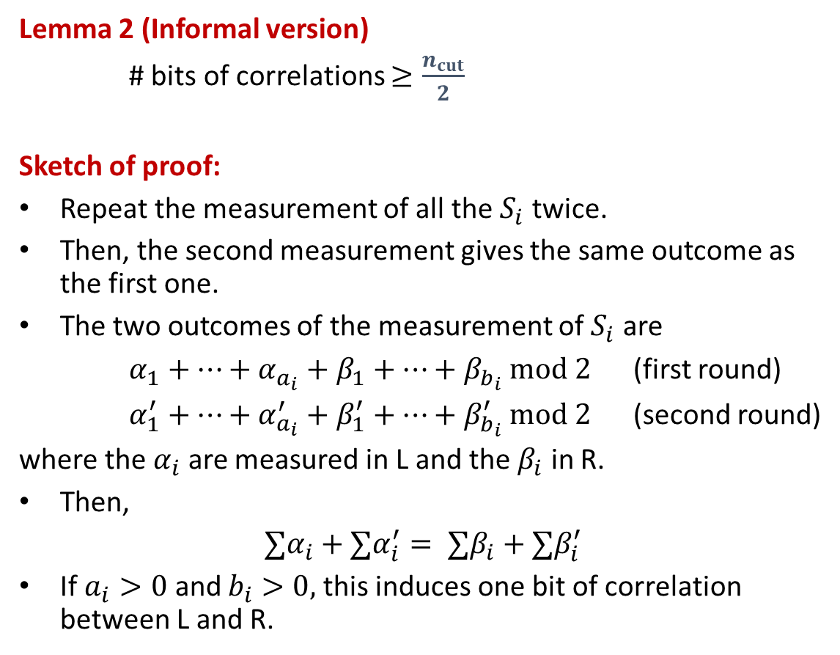
Second Lemma: Lower bound on correlations
Cut
Lemma 2 (Informal version)
# bits of correlations $≥\frac{n_{cut}}{2}$
Sketch of proof:
Repeat the measurement of all the $S_{i}$ twice.
Then, the second measurement gives the same outcome as the first one.
The two outcomes of the measurement of $S_{i}$ are
$α_{1}+…+α_{a_{i}}+β_{1}+…+β_{b_{i}} mod 2$ (first round)
$α_{1}^{′}+…+α_{a_{i}}^{′}+β_{1}^{′}+…+β_{b_{i}}^{′} mod 2$ (second round)
where the $α_{i}$ are measured in L and the $β_{i}$ in R.
Then,
$$∑α_{i}+∑α_{i}^{′}= ∑β_{i}+∑β_{i}^{′}$$
If $a_{i}>0$ and $b_{i}>0,$this induces one bit of correlation between L and R.
L
R
$$S_{i}$$

Slide 49
Overview
Motivation
Surface code
LDPC codes with 2D local gates
Circuit bound - Proof technique
LDPC codes with long range gates
Concatenation: Surface code + LDPC codes

Slide 50
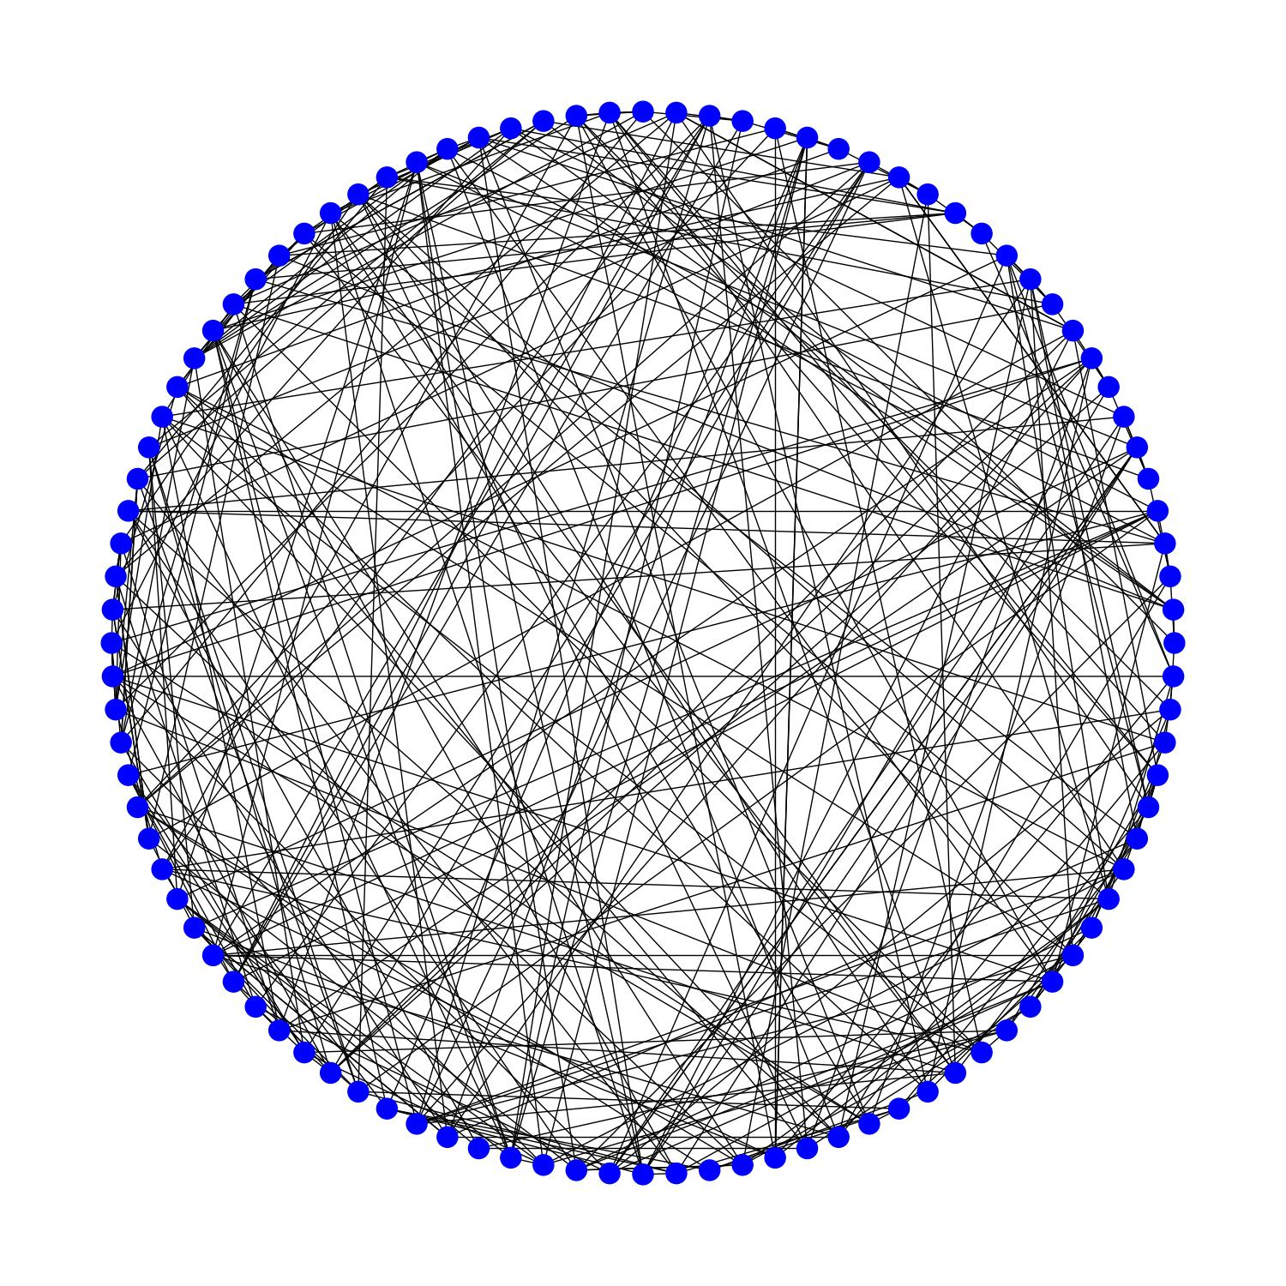
Circular layout with long-range connectivity
Issue:
Crossing gates may induce correlated errors.
Goal:
Short depth.
A small number of crossing gates.
Graph with 100 vertices with degree 8

Slide 51
2-planar layout for Hamming code
Degree = 4
# planar layers = 2

Slide 52
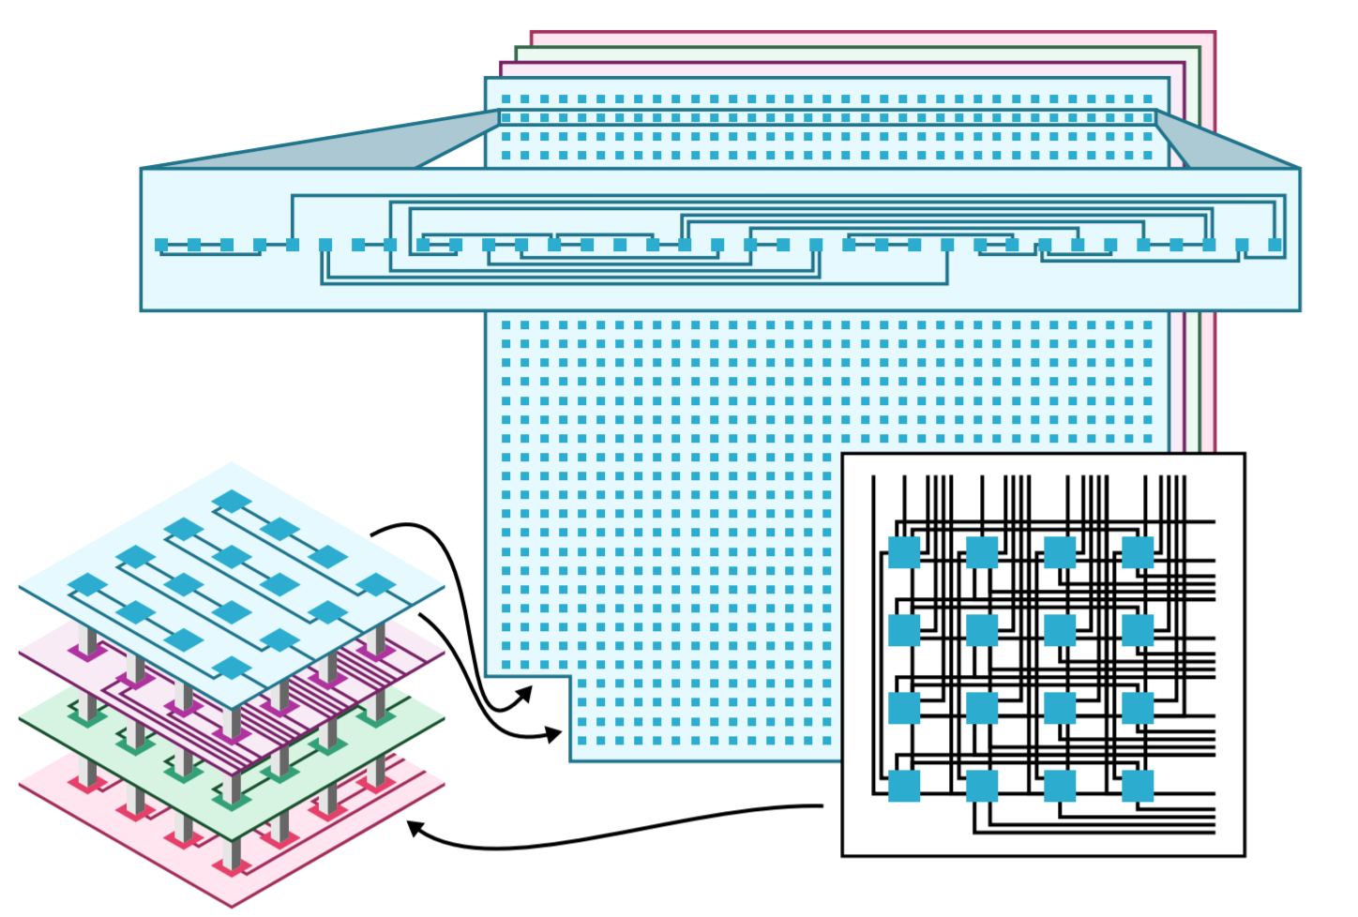

$ℓ$-planar layout
Assumption:
CSS code
Deg(Tanner graph) = $δ$
Syndrome extraction circuit:
$\left\lceil \frac{δ}{2}\right\rceil$ planar layers of gates
Depth = 2 $δ+2$
Improved depth for HGP codes.

Slide 53
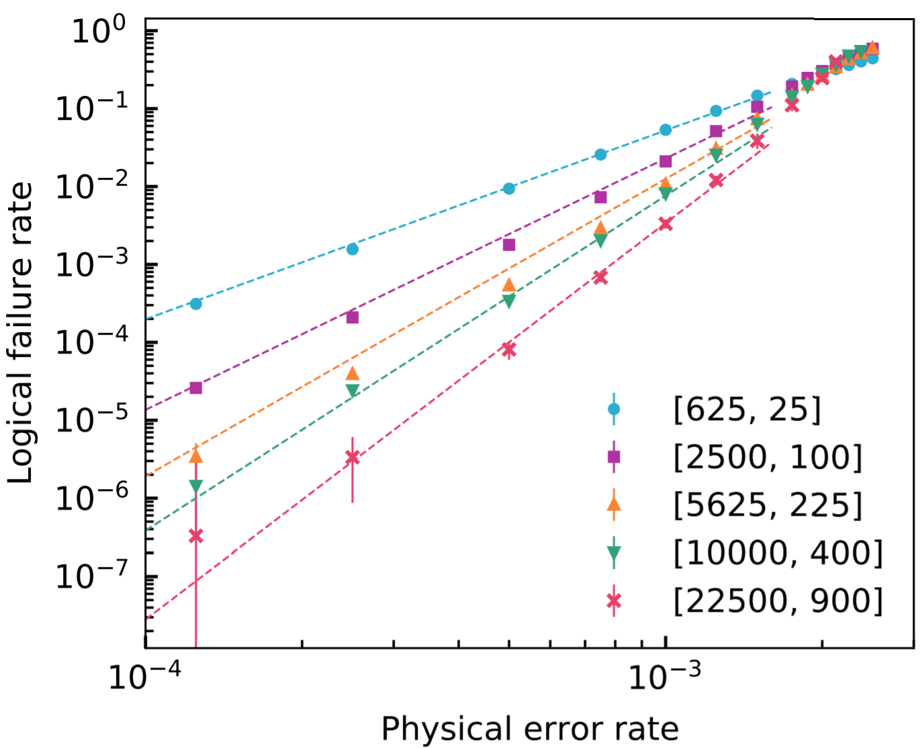
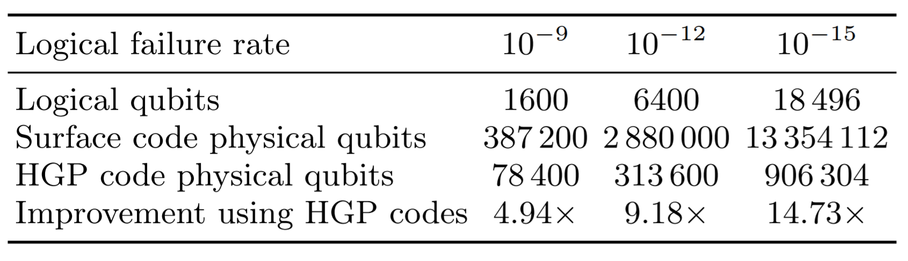
Numerical results
Noise threshold: 0.28%
(instead of 0.7% for the surface codes)
# physical qubits per logical qubit: 49
(instead of thousands for surface codes)

Slide 54
Overview
Motivation
Surface code
LDPC codes with 2D local gates
Circuit bound - Proof technique
LDPC codes with long range gates
Concatenation: Surface code + LDPC codes

Slide 55
Concatenation: SC + LDPC
Motivation:
SC have a higher threshold than LDPC codes.
LDPC codes encode more logical qubits.
Question:
Is it a good idea to build logical qubits with surface codes and use them to build LDPC codes?

Slide 56
Conclusion
Main results:
HGP codes equipped with some long-range gates can outperform surface codes.
Other positive rate LDPC codes also show an advantage. (Higgott, Breuckmann (2020) - arXiv:2010.09626)
To improve QLDPC codes we need:
Better LDPC codes.
Better decoders.
Better syndrome extraction
Better logical gates: see ref. 1, 2, 3, 4.
Reliable long-range connections.
Insulated layers of long-range connections with little crosstalk.
1. Jochym-O’Connor, arxiv:1807.09783
2. Krishna, Poulin, arxiv:1909.07424
3. Cohen, Kim, Bartlett, Brown, arxiv: 2110.10794
4. Breuckmann, Burton, arxiv:2202.06647

Slide 57
Azure Quantum for Researchers
Martin Roetteler
Microsoft

Slide 58






Azure Quantum
Explore and innovate with Quantum Compute
Build
Integrate
Test
Run
Choose your language, tools, pre-built libraries
Connect classical to quantum
Simulate and estimate
Choose your hardware
Q#, Cirq, Qiskit
VS/VS Code
Jupyter Notebooks
QDK Libraries
Python
.NET
Industry and research libraries
Client & Cloud Simulators
(Full State, Open Sys, etc.)
QDK Resource Estimator

Slide 59
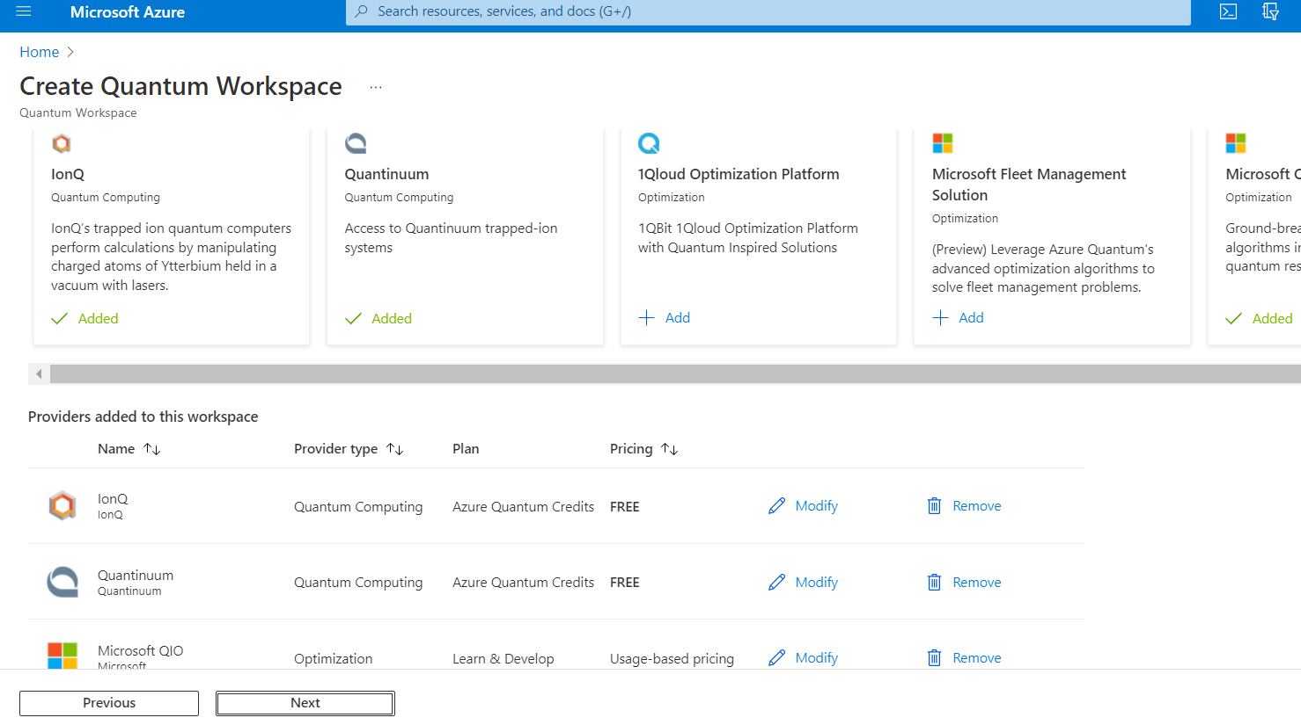
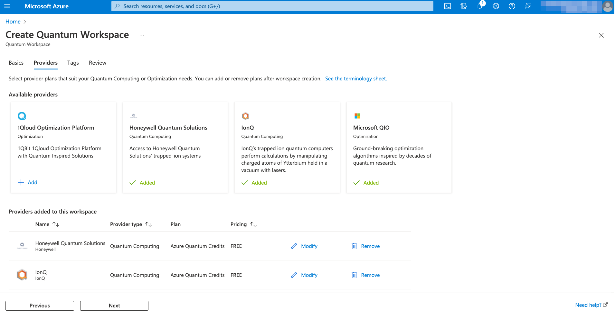
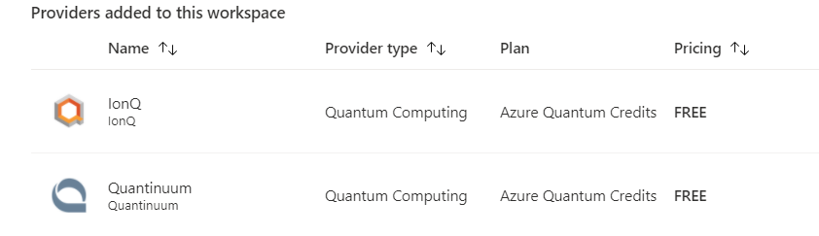


Slide 60





    Reduce the development effort,
    & promote interoperability
    Build on state-of-the-art compiler tools,
    & leverage high-performance computing
    Allow for progressive advances
    in how processor components interact
    & provide a holistic program representation
    Connect emerging technologies
    & take full advantage of the unique and distinct capabilities
https://github.com/qiralliance

Slide 61
QIR accelerates quantum research and development
Languages &
Frameworks
Q#
OpenQASM
Cirq
QCOR
Orquestra
QIR
Quantum Intermediate Representation
Hardware &
Simulators
Quantinuum
QCI
Rigetti
XACC
DM-/SV-Sim
...
devblogs.microsoft.com/qsharp/introducing-quantum-intermediate-representation-qir/

Slide 62
QIR unlocks the full potential of quantum processors
A path towards hybrid quantum applications: example of ground state estimation
Variational Quantum Eigensolver
  ➕ Low-depth circuits
  work well for near-term devices
  ➖ Can’t reuse state preparation.
  ➖ Limited by standard quantum limit.
Iterative Phase Estimation
  ➖ Large depth circuits
  that are hard for near-term devices
  ➕ Only need to prepare state once
  ➕ Limited by Heisenberg limit
Integrated approach:
Combine the two approaches as needed
  ➕ Low-depth circuits work well for near-term devices
  ➕ Can reuse state across iterations
  ➕ Limited by Heisenberg limit, rather than standard quantum limit

Slide 63
New Way of Thinking about Quantum Algorithms
This Random Walk Phase Estimation program includes both quantum and classical computation!
Using a QIR, we describe a quantum subroutine with parameters μ and σ
The calculation is iterative and adaptive: hybrid quantum/classical executed on QCI hardware while qubits are staying coherent
NO:
Next iteration
Classical
Subroutine
measurement = 0
μ = µ - 0.61 × σ
Done?
Parameters
μ, σ
Quantum
Subroutine
σ = σ × 0.80
YES: EXIT
measurement = 1
μ = µ + 0.61 × σ

Slide 64
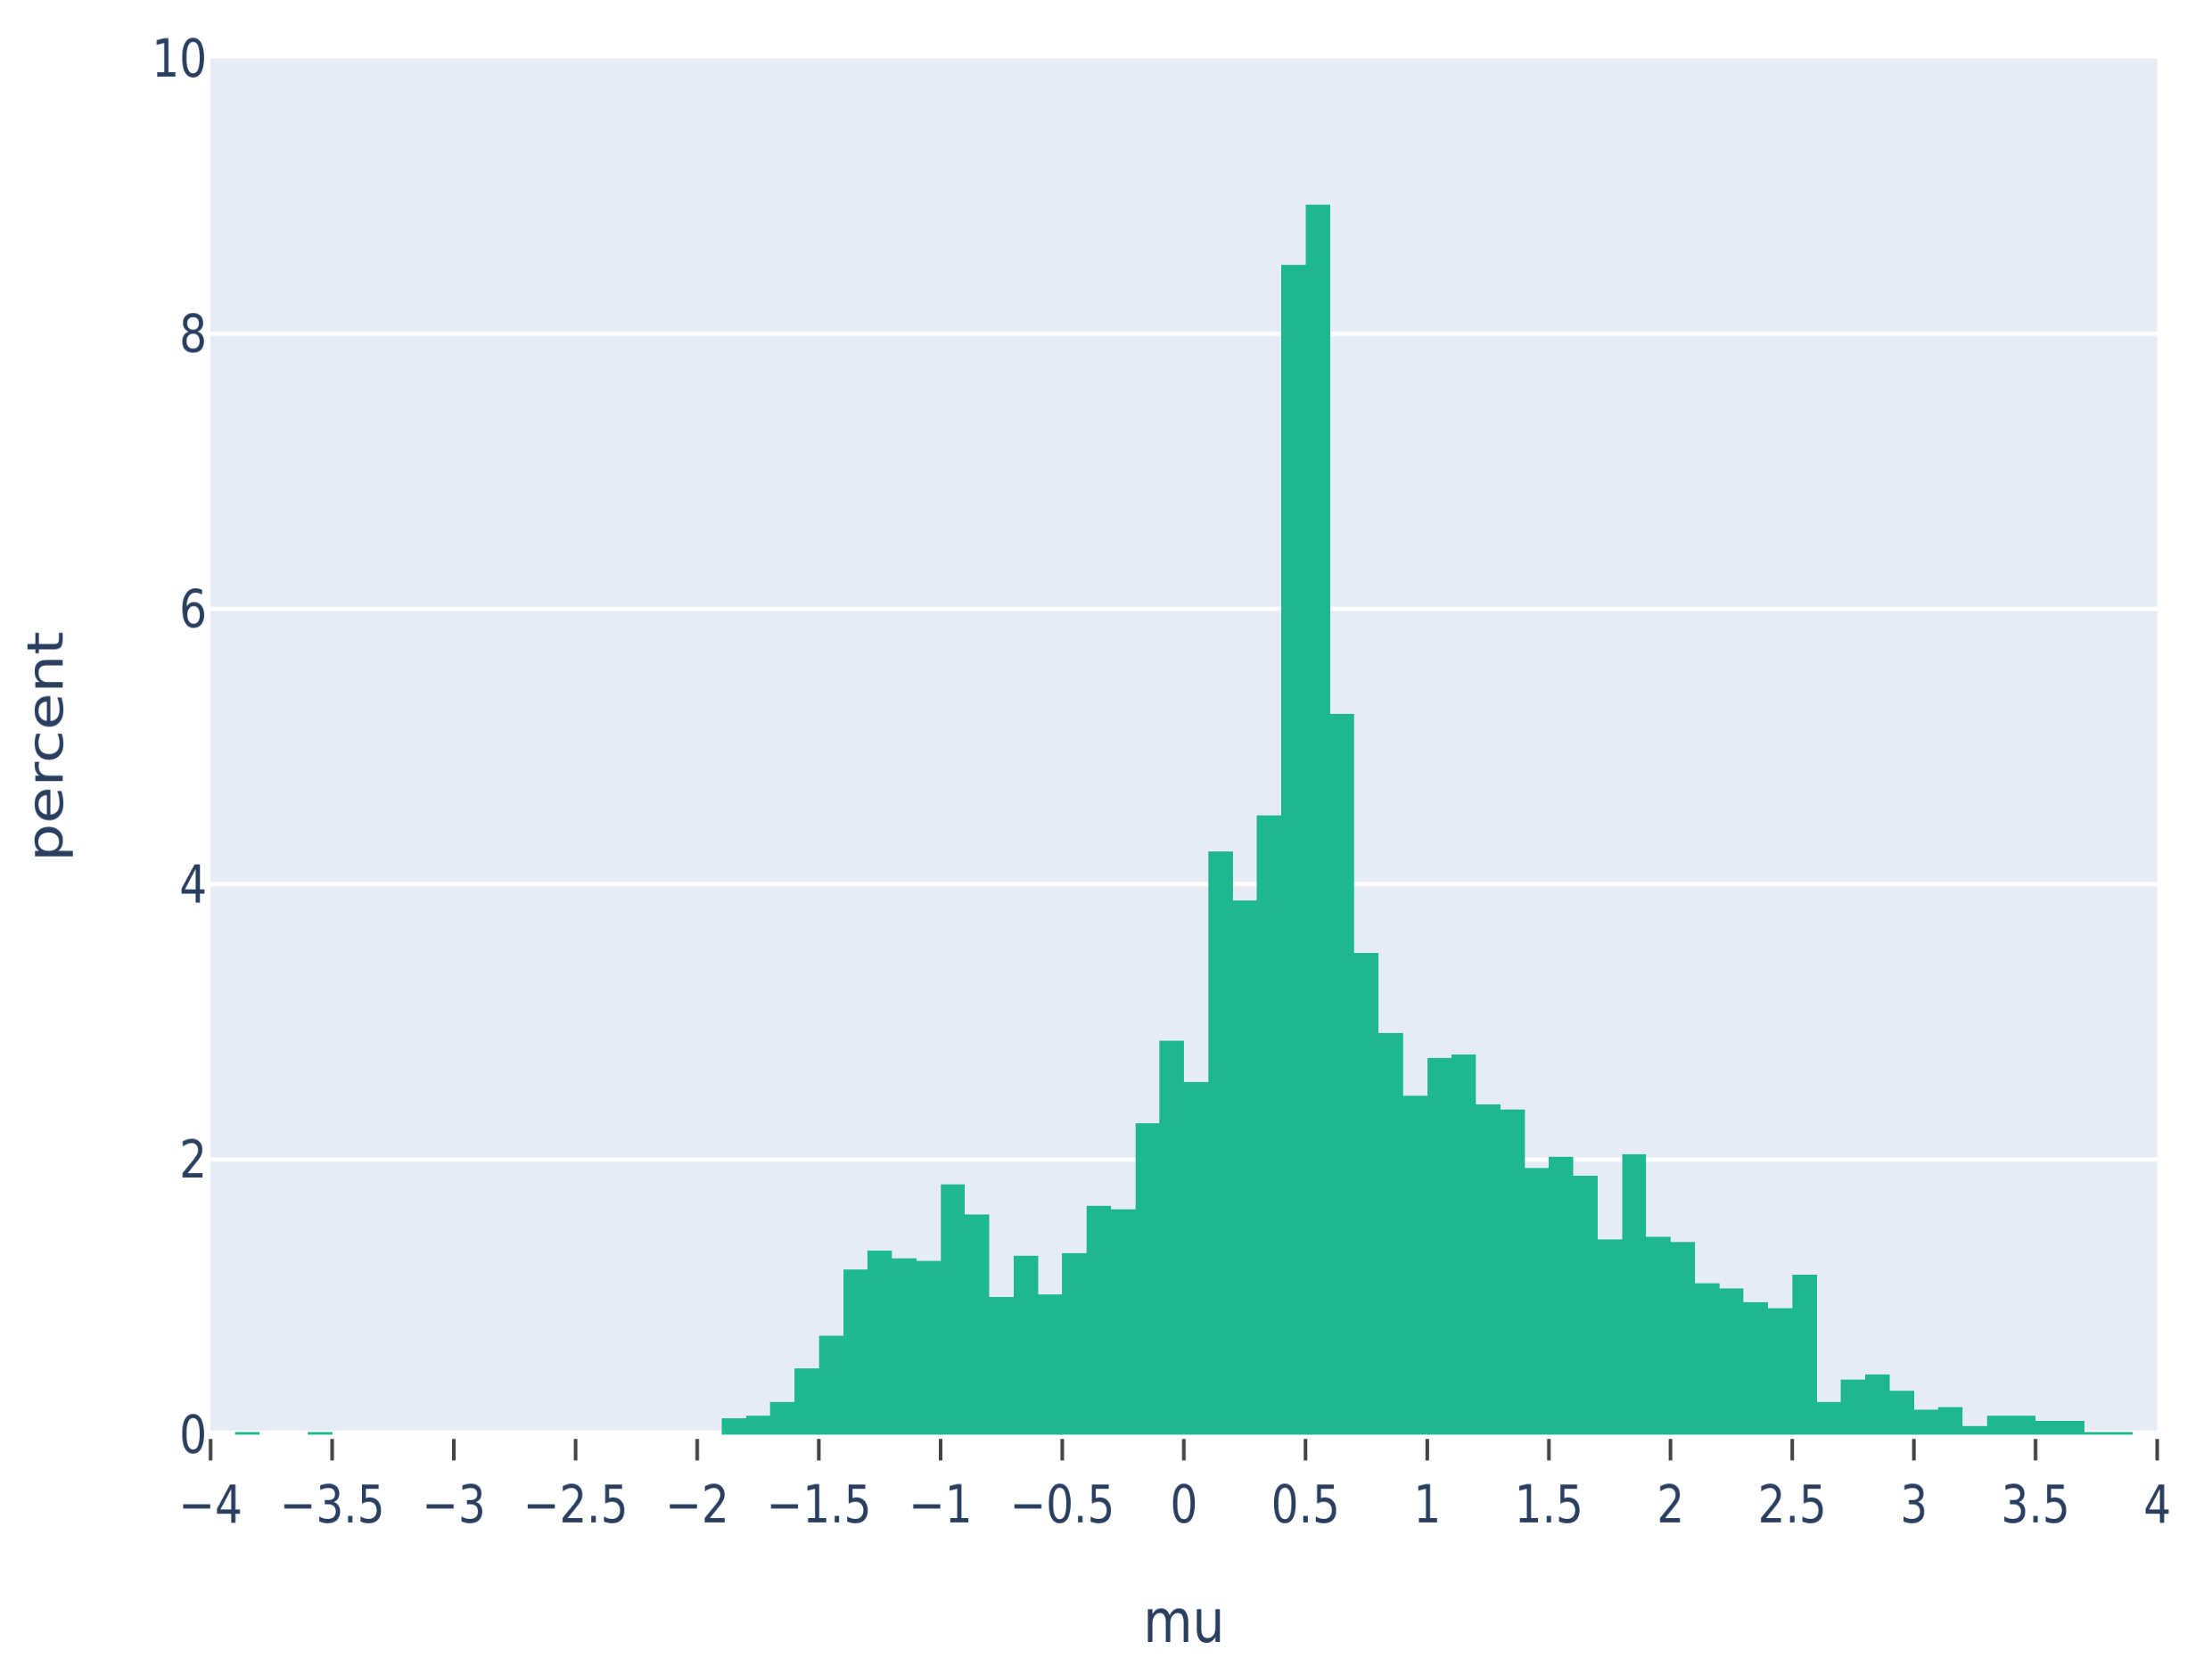
RWPE while running on QCI hardware
Combine two state-of-the-art approaches for Chemistry applications as needed
  reset qubits when needed to lower depth of iterative PE, trade off against state prep cost
Integrated approach
  ➕ Low-depth circuits
  work well for near-term devices
  ➕ Can reuse state across iterations
  ➕ Limited by Heisenberg limit,
  rather than standard quantum limit

Slide 65
Sparse pure state simulator: simple idea, big savings
Previous record
0.5 petabyte simulation for 45 qubits on Cori (Haener & Steiger at LBLN Berkeley)
Breaking the record (Jaques & Haener) with 1 core and < 100 MB RAM
Chemistry: 27 qubits in 15 min.
(vs. >1 week)
Factoring: 102 qubits in 219 sec
(vs. ~7hrs, with 2156 nodes and 14 TB RAM)
ECC DLog: 110 qubits in 69 sec
zeroes due to…
Particle conservation
Problem (e.g., period in factoring)
compress
(hashmap)
wavefunction
https://devblogs.microsoft.com/qsharp/testing-large-quantum-algorithms-using-sparse-simulation/
https://github.com/microsoft/qsharp-runtime/pull/918
Jaques/Haener arxiv:2105.01533

Slide 66



Thank you!
Sign up and try
for free today!
https://aka.ms/aq/preview
https://aka.ms/aq/credits
Access diverse set of quantum hardware
$500 credits for all
$10k credits for research projects
Sign up for new hybrid features
@msftquantum

Slide 67
Extra slides

Slide 68
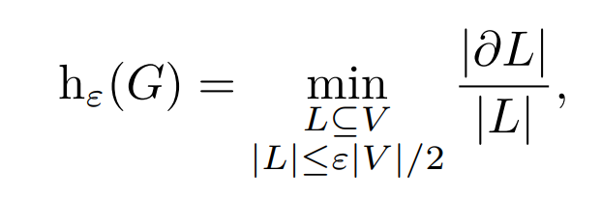
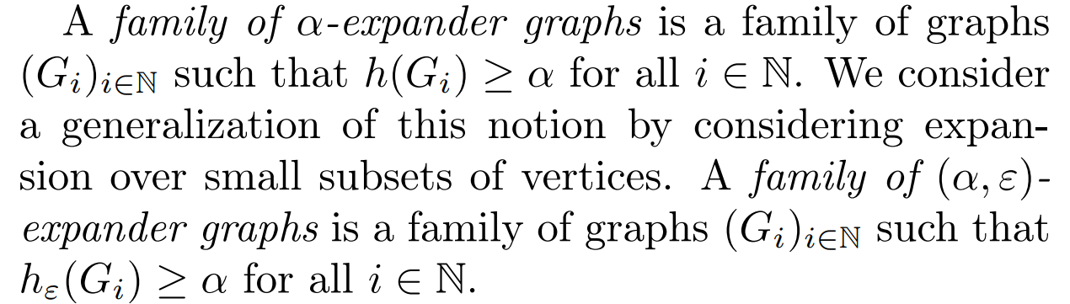
Local expander graphs

