Slide 1
Quantum LDPC codes Lecture 3
Nicolas Delfosse
Microsoft
PCMI Summer School 2023
July 27th 2023

Slide 2
Overview of the whole scheme
Today
code
Syndrome extraction circuit
X syndrome of E
0
1
1
Pauli error E
$$\left|ψ\right\rangle ∈stabilizer code$$
Correction of E
Decoder
$$E\left|ψ\right\rangle$$
Syndrome extraction circuit
1
0
1
Z syndrome of E
circuit
layout

Slide 3
The decoding problem

Slide 4
MLE, MLC and MW decoders
MLE = Most Likely Error
MLC = Most Likely Coset
MW = Min Weight
Model: Perfect measurement
Qubit noise: Probability distribution $\operatorname{Pr}\left(E\right)$ over ${\left\{I,X,Y,Z\right\}}^{n}$
Def. A decoder is a map $D:{\left\{0,1\right\}}^{r} →{\left\{I,X,Y,Z\right\}}^{n}$.
It is a MW decoder if $D(σ)$ is a min weight Pauli error with syndrome $σ$.
It is a MLE decoder if $D(σ)$ is a Pauli error that maximizes $\operatorname{Pr}\left(E|σ\right)$.
It is a MLC decoder if $D(σ)$ is a Pauli error that maximizes $\operatorname{Pr}\left(E.S|σ\right)$.

Slide 5
Comparison
In general MLC > MLE > MW
If low noise rate + low correlation probability then
MLE $≈$ MLC $≈$ MW
A MLC is better for high noise rate. For surface codes:
MLE threshold $≈$ 16%
MLC threshold $≈$ 19%

Slide 6
Standard Pauli noise models
Perfect measurement model:
Noise on data qubits
Phenomenological model:
Noise on data qubits
Noise on measurements
Circuit noise:
Noise on data qubits
Noise on measurements
Noise on ancilla qubits
Noise on gates
Noise on waiting qubits
$$|+>$$

Slide 7
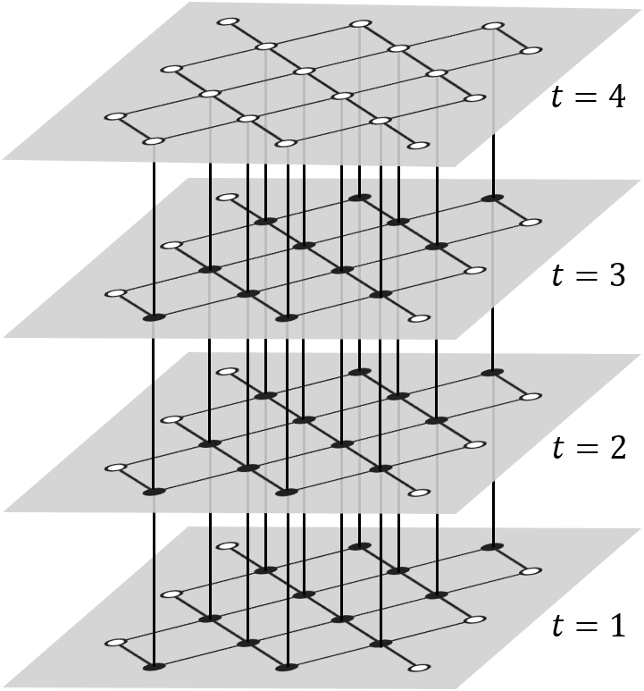
From perfect measurements to circuit model
The syndrome extraction circuit is noisy.
=> We need to correct circuit faults
But Circuit faults $≈$ Pauli errors for a larger code.
=> We focus on Pauli errors because:
Ex.
Circuit faults in 2D surface codes
$≈$ Pauli errors in 3D surface code¹.
Circuit fault in a Clifford circuit
$≈$ Pauli errors in the spacetime code².
Measurement error
Qubit errors
time
Dennis, Kitaev, Landhal, Preskill – Topological quantum memory (2001)
Delfosse, Paetznick – Spacetime codes of Clifford circuits (2023)
Three rounds of measurements

Slide 8
Lookup table decoder

Slide 9
Implementation of a MW decoder using a lookup table
Input: Code + bound $M$.
Output: A MW decoder for the correction of all errors with weight $≤M$
Initialize $D\left(σ\right)=0$ for all $σ$.
For $w=1,2,…,M$ do:
Loop over Pauli errors $E$ with weight w and do:
Compute $σ(E)$
If $D\left(σ\right)=0$, set $D\left(σ\right)=E$
Return $D$
Question. What is the size of $D$?
$$\sum_{w=`1,…,M}{\left(\begin{aligned}n \\ w\end{aligned}\right)3^{w} }$$
Checks | Correction
100 | Flip 4
010 | Flip 6
110 | Flip 2
001 | Flip 7
101 | Flip 3
011 | Flip 5
111 | Flip 1
LUT decoder for Hamming code

Slide 10
Example
Is there a LUT decoder in my laptop?
Claim:
The flash memory uses LDPC codes with length $n≈8,000$.
The code has distance $d≈30$
Is that feasible?
We need to store all corrections with weight up to $M=15$.
Cost: $≥\left(\begin{aligned}8,000 \\ 15\end{aligned}\right)≈{3.10}^{46}$ bits
30 trillions quetabits

Slide 11
Belief Propagation decoder for classical codes

Slide 12
Erasure channel
1-p
0
0
p
?
p
1
1
1-p

Slide 13
Correction of an erased bit with a (2,3)-code
?
Question: Does it work in practice?
Select graph with large girth (no short cycle).
?
?
?
?
?

Slide 14
Classical peeling decoder
$$x =$$
1
0
1
?
?
0
1
0
1
Def. A dangling check is a check connected to a single erased bit.
Peeling decoder:
While there exists a dangling check do:
Select a dangling check and use it to correct the incident bit.
$x_{1}+x_{2}+x_{5}+x_{6}=0$
$⇒1+x_{2}+1+0=0$
$⇒x_{2}=0$
Zyablov, Pinsker – 1974

Slide 15
Stopping sets
Def. A stopping set is a set of erased bits with no dangling check.
Prop. [Zyablov, Pinsker - 1974]. The peeling decoder fails iff the erasure contains a stopping set.
Theorem. [Richardson, Urbanke - 2001]. For carefully designed classical LDPC codes, the probability of an erased stopping sets vanishes.
Basic idea: Design graphs with no short cycle.
$$x =$$
1
?
?
0
?
0
1

Slide 16
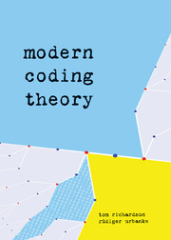
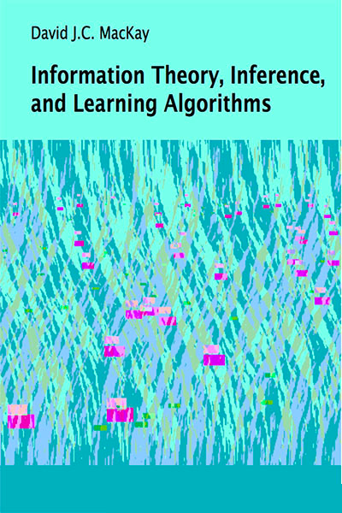
Some excellent resources on LDPC codes

Slide 17
Binary symmetric channel
1-p
0
0
p
p
1
1
1-p

Slide 18
Marginal bit-flip probability
channel
$$x_{1}x_{2}…x_{n}$$
$$y_{1}y_{2}…y_{n}$$
Goal: Compute $P\left(x_{i}=0 \right| y)$ and $P\left(x_{i}=1 \right| y)$ for all $i.$
We can use this value to correct each bit.
How?

Slide 19
Marginal bit-flip probability
We want to evaluate
$$P\left(x_{1}=0 \right| y)=\sum_{\begin{aligned}x_{1}=0 \\ x∈C \\ x_{2},{ x}_{3},…,{ x}_{n}\end{aligned}}{P\left(y\right| x)1_{x∈C}}$$
$$=\sum_{\begin{aligned}x_{1}=0 \\ x_{2},{ x}_{3},…,{ x}_{n}\end{aligned}}{\prod_{i=1,..n}{P\left(y_{i} \right| x_{i})}1_{x∈C}}$$
Question. What is $1_{x∈C}$ for the distance-3 repetition code?
$x∈C$iff $x_{1}+x_{2}=0$ and $x_{2}+x_{3}=0$
Therefore $1_{x∈C}=(1+x_{1}+x_{2})({1+x}_{2}+x_{3})$

Slide 20
Marginal bit-flip probability
We want to evaluate
$$P\left(x_{1}=0 \right| y)=\sum_{\begin{aligned}x_{1}=0 \\ x_{2},{ x}_{3},…,{ x}_{n}\end{aligned}}{\prod_{i=1,..n}{P\left(y_{i} \right| x_{i})}1_{x∈C}}$$
It a function of the form
$$\sum_{x_{2},{ x}_{3},…,{ x}_{n}}{f_{1}\left(x\right)…f_{m}(x)}$$
For LDPC codes each $f_{i}$ depends only on a small number of variables $x_{i}$.
Question. How many multiplications are needed?
$O(2^{k}n)$ multiplications.

Slide 21
Example
Compute the sum
$$\sum_{{x_{1}, x}_{2},{ x}_{3},x_{4} }{f\left(x_{1}, x_{2}, x_{3}\right)g\left(x_{4}\right)}$$
$$\left(\sum_{x_{1},{ x}_{2}, { x}_{3} }{f\left(x_{1}, x_{2}, x_{3}\right)}\right)\left(\sum_{x_{4}}{g\left(x_{4}\right)}\right)$$

Slide 22
Marginal computation by Belief Propagation
Ex. Compute the sum
$$\sum_{x_{2},{ x}_{3},x_{4},{ x}_{5},{ x}_{6}}{f_{1}\left(x_{1}, x_{2}, x_{3}\right)f_{2}\left(x_{1}, x_{4}, x_{6}\right)f_{3}\left(x_{4}\right)f_{4}(x_{4}, x_{5})}$$
Strategy:
Represent the $f_{i}$ and their variables as a graph (called factor graph).
Use the graph topology to optimize the computation of partial sums.

Slide 23
Factor graph construction:
Create a circle node for each $x_{i}$
Create a square node for each $f_{j}$
If $x_{i}$ is present in $f_{j}$ connect them
Orient edges toward the marginal variable ($x_{1}$ here)
$$x_{1}$$
$$f_{1}$$
$$f_{2}$$
$$x_{2}$$
$$x_{3}$$
$$x_{4}$$
$$x_{6}$$
$$f_{3}$$
$$f_{4}$$
$$\sum_{x_{2},{ x}_{3},x_{4},{ x}_{5},{ x}_{6}}{f_{1}\left(x_{1}, x_{2}, x_{3}\right)f_{2}\left(x_{1}, x_{4}, x_{6}\right)f_{3}\left(x_{4}\right)f_{4}(x_{4}, x_{5})}$$
$$x_{5}$$

Slide 24
Belief Propagation messages
$$f_{1}$$
$$\left({\prod_{i=2}^{m}{μ_{f_{i}→x_{1}}(0)} \atop \prod_{i=2}^{m}{μ_{f_{i}→x_{1}}(1)}}\right)$$
= product of incoming messages
$$x_{1}$$
$$…$$
$$f_{2}$$
$$f_{3}$$
$$f_{m}$$
From variables to checks

Slide 25
Belief Propagation messages
$$x_{1}$$
$$\left({\sum_{x_{2},…,x_{s}}{f_{1}(0,x_{2},…,x_{m}) \prod_{i=2}^{m}{μ_{x_{i}→f_{1}}(x_{i})}} \atop \sum_{x_{2},…,x_{s}}{f_{1}(1,x_{2},…,x_{m}) \prod_{i=2}^{m}{μ_{x_{i}→f_{1}}(x_{i})}}}\right)$$
$$f_{1}$$
= sum over all values of incoming variables
$$…$$
$$x_{2}$$
$$x_{3}$$
$$x_{m}$$
From checks to variable

Slide 26
$$\left({\sum_{x_{2}x_{3}}{f_{1}(0,x_{2},x_{3})×}\sum_{x_{4}x_{6}}{f_{2}\left(0,x_{4},x_{6}\right)}f_{3}\left(x_{4}\right)\sum_{x_{5}}{f_{4}\left(x_{4},x_{5}\right)} \atop \sum_{x_{2}x_{3}}{f_{1}(1,x_{2},x_{3})×}\sum_{x_{4}x_{6}}{f_{2}\left(1,x_{4},x_{6}\right)}f_{3}\left(x_{4}\right)\sum_{x_{5}}{f_{4}\left(x_{4},x_{5}\right)}}\right)$$
$$\left({\sum_{x_{2}x_{3}}{f_{1}(0,x_{2},x_{3})×1×1} \atop \sum_{x_{2}x_{3}}{f_{1}(1,x_{2},x_{3})×1×1}}\right)$$
$$\left({\sum_{x_{4}x_{6}}{f_{2}\left(0,x_{4},x_{6}\right)}×f_{3}\left(x_{4}\right)\sum_{x_{5}}{f_{4}\left(x_{4},x_{5}\right)×1} \atop \sum_{x_{4}x_{6}}{f_{2}\left(1,x_{4},x_{6}\right)}×f_{3}\left(x_{4}\right)\sum_{x_{5}}{f_{4}\left(x_{4},x_{5}\right)×1}}\right)$$
$$x_{1}$$
$$f_{1}$$
$$\left({f_{3}(0)×\sum_{x_{5}}{f_{4}(0,x_{5})} \atop f_{3}(1)×\sum_{x_{5}}{f_{4}(1,x_{5})}}\right)$$
$$f_{2}$$
$$\left({1 \atop 1}\right)$$
$$\left({1 \atop 1}\right)$$
$$\left({1 \atop 1}\right)$$
$$x_{2}$$
$$x_{3}$$
$$x_{4}$$
$$x_{6}$$
$$\left({f_{3}(0) \atop f_{3}(1)}\right)$$
$$\left({\sum_{x_{5}}{f_{4}(0,x_{5})×1} \atop \sum_{x_{5}}{f_{4}(1,x_{5})}×1}\right)$$
$$f_{3}$$
$$f_{4}$$
$$\left({1 \atop 1}\right)$$
$$\sum_{x_{2},{ x}_{3},x_{4},{ x}_{5},{ x}_{6}}{f_{1}\left(x_{1}, x_{2}, x_{3}\right)f_{2}\left(x_{1}, x_{4}, x_{6}\right)f_{3}\left(x_{4}\right)f_{4}(x_{4}, x_{5})}$$
$$x_{5}$$

Slide 27
Belief Propagation – Final comments
Applications:
In a tree: BP compute exactly the bit-flip probabilities.
In a graph: BP compute an approximation of the bit-flip probabilities.
For LDPC codes: For LDPC code with large girth (no short cycle), BP compute a good approximation of the bit-flip probabilities.
Progressive edge growth: Algorithm producing LDPC codes with large girth.
Remark.
BP does not generally return a codeword.
But it corrects each bit with high probability.

Slide 28
The quantum decoding problem

Slide 29
Depolarizing channel
1-p
0
0
p
p
1
1
1-p
1-p
Classical binary symmetric channel
$$ρ$$
$$ρ$$
p/3
p/3
$$XρX$$
p/3
$$YρY$$
$$ZρZ$$

Slide 30
First decoding attempt: BP
Classical case:
Use BP to compute $P\left(x_{i}=0 \right| y)$ and $P\left(x_{i}=1 \right| y)$.
Correct by selecting the most likely value $x_{i}$ $=0$ or 1.
Quantum case:
Use BP to compute $P\left(E_{i}=I \right| s),P\left(E_{i}=X \right| s),P\left(E_{i}=Y \right| s)$ and $P\left(E_{i}=Z \right| s)$.
BP does not perform well for two reasons:
The quantum Tanner graph contains many 4-cycles because of the commutation relations.
The event $E_{i}=I$ is not well defined up to a stabilizer.

Slide 31
UF decoder for LDPC codes

Slide 32
Separation of X and Z errors
In what follows we focus on Z errors.

Slide 33
Error detection
Z
= Z error
Z
Z
= check with value 0
Z
= check with value 1
A chain of errors is detected at its endpoints

Slide 34
Trivial errors and logical errors
Loops are trivial errors.
Paths connecting the same side are trivial errors.
Paths connecting the two opposite sides are logical errors.
No effect

Slide 35
Union-Find decoder
Union-Find decoder:
Grow clusters around check with value 1.
Stop growing a cluster when it becomes correctable.
Correct each cluster independently.
Remark:
We track the growing cluster using a Union-Find data structure which leads to an almost-linear complexity.
Delfosse, Nickerson (2017) arxiv1709.06218

Slide 36
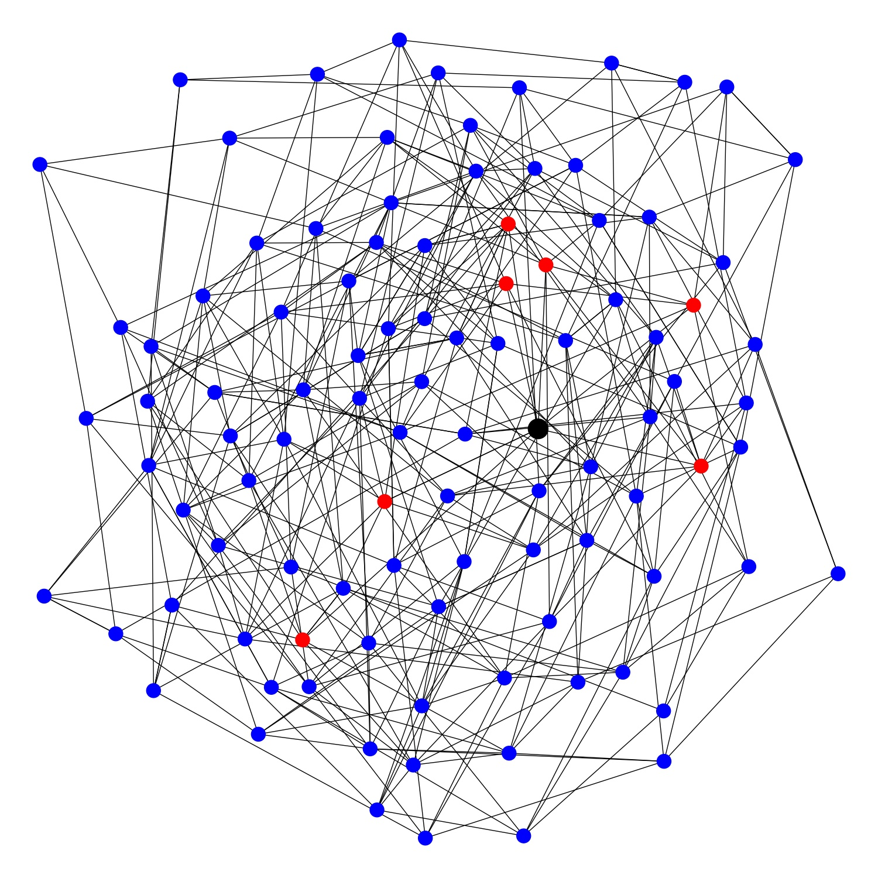
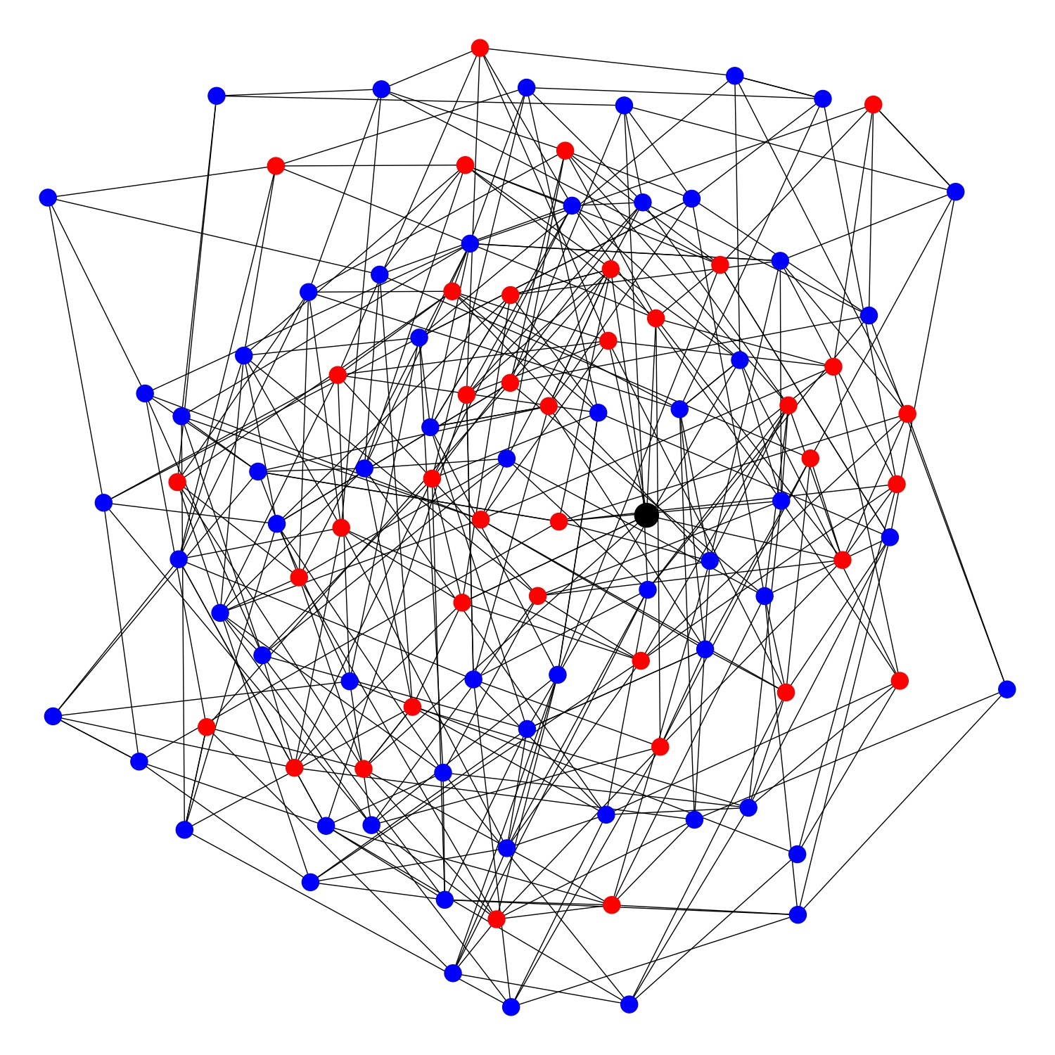
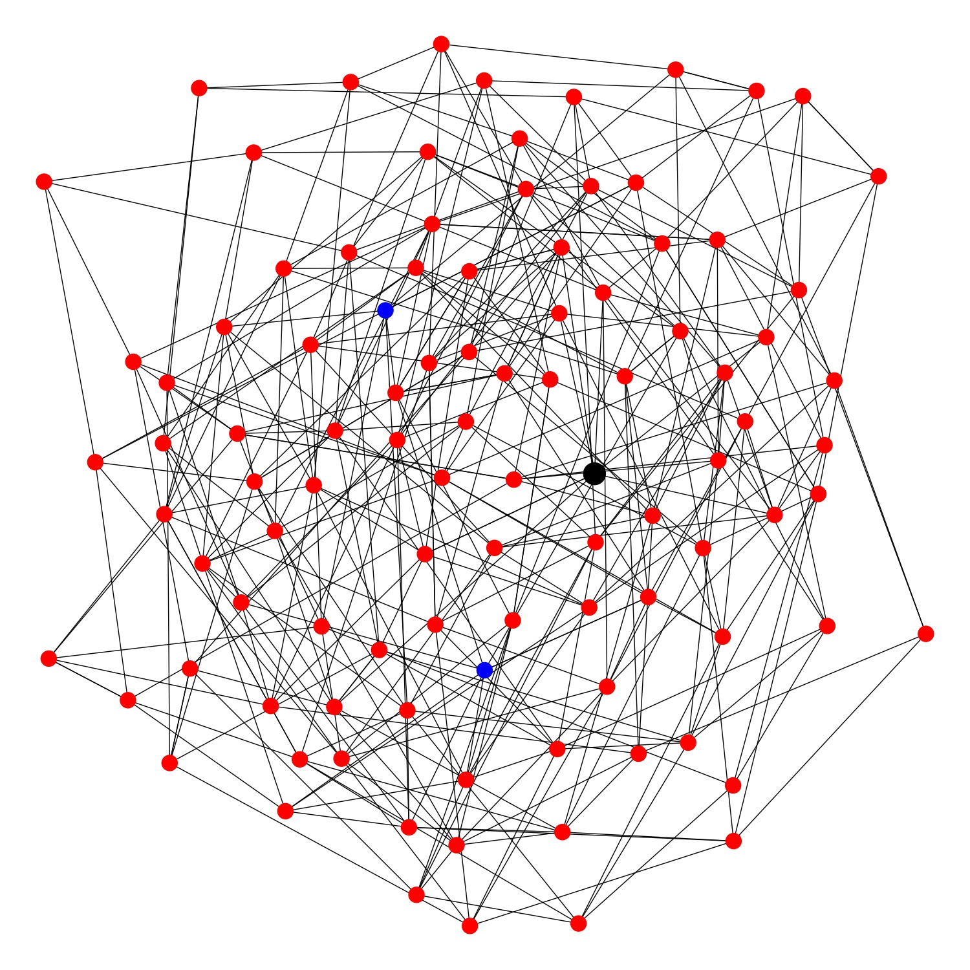
The problem with LDPC codes
Clusters grow too fast!

Slide 37
The covering radius
Def. The covering radius of a syndrome s is the min radius such that the red balls cover an error with syndrome s.
Theorem (informal). If the covering radius of the syndrome is small, then the Union-Find decoder succeeds.
Applications: The UF decoders corrects $n^{a}$ errors for:
Quantum expander codes
Hyperbolic codes¹ in dimension $D≥3$ [Guth, Lubotzky, (2013)]
Toric codes in dimension $D≥3$
error
detection
Delfosse, Londe, Beverland (2021) arxiv:2103.08049

Slide 38
Union-Find decoder - Complexity
Complexity:
For surface codes and color codes: $O(nα(n))$.
$α(n)$ is the inverse of Ackermann’s function.
For LDPC codes: $O(n^{4})$.
For typical LDPC codes (expander): $O(n^{3}\log{n})$.
Research question: Improve the complexity of the UF decoder for LDPC codes.
Research question: Design a UF decoder that corrects (d-1)/2 errors for toric codes in all dim $D≥3$.
See section 7 of arxiv:2103.08049.

Slide 39
BP-OSD

Slide 40
BP+OSD₀ decoder
error = ( 0 0 0 1 0 0 0 )
H = $\left(\begin{matrix}1 & 0 & 1 & 0 & 1 & 0 & 1 \\ 0 & 1 & 1 & 0 & 0 & 1 & 1 \\ 0 & 0 & 0 & 1 & 1 & 1 & 1\end{matrix}\right)$
=> Syndrome s = $\left(\begin{matrix}0 \\ 0 \\ 1\end{matrix}\right)$
Goal: Find a likely error x with H x = s
Estimate all bit flip probabilities using BP.
Select a basis H’ of columns made with highest probability columns.
Solve H’ x’ = s.
Construct x from x’.
(.12 .17 .05 .31 .32 .06 .01 )
H’ = $\left(\begin{matrix}1 & 0 & 0 \\ 0 & 0 & 1 \\ 1 & 1 & 0\end{matrix}\right)$
=> x’ = ( 0 1 0 )
=> x = ( 0 0 0 1 0 0 0 )
Panteleev, Kalachev - arXiv:1904.02703.

Slide 41
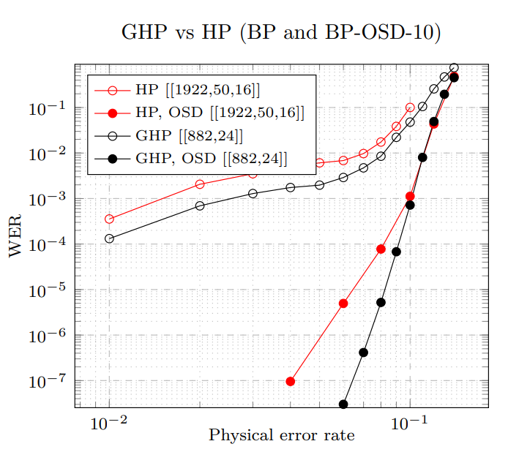
BP+OSD₀ decoder - Complexity
Complexity:
with OSD₀$: O(n^{3})$.
with OSD_{w}$: O({2^{w}n}^{3})$.
Panteleev, Kalachev - arXiv:1904.02703.

Slide 42
Other decoding strategies for QLDPC codes
Combining hard and soft decoders for hypergraph product codes - Grospellier, Groues, Krishna, Leverrier (2020)
Decoding Across the Quantum LDPC Code Landscape - Roffe, White, Burton, Campbell (2020)
ReShape: a decoder for hypergraph product codes - Quintavalle, Campbell (2021)
Stabilizer Inactivation for Message-Passing Decoding of Quantum LDPC Codes - Du Crest, Mhalla, Savin (2022)
Ultimate Goal: Linear complexity + performance close to optimal.

Slide 43
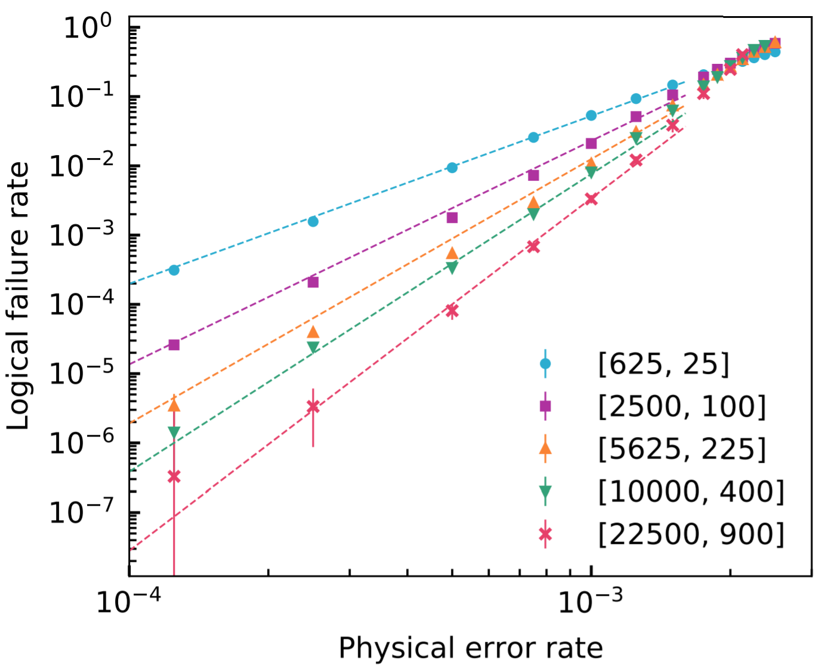
Conclusion: Which decoder should we use?
PB: Does not work well with quantum LDPC because of short cycles
UF for QLDPC: corrects a poly number of errors but may reduce the distance
BP-OSD: Heuristic but seems to behave well in simulation.

