Slide 1
Tutorial on Quantum Error Correction – Part 2
Nicolas Delfosse
Microsoft
UCLA – Mathematical and Computational Challenges in Quantum Computing
September 12th 2023

Slide 2
Overview
Classical error correction
Small quantum codes
Topological codes
LDPC codes

Slide 3
Defining a quantum code
$$H= \left[\begin{matrix}X & I & X & I & X & I & X \\ I & X & X & I & I & X & X \\ I & I & I & X & X & X & X \\ Z & I & Z & I & Z & I & Z \\ I & Z & Z & I & I & Z & Z \\ I & I & I & Z & Z & Z & Z\end{matrix}\right]$$
or
Requirement: The checks must commute

Slide 4
Part 2 - Topological codes

Slide 5
Topological codes
Code constructions

Slide 6
Homological codes
Consider a collection of objects with dim $i=0,1, 2,…,D$ with:
boundary maps to move from dimension $i$ and $i−1$
coboundary maps to move from dimension $i$ and $i+1$
Kitaev’s code construction
Place a qubit on each object with dim $i=1$ (edges).
Define a X check for each object with dim $i−1$.
Define a Z check for each object with dim $i+1$.
Prop. If the boundary maps form a chain complex, the checks commute.
Z
Z
Z
X
Z
X
X
X
Kitaev –Fault-tolerant quantum computation by anyons. arxiv:9707021

Slide 7
Example – The 3D toric code
Kitaev’s code construction:
Qubits on dim $i$.
X check on dim $i−1$.
Z check on dim $i+1$.
Two choices: Qubits on edges or faces.
3D toric code with qubits on face

Slide 8
Planar cellulation
Instead of a torus, we consider a planar region:
No identification of the opposite side.
Rotate the square grid.
Remove top and bottom vertices

Slide 9
Definition of the rotated surface code
Planar surface code:
Qubits on edges.
X check on vertices.
Z check on faces.
Remark.
The boundary vertices and faces define weight-2 generators.
X
X
X
X
Z
Z
Z
Z
Bravyi, Kitaev – Quantum code on a lattice with boundary. arxiv:9811052
Freedman, Meyer – Projective plane and planar quantum codes. arxiv:9810055
Bombin, Martin-Delgado – Optimal resources for 2D topological stabilizer codes: Comparative study. arxiv:0703272

Slide 10
Tanner graphs of the rotated surface code
$$=$$
3 x 3 surface code
Corrects 1 error
5 x 5 surface code
Corrects 2 errors
5 x 5 surface code
Alternative representation

Slide 11
Topological codes
Syndrome extraction circuit

Slide 12
Can we apply Shor FT scheme?
Shor FT:
Measure the checks sequentially
Repeat until we see the same syndrome multiple times
Is it a good idea?
There are many checks to measure ($899$ for $d≈30$)
In the meantime, errors accumulate during 899x6=5394 timesteps.
Solution:
Measure all the checks simultaneously.

Slide 13
Syndrome extraction circuit
$$|+>$$
$$|+>$$
$$|+>$$
$$|+>$$
Z
Z
flip
$$|+>$$
$$|+>$$
$$|+>$$
$$|+>$$
X plaquette circuit
$$|+>$$

Slide 14
Topological codes
Fault tolerance

Slide 15
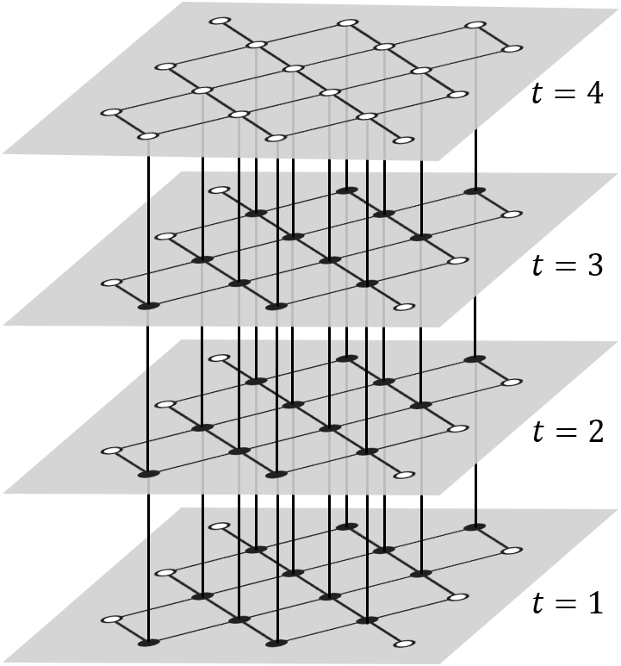
From perfect measurements to circuit model
To correct circuit faults, we repeat the syndrome extraction circuit $d$ times.
Circuit faults in 2D surface codes
$≈$ Pauli errors in 3D surface code.
Measurement error
Qubit errors
time
Three rounds of measurements
Dennis, Kitaev, Landhal, Preskill (2001)

Slide 16
Topological codes
Decoders

Slide 17
Many decoders for surface codes
Many decoders for surface codes:
Based on Tensor Networks contraction, Neural networks, Convolutional Neural Networks, Lookup tables, Simulated annealing, Cellular Automaton, Renormalization Group, Parallel algorithms, Belief Propagation, Reinforcement Learning, Markov Chain Monte-Carlo, Ising model, Combinatorial optimization Solvers.
I will describe
Minimum Weight Perfect Matching (MWPM) decoder¹
Union Find (UF) decoder²
Dennis, Kitaev, Landahl, Preskill (2001)
Delfosse, Nickerson (2017)

Slide 18
Separation of X and Z errors
In what follows we focus on Z errors.

Slide 19
Error detection
Z
= Z error
Z
Z
= check with value 0
Z
= check with value 1
A chain of errors is detected at its endpoints

Slide 20
Trivial errors and logical errors
Loops are trivial errors.
Paths connecting the same side are trivial errors.
Paths connecting the two opposite sides are logical errors.
No effect

Slide 21
Matching decoder
a
b
c
d
d
Correction
Error + correction = trivial error
The decoder succeeded.
a
b
a
1
b
Distance graph
2
1
2
1
c
d
Dennis, Kitaev, Landahl, Preskill. arxiv:0110143
Fowler. arxiv:1307.1740 Higgott, Gidney. arxiv:2303.15933
c
2
d
Min weight matching

Slide 22
Union-Find decoder
Union-Find decoder:
Grow clusters around check with value 1.
Stop growing a cluster when it becomes correctable.
Correct each cluster independently.
Remark:
We track the growing cluster using a Union-Find data structure which leads to a complexity in $O(nα\left(n\right))$.
Delfosse, Nickerson (2017) arxiv1709.06218

Slide 23
MWPM vs UF decoder
 | Matching | Union-Find
Complexity | $$O(n^{2})$$ | $$O(nα(n))$$
Threshold with circuit noise | 0.72% | 0.62%
Fast software implementations:
Pymacthing: MWPM in C++. v1 by Higgott (2021), v2 by Higgott, Gidney (2023)
Fusion blossom: MWPM in Rust. Yue Wu (2023)
Hardware implementation:
LUT decoder on FPGA by Google: Das, Locharla, Jones. arxiv:2108.06569
UF decoder on FPGA by Yale: Liyanage, Wu, Deters, Zhong. arxiv:2301.08419
UF decoder on FPGA by Riverlane: arxiv:2309.05558

Slide 24
Why surface codes?
25x25 surface code:
Physical error rate: ${10}^{−3}⇒$ Logical error rate: ${10}^{−12}$
Advantages:
High noise threshold (about 1%).
Implemented with 2D local gates.
Main issue:
Thousands of physical qubits per logical qubit.
Here: 1250 physical qubits
Dennis, Kitaev, Landhal, Preskill – Topological quantum memory. arxiv:0110143
Raussendorf, Harrington – Fault-Tolerant quantum computation with high threshold in two dimensions. arxiv:0610082
Fowler, Mariantoni, Martinis, Cleland – Surface code: Toward practical large-scale quantum computation. arxiv:1208.0928

Slide 25
Part 3 – Quantum LDPC codes

Slide 26
Quantum LDPC codes
Code constructions

Slide 27
Example – Hypergraph product code
Take the cartesian product of two Tanner graphs:
Place a qubit on each circle-circle.
Place a qubit on each square-square.
Define a X checks for each square-circle.
Define a Z checks for each circle-square.
What is n?
n=11
What is the first stabilizer generator?
III XII XII XI
X
Z
Z
Z
X
X
Z
Tillich, Zémor – Quantum LDPC codes with positive rate and minimum distance proportional to $n^{1/2}$. arxiv:0903.0566

Slide 28
A family of LDPC codes with constant rate
Select two random Tanner graphs with
4s bits with degree 3.
3s checks with degree 4.
We get HGP codes with
$n=25s^{2}$
$k=s^{2}$
Generator degree $=7$
Qubit degree $=$ 6 or 8
Grospellier, Krishna – Numerical study of hypergraph-product codes. arxiv:1810.03681

Slide 29
Surface codes vs LDPC codes
Code | Surface codes | LDPC codes
# logical qubits k | $$1$$ | $$\frac{n}{25}$$
Measurement weight | $$4$$ | $$7$$
# ancilla qubits | $$n$$ | ?

Slide 30
Quantum LDPC codes
Syndrome extraction circuits

Slide 31
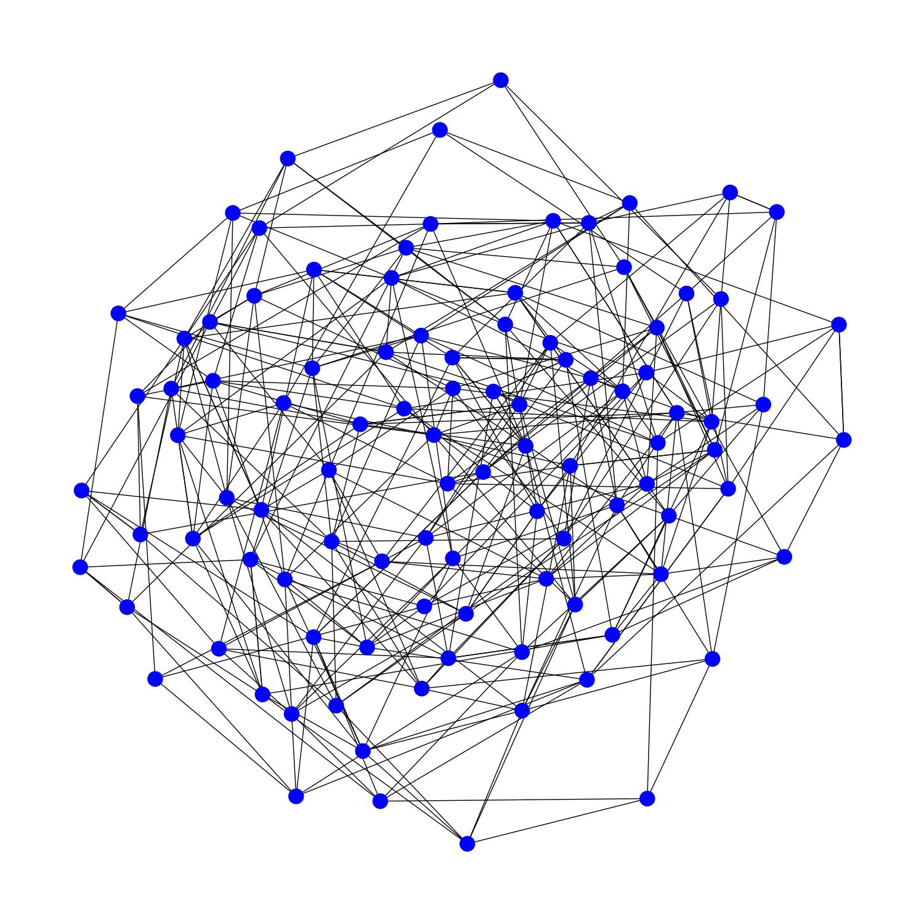
Can we implement quantum LDPC codes?
Typical LDPC code
Typical quantum computer

Slide 32
Main results
With 2D local gates¹:
Need large depth circuits or many ancilla qubits.
Numerically: poor performance.
With long-range connections^{2, 3}:
Layout based on only a few planar layers.
Numerically outperform surface codes.
1. Delfosse, Beverland, Tremblay – Bounds on stabilizer measurement circuits and obstruction to local implementations of quantum LDPC codes. arxiv2109.14599
2. Tremblay, Delfosse, Beverland – Constant overhead quantum error correction with thin plan connectivity. arxiv:2109.14609
3. Bravyi, Cross, Gambetta, Maslov, Rall, Yoder – High threshold and low overhead fault-tolerant quantum memory. arxiv:2308.07915

Slide 33
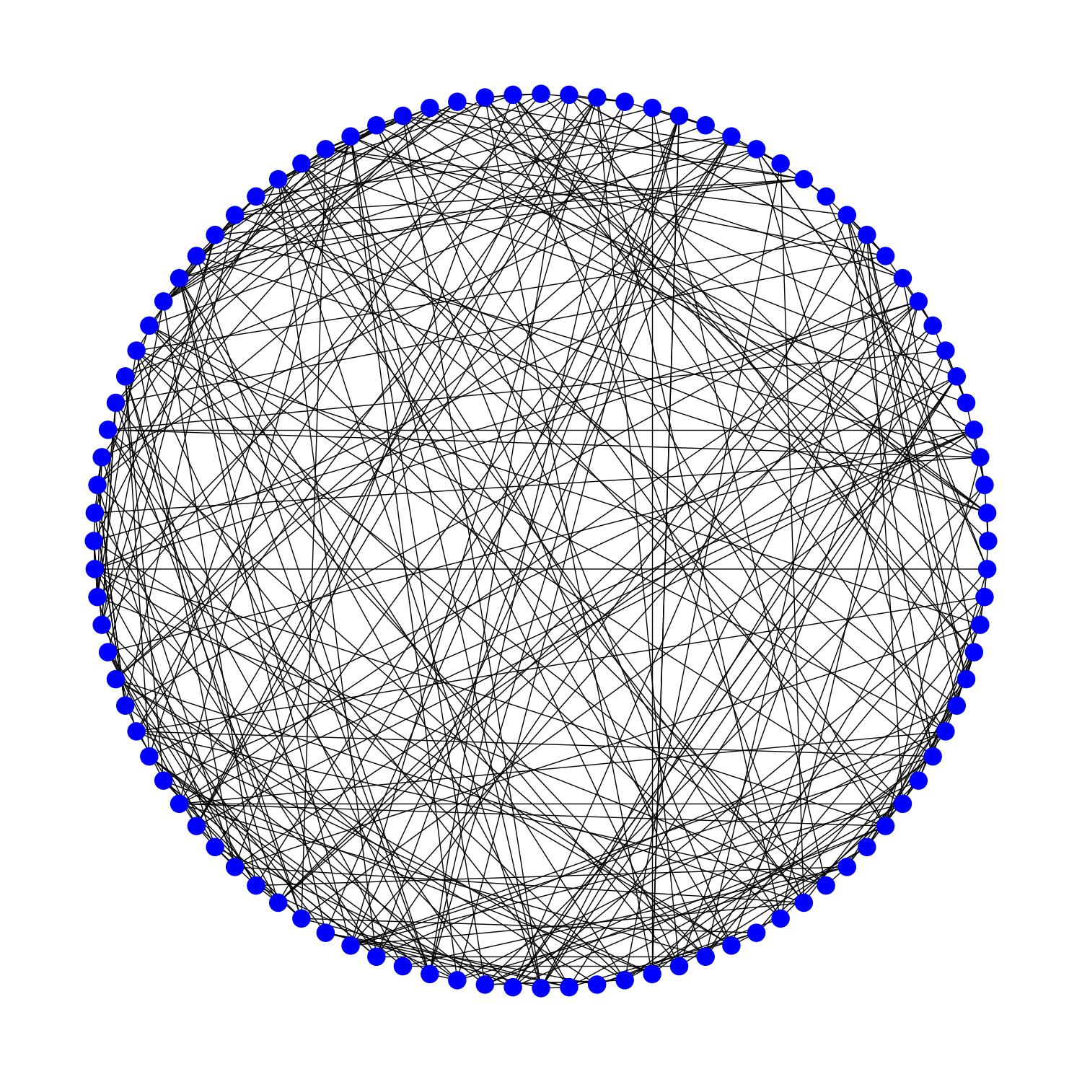
Naïve layout with long-range connectivity
Issue:
Crossing gates may induce correlated errors.
Goal:
A small number of crossing gates.
Short depth.
Graph with 100 vertices with degree 8

Slide 34
Planar decomposition of the Tanner graph
Degree = 4
# planar layers = 2

Slide 35
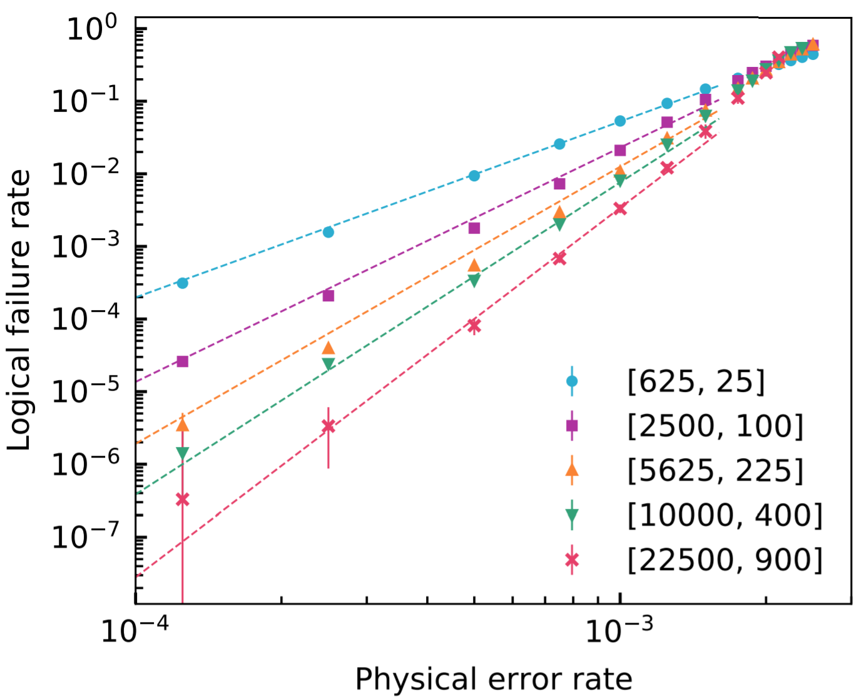
Numerical results
Noise threshold:
0.28% (instead of 0.7% for surface codes)
# physical qubits per logical qubit:
49 (instead of thousands for surface codes)
Layout:
4 planar layers
Qubit count to go from ${10}^{−4}$ to ${10}^{−15}$ :
Surface codes: 13 millions
LDPC codes: 900,000
Tremblay, Delfosse, Beverland – Constant overhead quantum error correction with thin plan connectivity. arxiv:2109.14609

Slide 36
Exciting recent improvements
Improvement:
Threshold: $0.3\% → 0.8\%$
Number of planar layers: $4 → 2$
Code length: $900,000 → 300$
Open question:
Build long range gates.
Using codes from: Kovalev, Pryadko – Quantum hyperbicycle low-density parity check codes with finite rate. arxiv:1212.6703

Slide 37
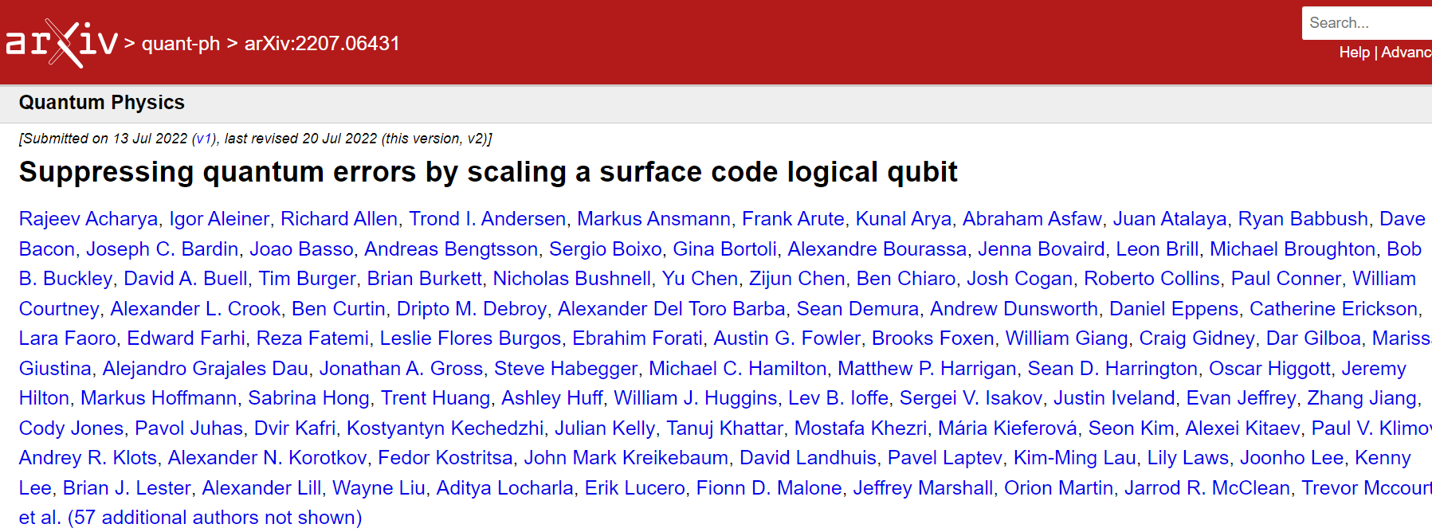
Conclusion and other related work
Don’t forget concatenation yet:
Small qubit and time overhead asymptotically
But no evidence yet that they can beat SC at finite size.
Surface codes experiments:
Easy to implement
But large overhead
QLDPC are promising:
Small qubit overhead
But need long-range gates

Slide 38
Other topics in QEC
Non-stabilizer codes: Hyperbolic codes, subsystem codes, Floquet codes, CWS codes, Turaev-Viro codes (Fibonacci anyons).
Logical gates: Transversal gates, surgery, magic states distillation
Capacity questions: What is the maximum achievable communication rate for a channel?
Threshold theorem.
Quantum codes in high energy physics: models for ADS-CFT, holography.
QEC experiments: next slide.

Slide 39
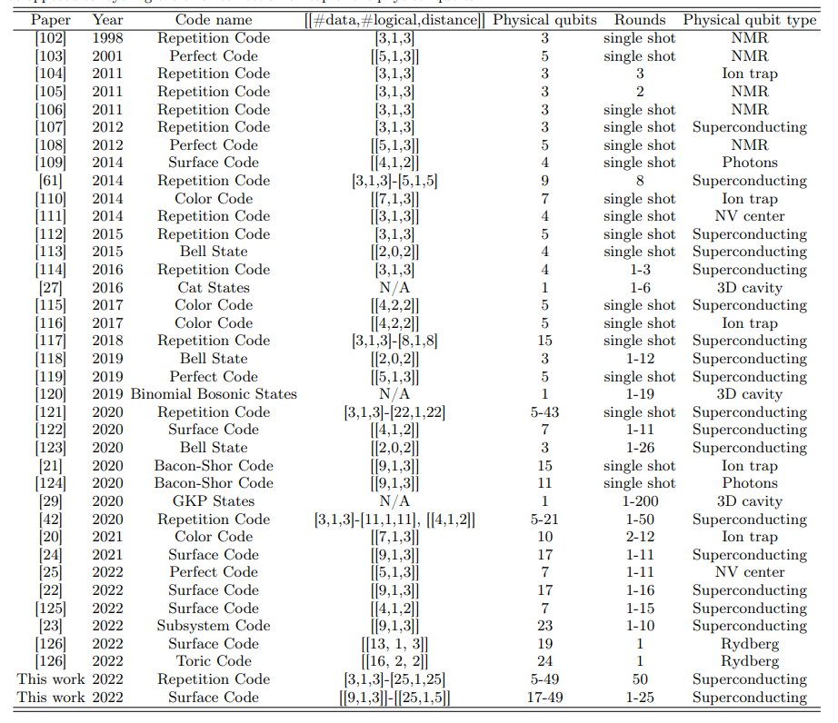
QEC experiments
Table from the Google surface code paper:
page 38 of arxiv:2207.06431
Thank you!
ni.delfosse@gmail.com

